Slide 1
Tutorial on EM algorithm – Part 1
Prof. Dr. Loc Nguyen, PhD, PostDoc
Loc Nguyen’s Academic Network, Vietnam
Email: ng_phloc@yahoo.com
Homepage: www.locnguyen.net

Slide 2
Abstract
Maximum likelihood estimation (MLE) is a popular method for parameter estimation in both applied probability and statistics but MLE cannot solve the problem of incomplete data or hidden data because it is impossible to maximize likelihood function from hidden data. Expectation maximum (EM) algorithm is a powerful mathematical tool for solving this problem if there is a relationship between hidden data and observed data. Such hinting relationship is specified by a mapping from hidden data to observed data or by a joint probability between hidden data and observed data. In other words, the relationship helps us know hidden data by surveying observed data. The essential ideology of EM is to maximize the expectation of likelihood function over observed data based on the hinting relationship instead of maximizing directly the likelihood function of hidden data. Pioneers in EM algorithm proved its convergence. As a result, EM algorithm produces parameter estimators as well as MLE does. This tutorial aims to provide explanations of EM algorithm in order to help researchers comprehend it. Moreover some improvements of EM algorithm are also proposed in the tutorial such as combination of EM and third-order convergence Newton-Raphson process, combination of EM and gradient descent method, and combination of EM and particle swarm optimization (PSO) algorithm.

Slide 3
Table of contents
This report focuses on introduction of EM and related concepts.
Basic concepts
Parameter estimation
EM algorithm

Slide 4
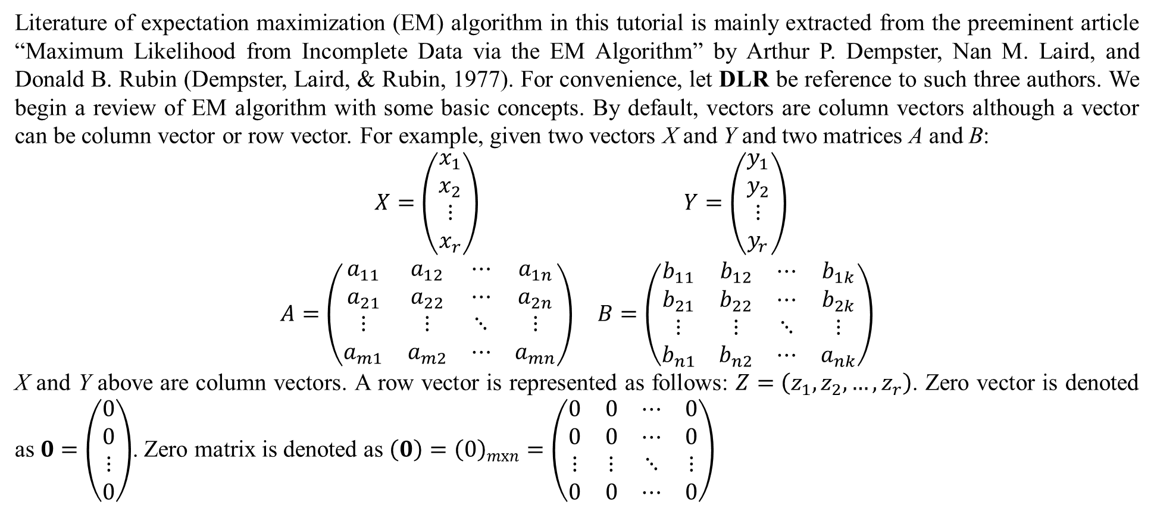
1. Basic concepts
Literature of expectation maximization (EM) algorithm in this tutorial is mainly extracted from the preeminent article “Maximum Likelihood from Incomplete Data via the EM Algorithm” by Arthur P. Dempster, Nan M. Laird, and Donald B. Rubin (Dempster, Laird, & Rubin, 1977). For convenience, let DLR be reference to such three authors. We begin a review of EM algorithm with some basic concepts. By default, vectors are column vectors although a vector can be column vector or row vector. For example, given two vectors X and Y and two matrices A and B:
$$\begin{matrix}X=\left(\begin{matrix}x_{1} \\ x_{2} \\ ⋮ \\ x_{r}\end{matrix}\right) & Y=\left(\begin{matrix}y_{1} \\ y_{2} \\ ⋮ \\ y_{r}\end{matrix}\right) \\ A=\left(\begin{matrix}a_{11} & a_{12} & ⋯ & a_{1n} \\ a_{21} & a_{22} & ⋯ & a_{2n} \\ ⋮ & ⋮ & ⋱ & ⋮ \\ a_{m1} & a_{m2} & ⋯ & a_{mn}\end{matrix}\right) & B=\left(\begin{matrix}b_{11} & b_{12} & ⋯ & b_{1k} \\ b_{21} & b_{22} & ⋯ & b_{2k} \\ ⋮ & ⋮ & ⋱ & ⋮ \\ b_{n1} & b_{n2} & ⋯ & a_{nk}\end{matrix}\right)\end{matrix}$$
X and Y above are column vectors. A row vector is represented as follows: $Z=\left(z_{1},z_{2},…,z_{r}\right)$. Zero vector is denoted as $0=\left(\begin{matrix}0 \\ 0 \\ ⋮ \\ 0\end{matrix}\right)$. Zero matrix is denoted as $\left(0\right)={\left(0\right)}_{mxn}=\left(\begin{matrix}0 & 0 & ⋯ & 0 \\ 0 & 0 & ⋯ & 0 \\ ⋮ & ⋮ & ⋱ & ⋮ \\ 0 & 0 & ⋯ & 0\end{matrix}\right)$

Slide 5
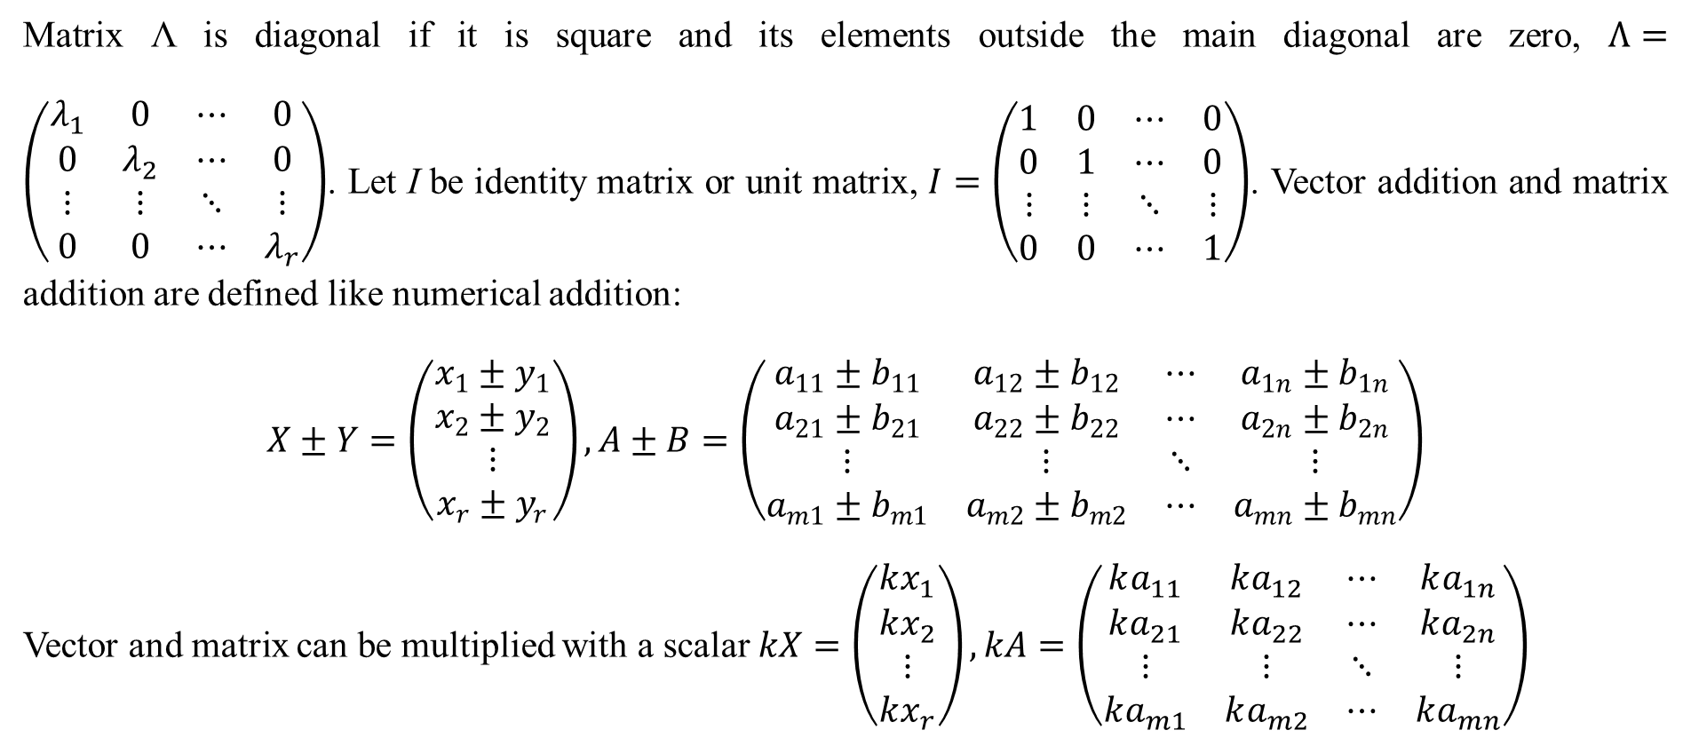
1. Basic concepts
Matrix Λ is diagonal if it is square and its elements outside the main diagonal are zero, $Λ=\left(\begin{matrix}λ_{1} & 0 & ⋯ & 0 \\ 0 & λ_{2} & ⋯ & 0 \\ ⋮ & ⋮ & ⋱ & ⋮ \\ 0 & 0 & ⋯ & λ_{r}\end{matrix}\right)$. Let I be identity matrix or unit matrix, $I=\left(\begin{matrix}1 & 0 & ⋯ & 0 \\ 0 & 1 & ⋯ & 0 \\ ⋮ & ⋮ & ⋱ & ⋮ \\ 0 & 0 & ⋯ & 1\end{matrix}\right)$. Vector addition and matrix addition are defined like numerical addition:
$$X±Y=\left(\begin{matrix}x_{1}±y_{1} \\ x_{2}±y_{2} \\ ⋮ \\ x_{r}±y_{r}\end{matrix}\right),A±B=\left(\begin{matrix}a_{11}±b_{11} & a_{12}±b_{12} & ⋯ & a_{1n}±b_{1n} \\ a_{21}±b_{21} & a_{22}±b_{22} & ⋯ & a_{2n}±b_{2n} \\ ⋮ & ⋮ & ⋱ & ⋮ \\ a_{m1}±b_{m1} & a_{m2}±b_{m2} & ⋯ & a_{mn}±b_{mn}\end{matrix}\right)$$
Vector and matrix can be multiplied with a scalar $kX=\left(\begin{matrix}kx_{1} \\ kx_{2} \\ ⋮ \\ kx_{r}\end{matrix}\right),kA=\left(\begin{matrix}ka_{11} & ka_{12} & ⋯ & ka_{1n} \\ ka_{21} & ka_{22} & ⋯ & ka_{2n} \\ ⋮ & ⋮ & ⋱ & ⋮ \\ ka_{m1} & ka_{m2} & ⋯ & ka_{mn}\end{matrix}\right)$

Slide 6
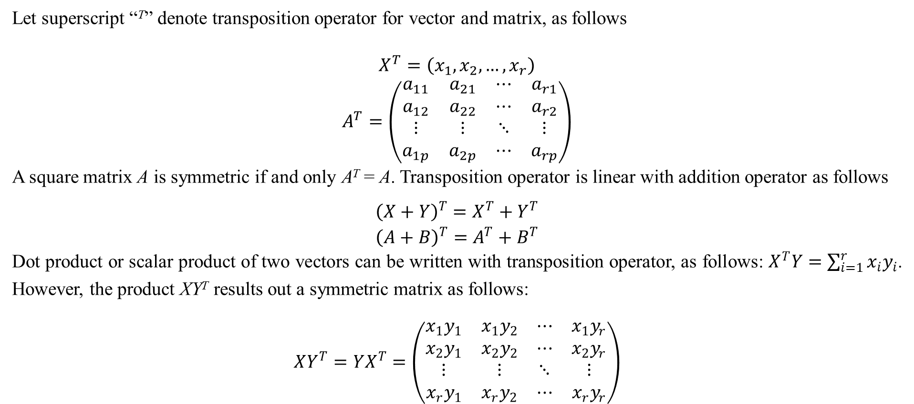
1. Basic concepts
Let superscript “^{T}” denote transposition operator for vector and matrix, as follows
$$\begin{matrix}X^{T}=\left(x_{1},x_{2},…,x_{r}\right) \\ A^{T}=\left(\begin{matrix}a_{11} & a_{21} & ⋯ & a_{r1} \\ a_{12} & a_{22} & ⋯ & a_{r2} \\ ⋮ & ⋮ & ⋱ & ⋮ \\ a_{1p} & a_{2p} & ⋯ & a_{rp}\end{matrix}\right)\end{matrix}$$
A square matrix A is symmetric if and only A^{T} = A. Transposition operator is linear with addition operator as follows
$$\begin{matrix}{\left(X+Y\right)}^{T}=X^{T}+Y^{T} \\ {\left(A+B\right)}^{T}=A^{T}+B^{T}\end{matrix}$$
Dot product or scalar product of two vectors can be written with transposition operator, as follows: $X^{T}Y=\sum_{i=1}^{r}{x_{i}y_{i}}$. However, the product XY^{T} results out a symmetric matrix as follows:
$$XY^{T}=YX^{T}=\left(\begin{matrix}x_{1}y_{1} & x_{1}y_{2} & ⋯ & x_{1}y_{r} \\ x_{2}y_{1} & x_{2}y_{2} & ⋯ & x_{2}y_{r} \\ ⋮ & ⋮ & ⋱ & ⋮ \\ x_{r}y_{1} & x_{r}y_{2} & ⋯ & x_{r}y_{r}\end{matrix}\right)$$

Slide 7
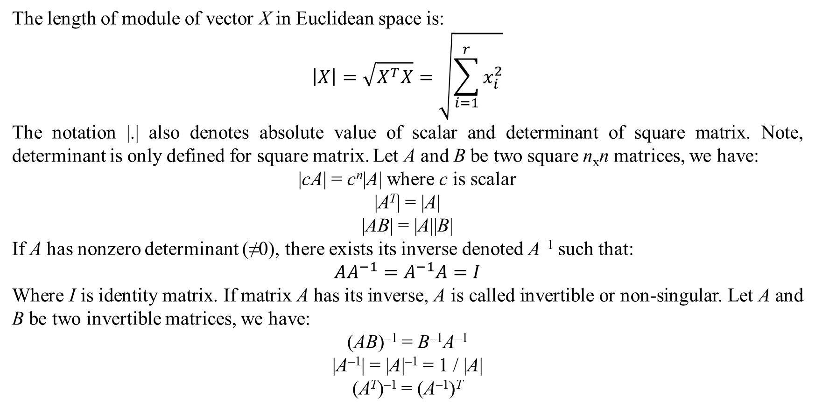
1. Basic concepts
The length of module of vector X in Euclidean space is:
$$\left|X\right|=\sqrt{X^{T}X}=\sqrt{\sum_{i=1}^{r}{x_{i}^{2}}}$$
The notation |.| also denotes absolute value of scalar and determinant of square matrix. Note, determinant is only defined for square matrix. Let A and B be two square n_{x}n matrices, we have:
|cA| = c^{n}|A| where c is scalar
|A^{T}| = |A|
|AB| = |A||B|
If A has nonzero determinant (≠0), there exists its inverse denoted A^{–1} such that:
$$AA^{−1}=A^{−1}A=I$$
Where I is identity matrix. If matrix A has its inverse, A is called invertible or non-singular. Let A and B be two invertible matrices, we have:
(AB)^{–1} = B^{–1}A^{–1}
|A^{–1}| = |A|^{–1} = 1 / |A|
(A^{T})^{–1} = (A^{–1})^{T}

Slide 8
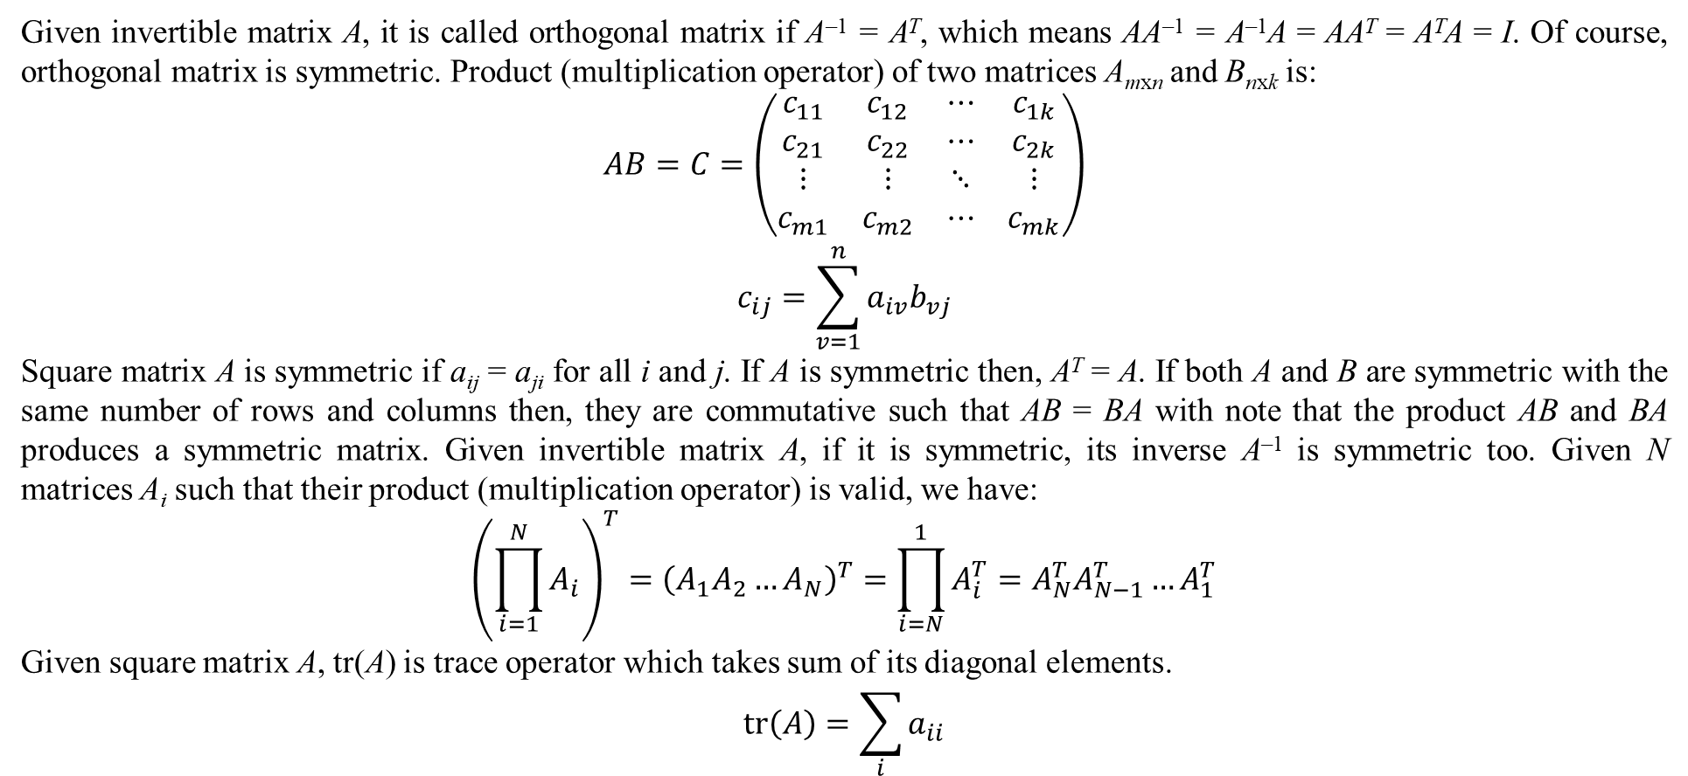
1. Basic concepts
Given invertible matrix A, it is called orthogonal matrix if A^{–1} = A^{T}, which means AA^{–1} = A^{–1}A = AA^{T} = A^{T}A = I. Of course, orthogonal matrix is symmetric. Product (multiplication operator) of two matrices A_{mxn} and B_{nxk} is:
$$\begin{matrix}AB=C=\left(\begin{matrix}c_{11} & c_{12} & ⋯ & c_{1k} \\ c_{21} & c_{22} & ⋯ & c_{2k} \\ ⋮ & ⋮ & ⋱ & ⋮ \\ c_{m1} & c_{m2} & ⋯ & c_{mk}\end{matrix}\right) \\ c_{ij}=\sum_{v=1}^{n}{a_{iv}b_{vj}}\end{matrix}$$
Square matrix A is symmetric if a_{ij} = a_{ji} for all i and j. If A is symmetric then, A^{T} = A. If both A and B are symmetric with the same number of rows and columns then, they are commutative such that AB = BA with note that the product AB and BA produces a symmetric matrix. Given invertible matrix A, if it is symmetric, its inverse A^{–1} is symmetric too. Given N matrices A_{i} such that their product (multiplication operator) is valid, we have:
$${\left(\prod_{i=1}^{N}{A_{i}}\right)}^{T}={\left(A_{1}A_{2}…A_{N}\right)}^{T}=\prod_{i=N}^{1}{A_{i}^{T}}=A_{N}^{T}A_{N−1}^{T}…A_{1}^{T}$$
Given square matrix A, tr(A) is trace operator which takes sum of its diagonal elements.
$$tr\left(A\right)=\sum_{i}{a_{ii}}$$

Slide 9
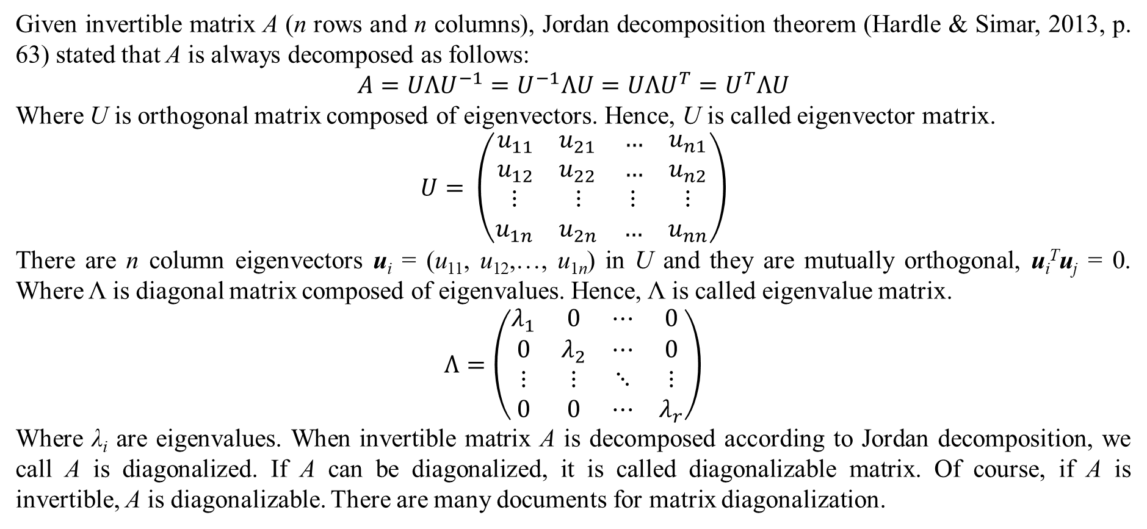
1. Basic concepts
Given invertible matrix A (n rows and n columns), Jordan decomposition theorem (Hardle & Simar, 2013, p. 63) stated that A is always decomposed as follows:
$$A=UΛU^{−1}=U^{−1}ΛU=UΛU^{T}=U^{T}ΛU$$
Where U is orthogonal matrix composed of eigenvectors. Hence, U is called eigenvector matrix.
$$U= \left(\begin{matrix}\begin{matrix}u_{11} & u_{21} \\ u_{12} & u_{22}\end{matrix} & \begin{matrix}… & u_{n1} \\ … & u_{n2}\end{matrix} \\ \begin{matrix}⋮ & ⋮ \\ u_{1n} & u_{2n}\end{matrix} & \begin{matrix}⋮ & ⋮ \\ … & u_{nn}\end{matrix}\end{matrix}\right)$$
There are n column eigenvectors u_{i} = (u₁₁, u₁₂,…, u_{1n}) in U and they are mutually orthogonal, u_{i}^{T}u_{j} = 0. Where Λ is diagonal matrix composed of eigenvalues. Hence, Λ is called eigenvalue matrix.
$$Λ=\left(\begin{matrix}λ_{1} & 0 & ⋯ & 0 \\ 0 & λ_{2} & ⋯ & 0 \\ ⋮ & ⋮ & ⋱ & ⋮ \\ 0 & 0 & ⋯ & λ_{r}\end{matrix}\right)$$
Where λ_{i} are eigenvalues. When invertible matrix A is decomposed according to Jordan decomposition, we call A is diagonalized. If A can be diagonalized, it is called diagonalizable matrix. Of course, if A is invertible, A is diagonalizable. There are many documents for matrix diagonalization.

Slide 10
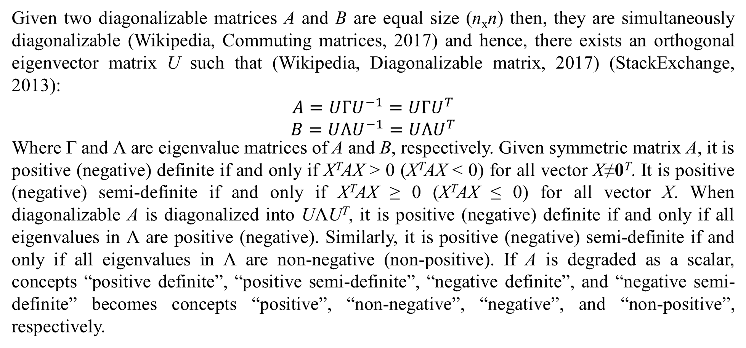
1. Basic concepts
Given two diagonalizable matrices A and B are equal size (n_{x}n) then, they are simultaneously diagonalizable (Wikipedia, Commuting matrices, 2017) and hence, there exists an orthogonal eigenvector matrix U such that (Wikipedia, Diagonalizable matrix, 2017) (StackExchange, 2013):
$$\begin{matrix}A=UΓU^{−1}=UΓU^{T} \\ B=UΛU^{−1}=UΛU^{T}\end{matrix}$$
Where Γ and Λ are eigenvalue matrices of A and B, respectively. Given symmetric matrix A, it is positive (negative) definite if and only if X^{T}AX > 0 (X^{T}AX < 0) for all vector X≠0^{T}. It is positive (negative) semi-definite if and only if X^{T}AX ≥ 0 (X^{T}AX ≤ 0) for all vector X. When diagonalizable A is diagonalized into UΛU^{T}, it is positive (negative) definite if and only if all eigenvalues in Λ are positive (negative). Similarly, it is positive (negative) semi-definite if and only if all eigenvalues in Λ are non-negative (non-positive). If A is degraded as a scalar, concepts “positive definite”, “positive semi-definite”, “negative definite”, and “negative semi-definite” becomes concepts “positive”, “non-negative”, “negative”, and “non-positive”, respectively.

Slide 11
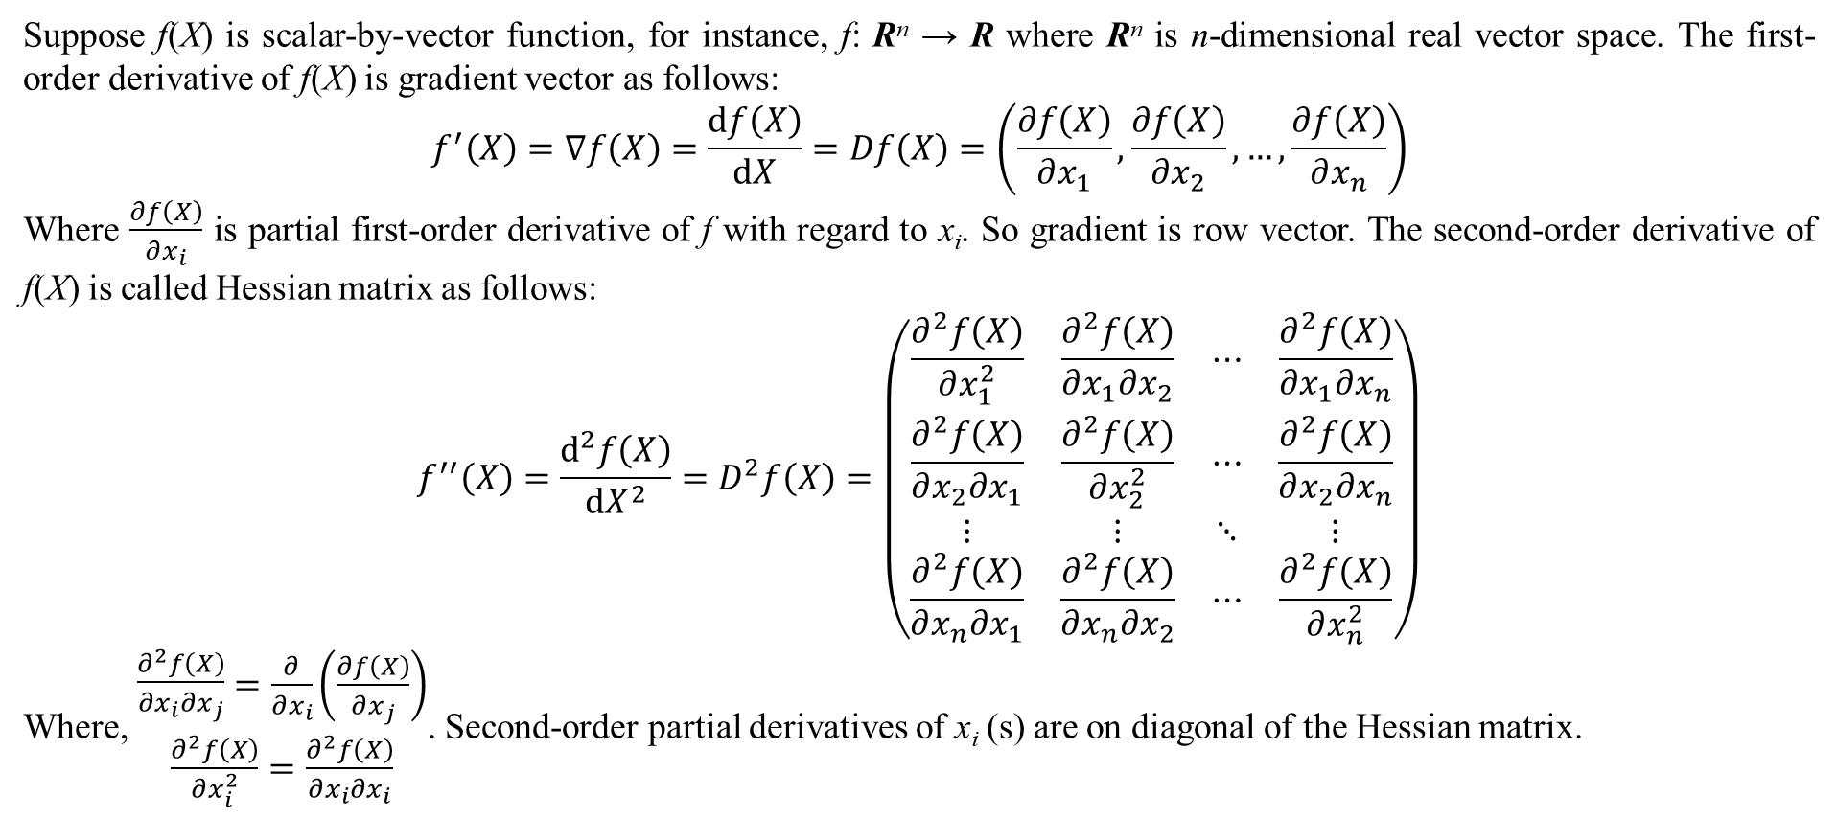
1. Basic concepts
Suppose f(X) is scalar-by-vector function, for instance, f: R^{n} → R where R^{n} is n-dimensional real vector space. The first-order derivative of f(X) is gradient vector as follows:
$$f^{′}\left(X\right)=∇f\left(X\right)=\frac{df\left(X\right)}{dX}=Df\left(X\right)=\left(\frac{∂f\left(X\right)}{∂x_{1}}, \frac{∂f\left(X\right)}{∂x_{2}},…,\frac{∂f\left(X\right)}{∂x_{n}}\right)$$
Where $\frac{∂f\left(X\right)}{∂x_{i}}$ is partial first-order derivative of f with regard to x_{i}. So gradient is row vector. The second-order derivative of f(X) is called Hessian matrix as follows:
$$f^{′′}\left(X\right)=\frac{d^{2}f\left(X\right)}{{dX}^{2}}=D^{2}f\left(X\right)=\left(\begin{matrix}\frac{∂^{2}f\left(X\right)}{∂x_{1}^{2}} & \frac{∂^{2}f\left(X\right)}{∂x_{1}∂x_{2}} & ⋯ & \frac{∂^{2}f\left(X\right)}{∂x_{1}∂x_{n}} \\ \frac{∂^{2}f\left(X\right)}{∂x_{2}∂x_{1}} & \frac{∂^{2}f\left(X\right)}{∂x_{2}^{2}} & ⋯ & \frac{∂^{2}f\left(X\right)}{∂x_{2}∂x_{n}} \\ ⋮ & ⋮ & ⋱ & ⋮ \\ \frac{∂^{2}f\left(X\right)}{∂x_{n}∂x_{1}} & \frac{∂^{2}f\left(X\right)}{∂x_{n}∂x_{2}} & ⋯ & \frac{∂^{2}f\left(X\right)}{∂x_{n}^{2}}\end{matrix}\right)$$
Where, $\begin{matrix}\begin{matrix}\frac{∂^{2}f\left(X\right)}{∂x_{i}∂x_{j}}\end{matrix}=\frac{∂}{∂x_{i}}\left(\frac{∂f\left(X\right)}{∂x_{j}}\right) \\ \frac{∂^{2}f\left(X\right)}{∂x_{i}^{2}}=\frac{∂^{2}f\left(X\right)}{∂x_{i}∂x_{i}}\end{matrix}$. Second-order partial derivatives of x_{i} (s) are on diagonal of the Hessian matrix.

Slide 12
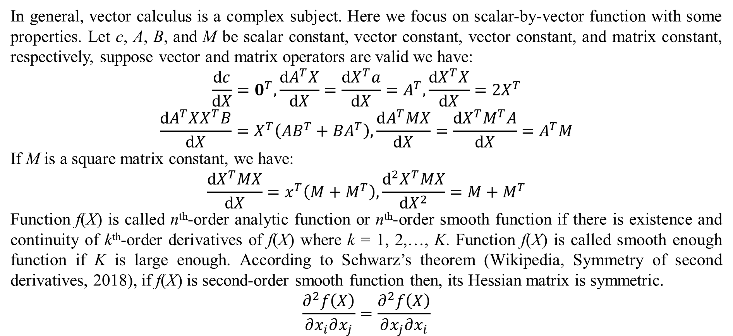
1. Basic concepts
In general, vector calculus is a complex subject. Here we focus on scalar-by-vector function with some properties. Let c, A, B, and M be scalar constant, vector constant, vector constant, and matrix constant, respectively, suppose vector and matrix operators are valid we have:
$$\frac{dc}{dX}=0^{T},\frac{dA^{T}X}{dX}=\frac{dX^{T}a}{dX}=A^{T},\frac{dX^{T}X}{dX}=2X^{T}$$
$$\frac{dA^{T}XX^{T}B}{dX}=X^{T}\left(AB^{T}+BA^{T}\right),\frac{dA^{T}MX}{dX}=\frac{dX^{T}M^{T}A}{dX}=A^{T}M$$
If M is a square matrix constant, we have:
$$\frac{dX^{T}MX}{dX}=x^{T}\left(M+M^{T}\right),\frac{d^{2}X^{T}MX}{dX^{2}}=M+M^{T}$$
Function f(X) is called n^{th}-order analytic function or n^{th}-order smooth function if there is existence and continuity of k^{th}-order derivatives of f(X) where k = 1, 2,…, K. Function f(X) is called smooth enough function if K is large enough. According to Schwarz’s theorem (Wikipedia, Symmetry of second derivatives, 2018), if f(X) is second-order smooth function then, its Hessian matrix is symmetric.
$$\frac{∂^{2}f\left(X\right)}{∂x_{i}∂x_{j}}=\frac{∂^{2}f\left(X\right)}{∂x_{j}∂x_{i}}$$

Slide 13
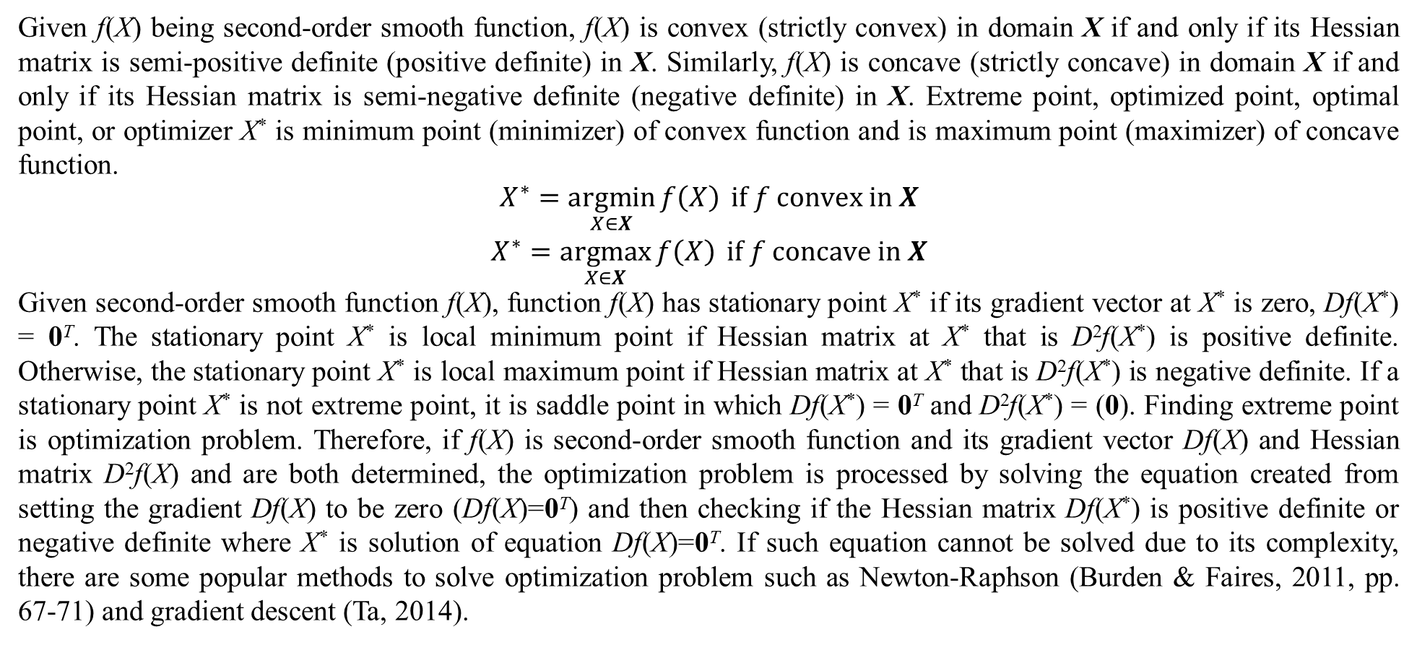
1. Basic concepts
Given f(X) being second-order smooth function, f(X) is convex (strictly convex) in domain X if and only if its Hessian matrix is semi-positive definite (positive definite) in X. Similarly, f(X) is concave (strictly concave) in domain X if and only if its Hessian matrix is semi-negative definite (negative definite) in X. Extreme point, optimized point, optimal point, or optimizer X* is minimum point (minimizer) of convex function and is maximum point (maximizer) of concave function.
$$\begin{matrix}X^{∗}=\underset{X∈X}{argmin}{f\left(X\right)} if f convex in X \\ X^{∗}=\underset{X∈X}{argmax}{f\left(X\right)} if f concave in X\end{matrix}$$
Given second-order smooth function f(X), function f(X) has stationary point X* if its gradient vector at X* is zero, Df(X*) = 0^{T}. The stationary point X* is local minimum point if Hessian matrix at X* that is D²f(X*) is positive definite. Otherwise, the stationary point X* is local maximum point if Hessian matrix at X* that is D²f(X*) is negative definite. If a stationary point X* is not extreme point, it is saddle point in which Df(X*) = 0^{T} and D²f(X*) = (0). Finding extreme point is optimization problem. Therefore, if f(X) is second-order smooth function and its gradient vector Df(X) and Hessian matrix D²f(X) and are both determined, the optimization problem is processed by solving the equation created from setting the gradient Df(X) to be zero (Df(X)=0^{T}) and then checking if the Hessian matrix Df(X*) is positive definite or negative definite where X* is solution of equation Df(X)=0^{T}. If such equation cannot be solved due to its complexity, there are some popular methods to solve optimization problem such as Newton-Raphson (Burden & Faires, 2011, pp. 67-71) and gradient descent (Ta, 2014).

Slide 14
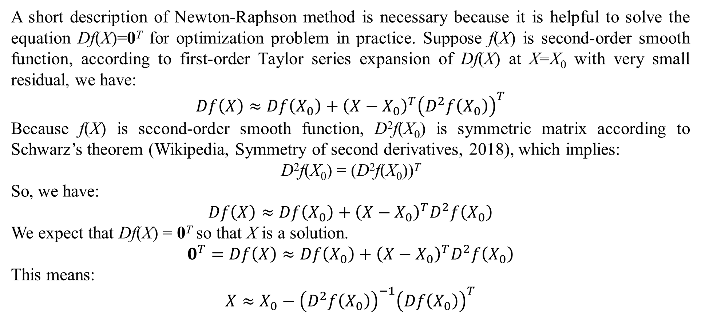
1. Basic concepts
A short description of Newton-Raphson method is necessary because it is helpful to solve the equation Df(X)=0^{T} for optimization problem in practice. Suppose f(X) is second-order smooth function, according to first-order Taylor series expansion of Df(X) at X=X₀ with very small residual, we have:
$$Df\left(X\right)≈Df\left(X_{0}\right)+{\left(X−X_{0}\right)}^{T}{\left(D^{2}f\left(X_{0}\right)\right)}^{T}$$
Because f(X) is second-order smooth function, D²f(X₀) is symmetric matrix according to Schwarz’s theorem (Wikipedia, Symmetry of second derivatives, 2018), which implies:
D²f(X₀) = (D²f(X₀))^{T}
So, we have:
$$Df\left(X\right)≈Df\left(X_{0}\right)+{\left(X−X_{0}\right)}^{T}D^{2}f\left(X_{0}\right)$$
We expect that Df(X) = 0^{T} so that X is a solution.
$$0^{T}=Df\left(X\right)≈Df\left(X_{0}\right)+{\left(X−X_{0}\right)}^{T}D^{2}f\left(X_{0}\right)$$
This means:
$$X≈X_{0}−{\left(D^{2}f\left(X_{0}\right)\right)}^{−1}{\left(Df\left(X_{0}\right)\right)}^{T}$$

Slide 15
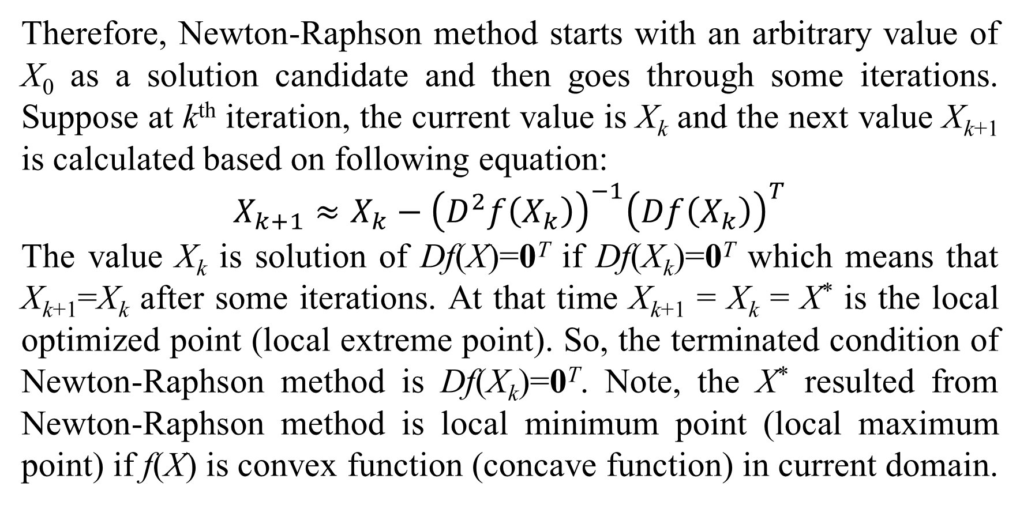
1. Basic concepts
Therefore, Newton-Raphson method starts with an arbitrary value of X₀ as a solution candidate and then goes through some iterations. Suppose at k^{th} iteration, the current value is X_{k} and the next value X_{k+1} is calculated based on following equation:
$$X_{k+1}≈X_{k}−{\left(D^{2}f\left(X_{k}\right)\right)}^{−1}{\left(Df\left(X_{k}\right)\right)}^{T}$$
The value X_{k} is solution of Df(X)=0^{T} if Df(X_{k})=0^{T} which means that X_{k+1}=X_{k} after some iterations. At that time X_{k+1} = X_{k} = X* is the local optimized point (local extreme point). So, the terminated condition of Newton-Raphson method is Df(X_{k})=0^{T}. Note, the X* resulted from Newton-Raphson method is local minimum point (local maximum point) if f(X) is convex function (concave function) in current domain.

Slide 16
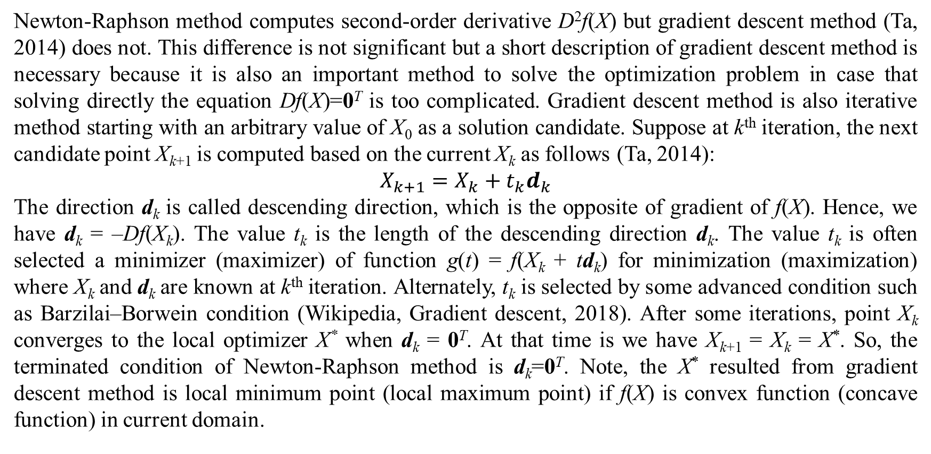
1. Basic concepts
Newton-Raphson method computes second-order derivative D²f(X) but gradient descent method (Ta, 2014) does not. This difference is not significant but a short description of gradient descent method is necessary because it is also an important method to solve the optimization problem in case that solving directly the equation Df(X)=0^{T} is too complicated. Gradient descent method is also iterative method starting with an arbitrary value of X₀ as a solution candidate. Suppose at k^{th} iteration, the next candidate point X_{k+1} is computed based on the current X_{k} as follows (Ta, 2014):
$$X_{k+1}=X_{k}+t_{k}d_{k}$$
The direction d_{k} is called descending direction, which is the opposite of gradient of f(X). Hence, we have d_{k} = –Df(X_{k}). The value t_{k} is the length of the descending direction d_{k}. The value t_{k} is often selected a minimizer (maximizer) of function g(t) = f(X_{k} + td_{k}) for minimization (maximization) where X_{k} and d_{k} are known at k^{th} iteration. Alternately, t_{k} is selected by some advanced condition such as Barzilai–Borwein condition (Wikipedia, Gradient descent, 2018). After some iterations, point X_{k} converges to the local optimizer X* when d_{k} = 0^{T}. At that time is we have X_{k+1} = X_{k} = X*. So, the terminated condition of Newton-Raphson method is d_{k}=0^{T}. Note, the X* resulted from gradient descent method is local minimum point (local maximum point) if f(X) is convex function (concave function) in current domain.

Slide 17
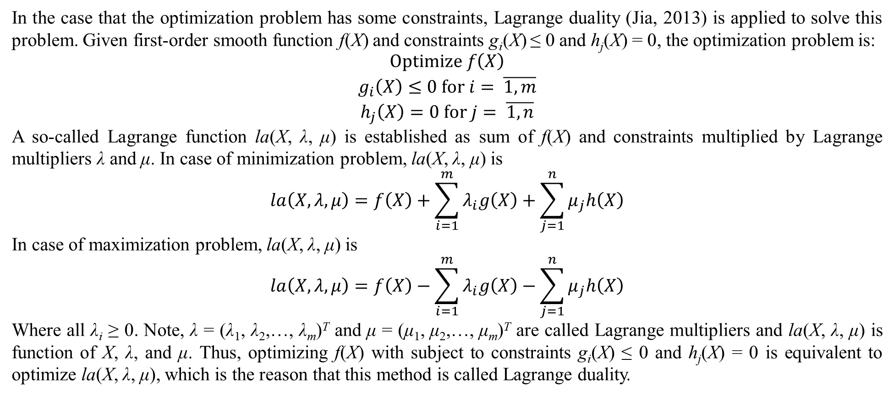
1. Basic concepts
In the case that the optimization problem has some constraints, Lagrange duality (Jia, 2013) is applied to solve this problem. Given first-order smooth function f(X) and constraints g_{i}(X) ≤ 0 and h_{j}(X) = 0, the optimization problem is:
$$\begin{matrix}Optimize f\left(X\right) \\ g_{i}\left(X\right)≤0 for i= \overline{1,m} \\ h_{j}\left(X\right)=0 for j= \overline{1,n}\end{matrix}$$
A so-called Lagrange function la(X, λ, μ) is established as sum of f(X) and constraints multiplied by Lagrange multipliers λ and μ. In case of minimization problem, la(X, λ, μ) is
$$la\left(X,λ,μ\right)=f\left(X\right)+\sum_{i=1}^{m}{λ_{i}g\left(X\right)}+\sum_{j=1}^{n}{μ_{j}h\left(X\right)}$$
In case of maximization problem, la(X, λ, μ) is
$$la\left(X,λ,μ\right)=f\left(X\right)−\sum_{i=1}^{m}{λ_{i}g\left(X\right)}−\sum_{j=1}^{n}{μ_{j}h\left(X\right)}$$
Where all λ_{i} ≥ 0. Note, λ = (λ₁, λ₂,…, λ_{m})^{T} and μ = (μ₁, μ₂,…, μ_{m})^{T} are called Lagrange multipliers and la(X, λ, μ) is function of X, λ, and μ. Thus, optimizing f(X) with subject to constraints g_{i}(X) ≤ 0 and h_{j}(X) = 0 is equivalent to optimize la(X, λ, μ), which is the reason that this method is called Lagrange duality.

Slide 18
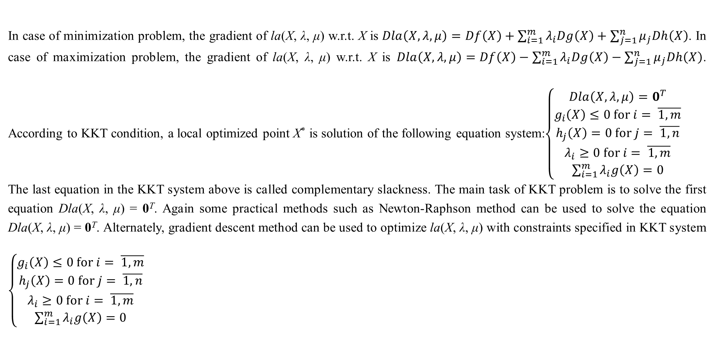
1. Basic concepts
In case of minimization problem, the gradient of la(X, λ, μ) w.r.t. X is $Dla\left(X,λ,μ\right)=Df\left(X\right)+\sum_{i=1}^{m}{λ_{i}Dg\left(X\right)}+\sum_{j=1}^{n}{μ_{j}Dh\left(X\right)}$. In case of maximization problem, the gradient of la(X, λ, μ) w.r.t. X is $Dla\left(X,λ,μ\right)=Df\left(X\right)−\sum_{i=1}^{m}{λ_{i}Dg\left(X\right)}−\sum_{j=1}^{n}{μ_{j}Dh\left(X\right)}$. According to KKT condition, a local optimized point X* is solution of the following equation system:$\left\{\begin{matrix}Dla\left(X,λ,μ\right)=0^{T} \\ g_{i}\left(X\right)≤0 for i= \overline{1,m} \\ h_{j}\left(X\right)=0 for j= \overline{1,n} \\ λ_{i}≥0 for i= \overline{1,m} \\ \sum_{i=1}^{m}{λ_{i}g\left(X\right)}=0\end{matrix}\right.$
The last equation in the KKT system above is called complementary slackness. The main task of KKT problem is to solve the first equation Dla(X, λ, μ) = 0^{T}. Again some practical methods such as Newton-Raphson method can be used to solve the equation Dla(X, λ, μ) = 0^{T}. Alternately, gradient descent method can be used to optimize la(X, λ, μ) with constraints specified in KKT system $\left\{\begin{matrix}g_{i}\left(X\right)≤0 for i= \overline{1,m} \\ h_{j}\left(X\right)=0 for j= \overline{1,n} \\ λ_{i}≥0 for i= \overline{1,m} \\ \sum_{i=1}^{m}{λ_{i}g\left(X\right)}=0\end{matrix}\right.$

Slide 19
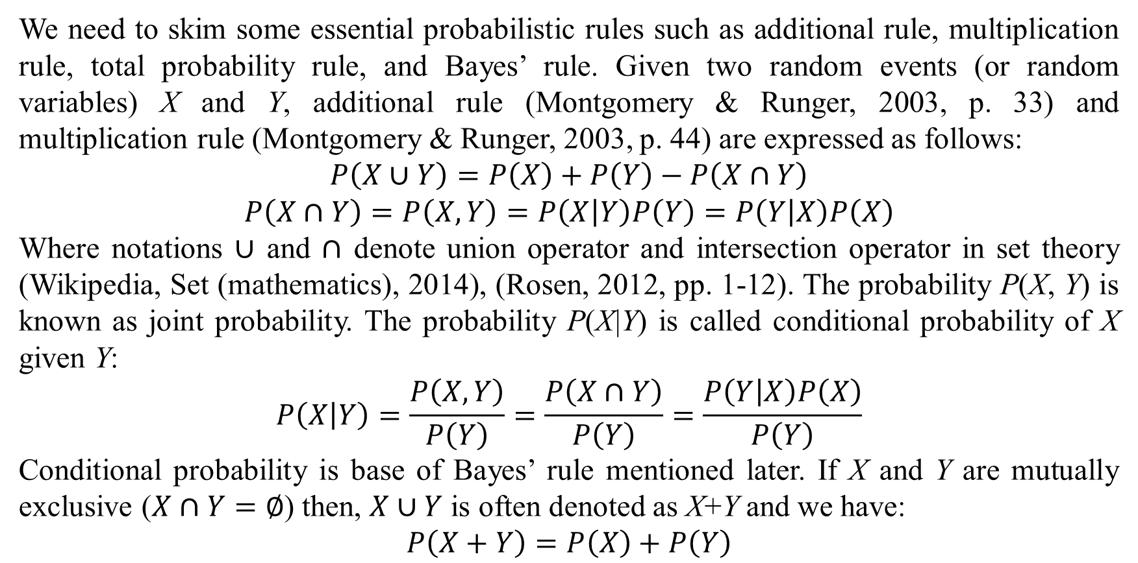
1. Basic concepts
We need to skim some essential probabilistic rules such as additional rule, multiplication rule, total probability rule, and Bayes’ rule. Given two random events (or random variables) X and Y, additional rule (Montgomery & Runger, 2003, p. 33) and multiplication rule (Montgomery & Runger, 2003, p. 44) are expressed as follows:
$$P\left(X∪Y\right)=P\left(X\right)+P\left(Y\right)−P\left(X∩Y\right)$$
$$P\left(X∩Y\right)=P\left(X,Y\right)=P\left(X | Y\right)P\left(Y\right)=P\left(Y | X\right)P\left(X\right)$$
Where notations $∪$ and $∩$ denote union operator and intersection operator in set theory (Wikipedia, Set (mathematics), 2014), (Rosen, 2012, pp. 1-12). The probability P(X, Y) is known as joint probability. The probability P(X|Y) is called conditional probability of X given Y:
$$P\left(X | Y\right)=\frac{P\left(X,Y\right)}{P\left(Y\right)}=\frac{P\left(X∩Y\right)}{P\left(Y\right)}=\frac{P\left(Y | X\right)P\left(X\right)}{P\left(Y\right)}$$
Conditional probability is base of Bayes’ rule mentioned later. If X and Y are mutually exclusive ($X∩Y=∅$) then, $X∪Y$ is often denoted as X+Y and we have:
$$P\left(X+Y\right)=P\left(X\right)+P\left(Y\right)$$

Slide 20
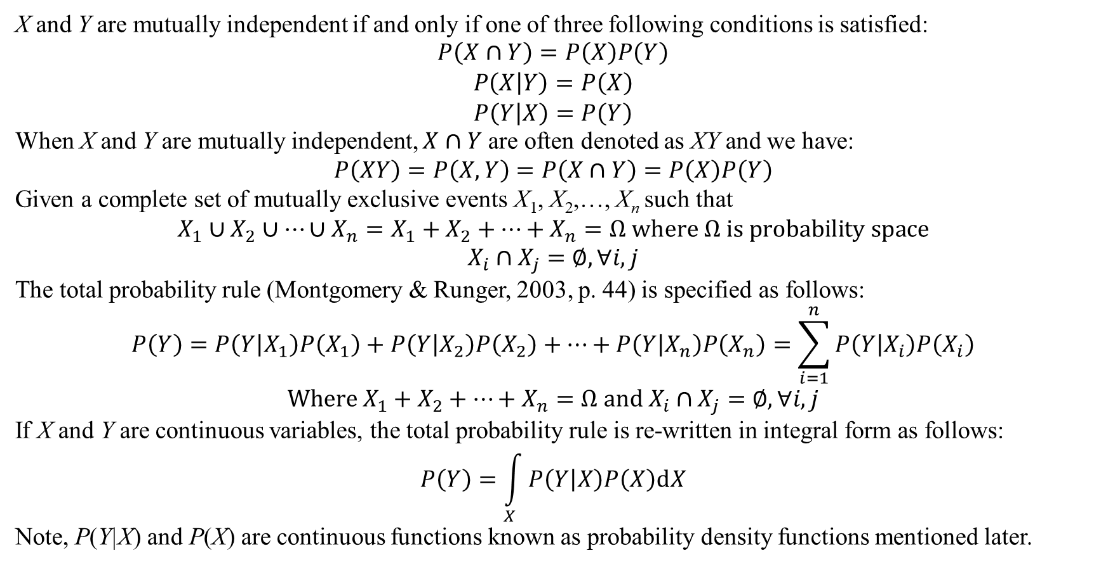
1. Basic concepts
X and Y are mutually independent if and only if one of three following conditions is satisfied:
$$\begin{matrix}P\left(X∩Y\right)=P\left(X\right)P\left(Y\right) \\ P\left(X | Y\right)=P\left(X\right) \\ P\left(Y | X\right)=P\left(Y\right)\end{matrix}$$
When X and Y are mutually independent, $X∩Y$ are often denoted as XY and we have:
$$P\left(XY\right)=P\left(X,Y\right)=P\left(X∩Y\right)=P\left(X\right)P\left(Y\right)$$
Given a complete set of mutually exclusive events X₁, X₂,…, X_{n} such that
$$X_{1}∪X_{2}∪…∪X_{n}=X_{1}+X_{2}+…+X_{n}=Ω where Ω is probability space$$
$$X_{i}∩X_{j}=∅,∀i,j$$
The total probability rule (Montgomery & Runger, 2003, p. 44) is specified as follows:
$$P\left(Y\right)=P\left(Y | X_{1}\right)P\left(X_{1}\right)+P\left(Y | X_{2}\right)P\left(X_{2}\right)+…+P\left(Y | X_{n}\right)P\left(X_{n}\right)=\sum_{i=1}^{n}{P\left(Y | X_{i}\right)P\left(X_{i}\right)}$$
$$Where X_{1}+X_{2}+…+X_{n}=Ω and X_{i}∩X_{j}=∅,∀i,j$$
If X and Y are continuous variables, the total probability rule is re-written in integral form as follows:
$$P\left(Y\right)=\int_{X}{P\left(Y | X\right)P\left(X\right)dX}$$
Note, P(Y|X) and P(X) are continuous functions known as probability density functions mentioned later.

Slide 21
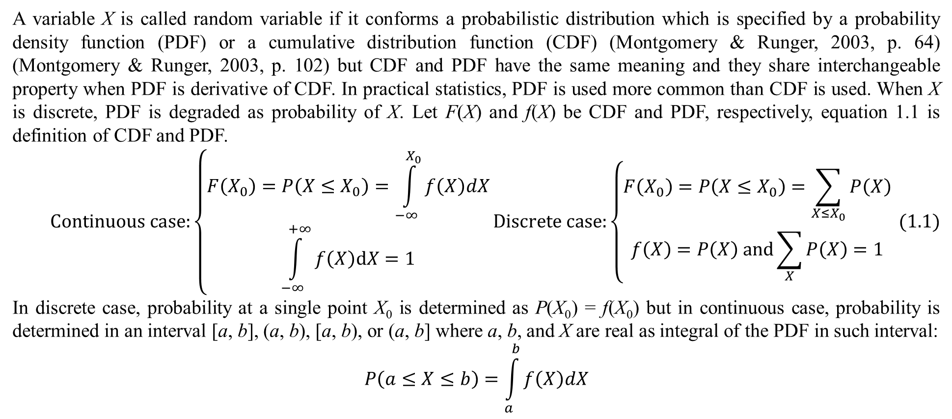
1. Basic concepts
A variable X is called random variable if it conforms a probabilistic distribution which is specified by a probability density function (PDF) or a cumulative distribution function (CDF) (Montgomery & Runger, 2003, p. 64) (Montgomery & Runger, 2003, p. 102) but CDF and PDF have the same meaning and they share interchangeable property when PDF is derivative of CDF. In practical statistics, PDF is used more common than CDF is used. When X is discrete, PDF is degraded as probability of X. Let F(X) and f(X) be CDF and PDF, respectively, equation 1.1 is definition of CDF and PDF.
$$\begin{matrix}Continuous case:\left\{\begin{matrix}F\left(X_{0}\right)=P\left(X≤X_{0}\right)=\int_{−∞}^{X_{0}}{f\left(X\right)dX} \\ \int_{−∞}^{+∞}{f\left(X\right)dX}=1\end{matrix}\right.Discrete case:\left\{\begin{matrix}F\left(X_{0}\right)=P\left(X≤X_{0}\right)=\sum_{X≤X_{0}}{P\left(X\right)} \\ f\left(X\right)=P\left(X\right) and\sum_{X}{P\left(X\right)}=1\end{matrix}\right. (1.1)\end{matrix}$$
In discrete case, probability at a single point X₀ is determined as P(X₀) = f(X₀) but in continuous case, probability is determined in an interval [a, b], (a, b), [a, b), or (a, b] where a, b, and X are real as integral of the PDF in such interval:
$$P\left(a≤X≤b\right)=\int_{a}^{b}{f\left(X\right)dX}$$

Slide 22
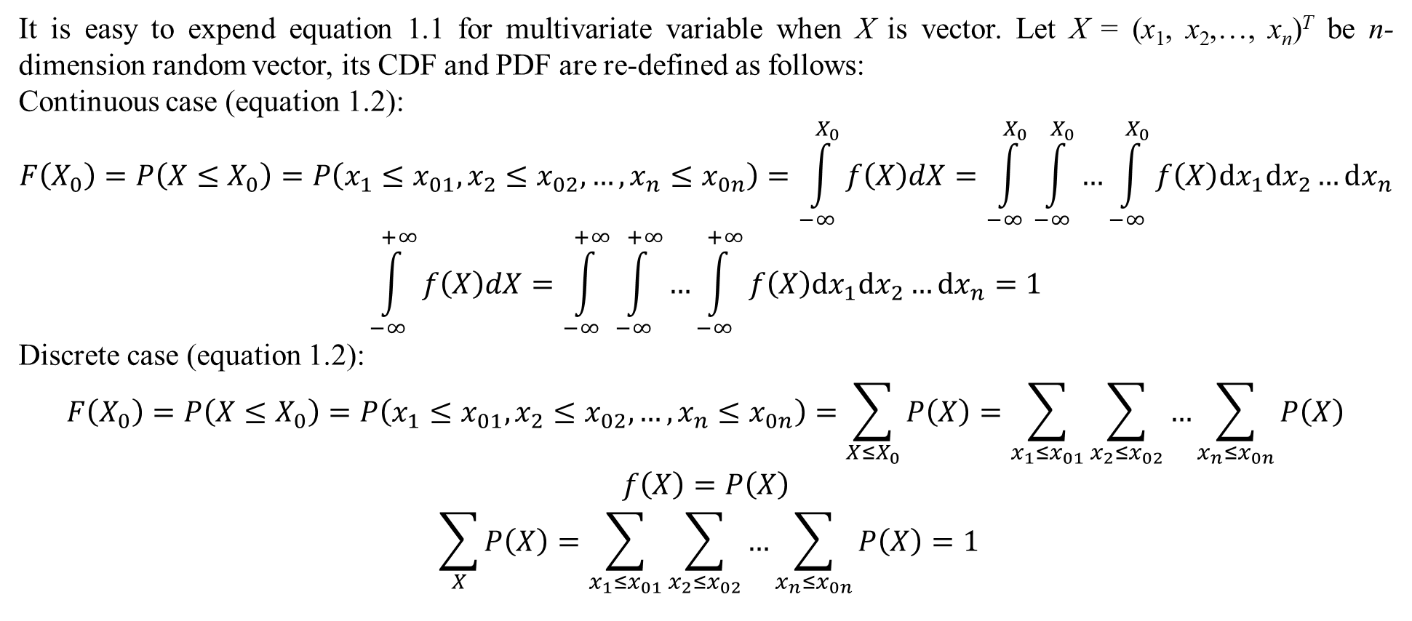
1. Basic concepts
It is easy to expend equation 1.1 for multivariate variable when X is vector. Let X = (x₁, x₂,…, x_{n})^{T} be n-dimension random vector, its CDF and PDF are re-defined as follows:
Continuous case (equation 1.2):
$$F\left(X_{0}\right)=P\left(X≤X_{0}\right)=P\left(x_{1}≤x_{01},x_{2}≤x_{02},…,x_{n}≤x_{0n}\right)=\int_{−∞}^{X_{0}}{f\left(X\right)dX}=\int_{−∞}^{X_{0}}{\int_{−∞}^{X_{0}}{…\int_{−∞}^{X_{0}}{f\left(X\right)dx_{1}dx_{2}…dx_{n}}}}$$
$$\int_{−∞}^{+∞}{f\left(X\right)dX}=\int_{−∞}^{+∞}{\int_{−∞}^{+∞}{…\int_{−∞}^{+∞}{f\left(X\right)dx_{1}dx_{2}…dx_{n}}}}=1$$
Discrete case (equation 1.2):
$$F\left(X_{0}\right)=P\left(X≤X_{0}\right)=P\left(x_{1}≤x_{01},x_{2}≤x_{02},…,x_{n}≤x_{0n}\right)=\sum_{X≤X_{0}}{P\left(X\right)}=\sum_{x_{1}≤x_{01}}{\sum_{x_{2}≤x_{02}}{…\sum_{x_{n}≤x_{0n}}{P\left(X\right)}}}$$
$$f\left(X\right)=P\left(X\right)$$
$$\sum_{X}{P\left(X\right)}=\sum_{x_{1}≤x_{01}}{\sum_{x_{2}≤x_{02}}{…\sum_{x_{n}≤x_{0n}}{P\left(X\right)}}}=1$$

Slide 23
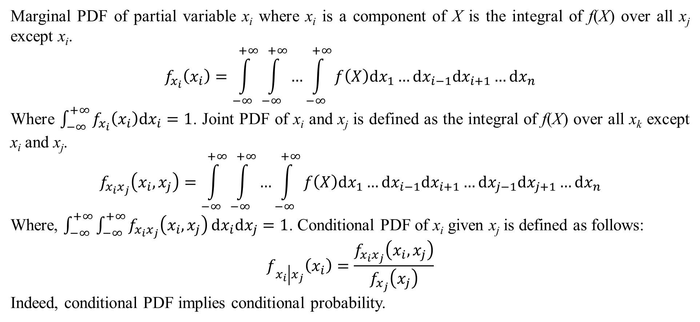
1. Basic concepts
Marginal PDF of partial variable x_{i} where x_{i} is a component of X is the integral of f(X) over all x_{j} except x_{i}.
$$f_{x_{i}}\left(x_{i}\right)=\int_{−∞}^{+∞}{\int_{−∞}^{+∞}{…\int_{−∞}^{+∞}{f\left(X\right)dx_{1}…dx_{i−1}dx_{i+1}…dx_{n}}}}$$
Where $\int_{−∞}^{+∞}{f_{x_{i}}\left(x_{i}\right)dx_{i}}=1$. Joint PDF of x_{i} and x_{j} is defined as the integral of f(X) over all x_{k} except x_{i} and x_{j}.
$$f_{x_{i}x_{j}}\left(x_{i},x_{j}\right)=\int_{−∞}^{+∞}{\int_{−∞}^{+∞}{…\int_{−∞}^{+∞}{f\left(X\right)dx_{1}…dx_{i−1}dx_{i+1}…dx_{j−1}dx_{j+1}…dx_{n}}}}$$
Where, $\int_{−∞}^{+∞}{\int_{−∞}^{+∞}{f_{x_{i}x_{j}}\left(x_{i},x_{j}\right)}dx_{i}dx_{j}}=1$. Conditional PDF of x_{i} given x_{j} is defined as follows:
$$f_{x_{i}\left|x_{j}\right.}\left(x_{i}\right)=\frac{f_{x_{i}x_{j}}\left(x_{i},x_{j}\right)}{f_{x_{j}}\left(x_{j}\right)}$$
Indeed, conditional PDF implies conditional probability.

Slide 24
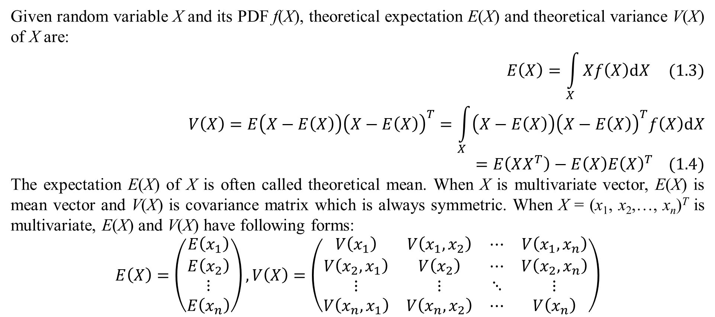
1. Basic concepts
Given random variable X and its PDF f(X), theoretical expectation E(X) and theoretical variance V(X) of X are:
$$E\left(X\right)=\int_{X}{Xf\left(X\right)dX} (1.3)$$
$$V\left(X\right)=E\left(X−E\left(X\right)\right){\left(X−E\left(X\right)\right)}^{T}=\int_{X}{\left(X−E\left(X\right)\right){\left(X−E\left(X\right)\right)}^{T}f\left(X\right)dX}=E\left(XX^{T}\right)−E\left(X\right){E\left(X\right)}^{T} (1.4)$$
The expectation E(X) of X is often called theoretical mean. When X is multivariate vector, E(X) is mean vector and V(X) is covariance matrix which is always symmetric. When X = (x₁, x₂,…, x_{n})^{T} is multivariate, E(X) and V(X) have following forms:
$$E\left(X\right)=\left(\begin{matrix}E\left(x_{1}\right) \\ E\left(x_{2}\right) \\ ⋮ \\ E\left(x_{n}\right)\end{matrix}\right),\begin{matrix}V\left(X\right)=\left(\begin{matrix}V\left(x_{1}\right) & V\left(x_{1},x_{2}\right) & ⋯ & V\left(x_{1},x_{n}\right) \\ V\left(x_{2},x_{1}\right) & V\left(x_{2}\right) & ⋯ & V\left(x_{2},x_{n}\right) \\ ⋮ & ⋮ & ⋱ & ⋮ \\ V\left(x_{n},x_{1}\right) & V\left(x_{n},x_{2}\right) & ⋯ & V\left(x_{n}\right)\end{matrix}\right)\end{matrix}$$

Slide 25
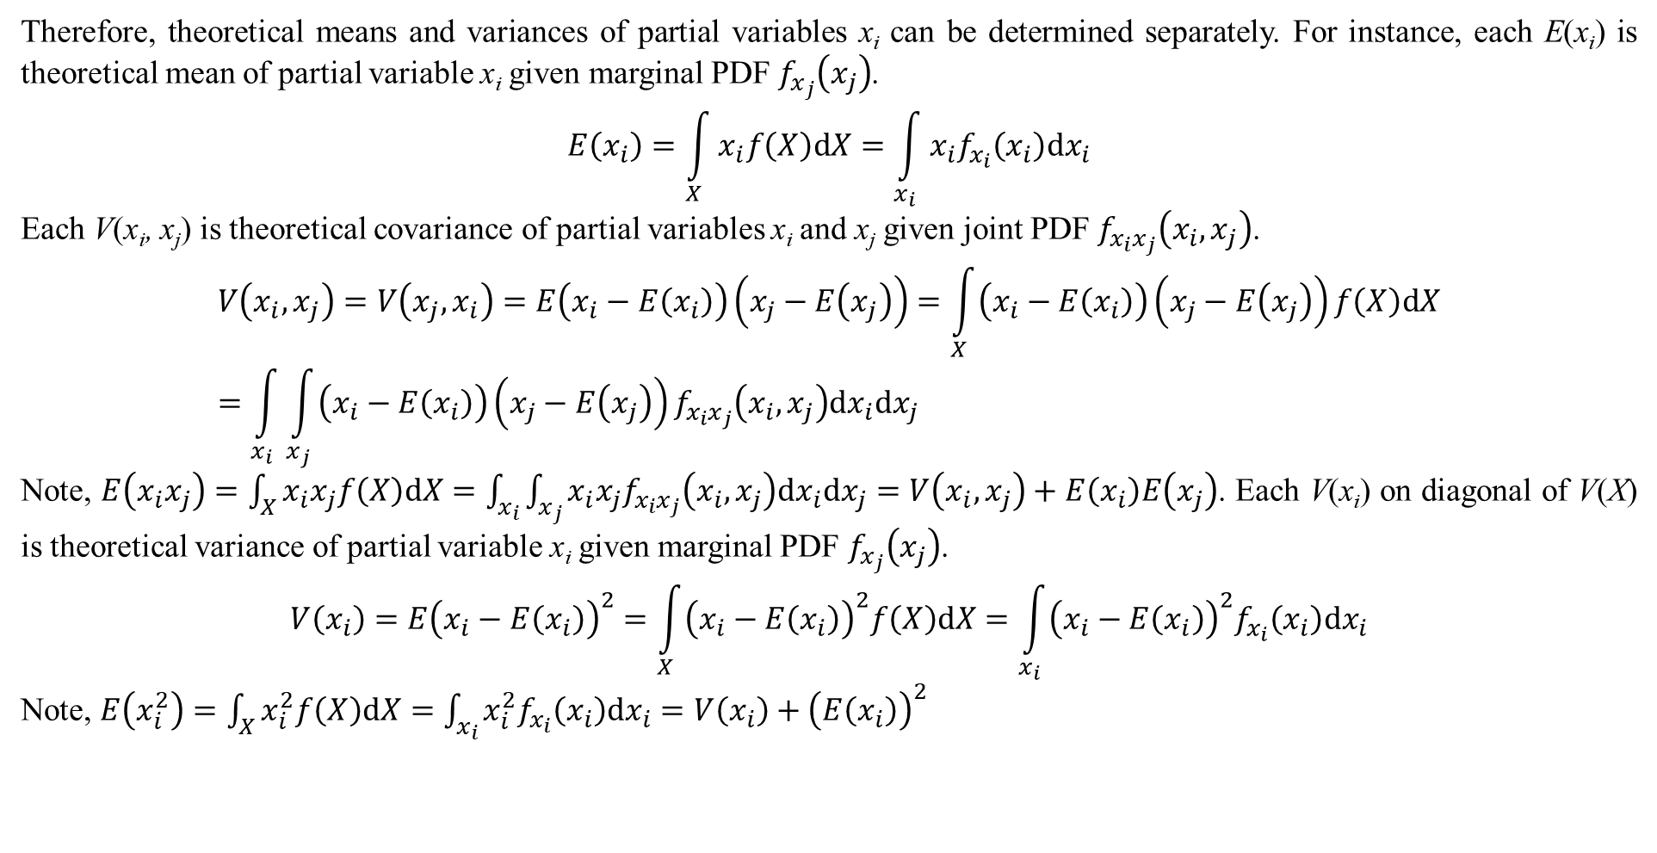
1. Basic concepts
Therefore, theoretical means and variances of partial variables x_{i} can be determined separately. For instance, each E(x_{i}) is theoretical mean of partial variable x_{i} given marginal PDF $f_{x_{j}}\left(x_{j}\right)$.
$$E\left(x_{i}\right)=\int_{X}{x_{i}f\left(X\right)dX}=\int_{x_{i}}{x_{i}f_{x_{i}}\left(x_{i}\right)dx_{i}}$$
Each V(x_{i}, x_{j}) is theoretical covariance of partial variables x_{i} and x_{j} given joint PDF $f_{x_{i}x_{j}}\left(x_{i},x_{j}\right)$.
$$V\left(x_{i},x_{j}\right)=V\left(x_{j},x_{i}\right)=E\left(x_{i}−E\left(x_{i}\right)\right)\left(x_{j}−E\left(x_{j}\right)\right)=\int_{X}{\left(x_{i}−E\left(x_{i}\right)\right)\left(x_{j}−E\left(x_{j}\right)\right)f\left(X\right)dX}=\int_{x_{i}}{\int_{x_{j}}{\left(x_{i}−E\left(x_{i}\right)\right)\left(x_{j}−E\left(x_{j}\right)\right)f_{x_{i}x_{j}}\left(x_{i},x_{j}\right)dx_{i}dx_{j}}}$$
Note, $E\left(x_{i}x_{j}\right)=\int_{X}{x_{i}x_{j}f\left(X\right)dX}=\int_{x_{i}}{\int_{x_{j}}{x_{i}x_{j}f_{x_{i}x_{j}}\left(x_{i},x_{j}\right)dx_{i}dx_{j}}}=V\left(x_{i},x_{j}\right)+E\left(x_{i}\right)E\left(x_{j}\right)$. Each V(x_{i}) on diagonal of V(X) is theoretical variance of partial variable x_{i} given marginal PDF $f_{x_{j}}\left(x_{j}\right)$.
$$V\left(x_{i}\right)=E{\left(x_{i}−E\left(x_{i}\right)\right)}^{2}=\int_{X}{{\left(x_{i}−E\left(x_{i}\right)\right)}^{2}f\left(X\right)dX}=\int_{x_{i}}{{\left(x_{i}−E\left(x_{i}\right)\right)}^{2}f_{x_{i}}\left(x_{i}\right)dx_{i}}$$
Note, $E\left(x_{i}^{2}\right)=\int_{X}{x_{i}^{2}f\left(X\right)dX}=\int_{x_{i}}{x_{i}^{2}f_{x_{i}}\left(x_{i}\right)dx_{i}}=V\left(x_{i}\right)+{\left(E\left(x_{i}\right)\right)}^{2}$

Slide 26
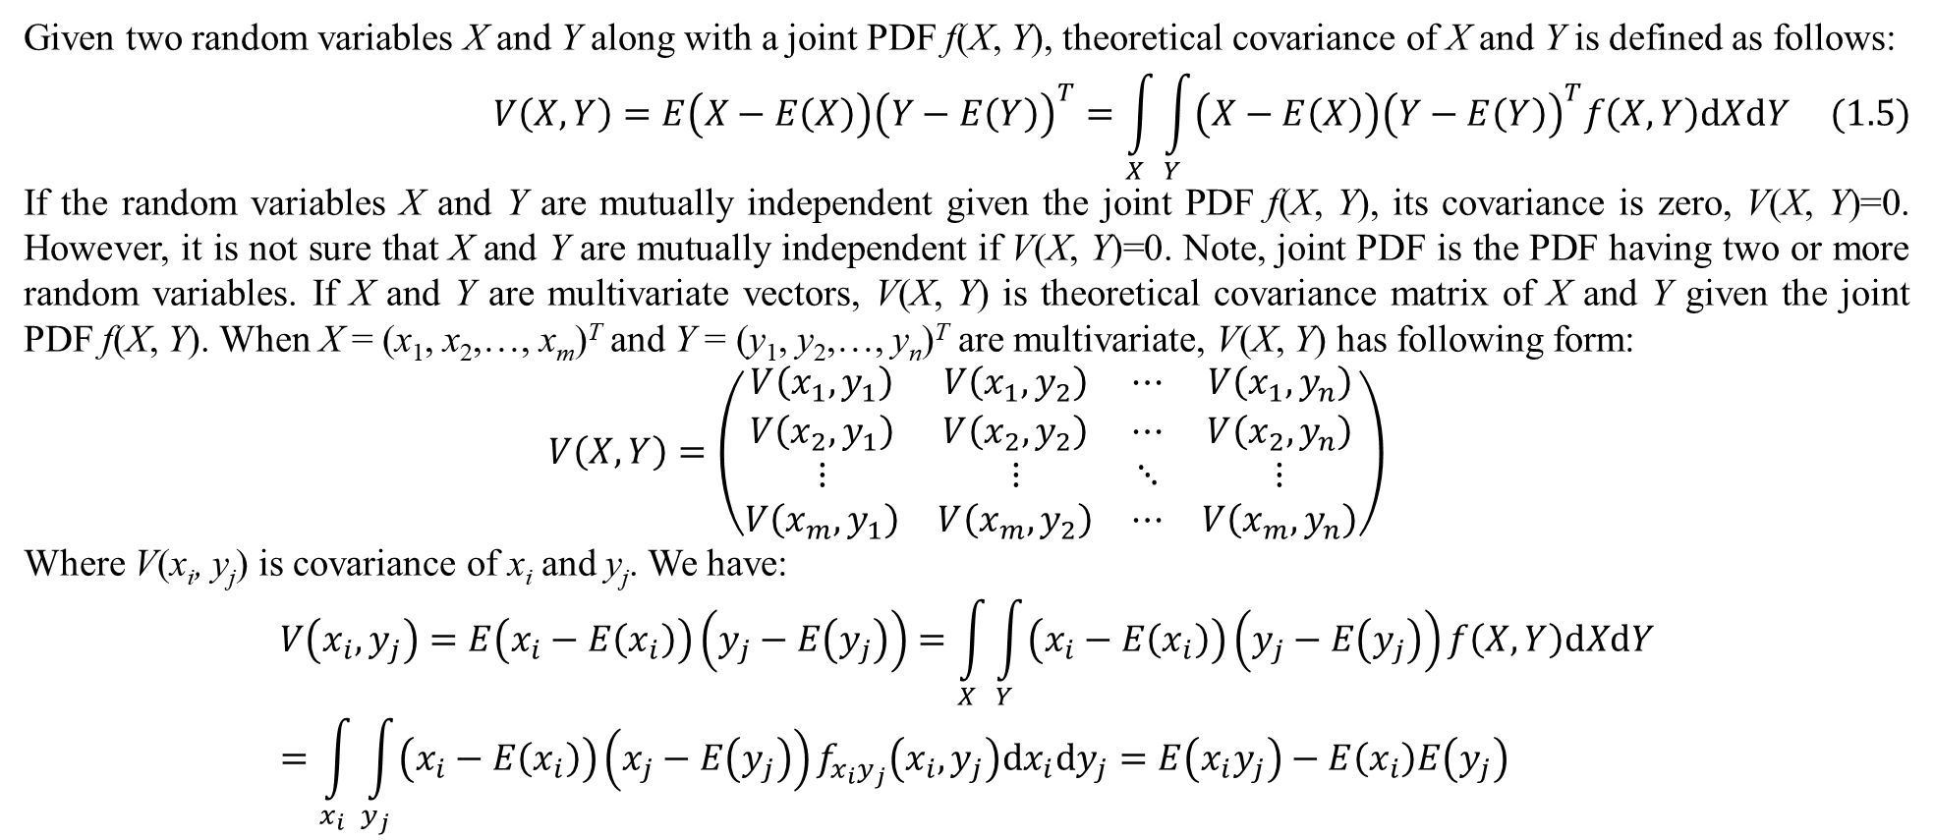
1. Basic concepts
Given two random variables X and Y along with a joint PDF f(X, Y), theoretical covariance of X and Y is defined as follows:
$$V\left(X,Y\right)=E\left(X−E\left(X\right)\right){\left(Y−E\left(Y\right)\right)}^{T}=\int_{X}{\int_{Y}{\left(X−E\left(X\right)\right){\left(Y−E\left(Y\right)\right)}^{T}f\left(X,Y\right)dXdY}} (1.5)$$
If the random variables X and Y are mutually independent given the joint PDF f(X, Y), its covariance is zero, V(X, Y)=0. However, it is not sure that X and Y are mutually independent if V(X, Y)=0. Note, joint PDF is the PDF having two or more random variables. If X and Y are multivariate vectors, V(X, Y) is theoretical covariance matrix of X and Y given the joint PDF f(X, Y). When X = (x₁, x₂,…, x_{m})^{T} and Y = (y₁, y₂,…, y_{n})^{T} are multivariate, V(X, Y) has following form:
$$V\left(X,Y\right)=\left(\begin{matrix}V\left(x_{1},y_{1}\right) & V\left(x_{1},y_{2}\right) & ⋯ & V\left(x_{1},y_{n}\right) \\ V\left(x_{2},y_{1}\right) & V\left(x_{2},y_{2}\right) & ⋯ & V\left(x_{2},y_{n}\right) \\ ⋮ & ⋮ & ⋱ & ⋮ \\ V\left(x_{m},y_{1}\right) & V\left(x_{m},y_{2}\right) & ⋯ & V\left(x_{m},y_{n}\right)\end{matrix}\right)$$
Where V(x_{i}, y_{j}) is covariance of x_{i} and y_{j}. We have:
$$V\left(x_{i},y_{j}\right)=E\left(x_{i}−E\left(x_{i}\right)\right)\left(y_{j}−E\left(y_{j}\right)\right)=\int_{X}{\int_{Y}{\left(x_{i}−E\left(x_{i}\right)\right)\left(y_{j}−E\left(y_{j}\right)\right)}f\left(X,Y\right)dXdY}=\int_{x_{i}}{\int_{y_{j}}{\left(x_{i}−E\left(x_{i}\right)\right)\left(x_{j}−E\left(y_{j}\right)\right)f_{x_{i}y_{j}}\left(x_{i},y_{j}\right)dx_{i}dy_{j}}}=E\left(x_{i}y_{j}\right)−E\left(x_{i}\right)E\left(y_{j}\right)$$

Slide 27
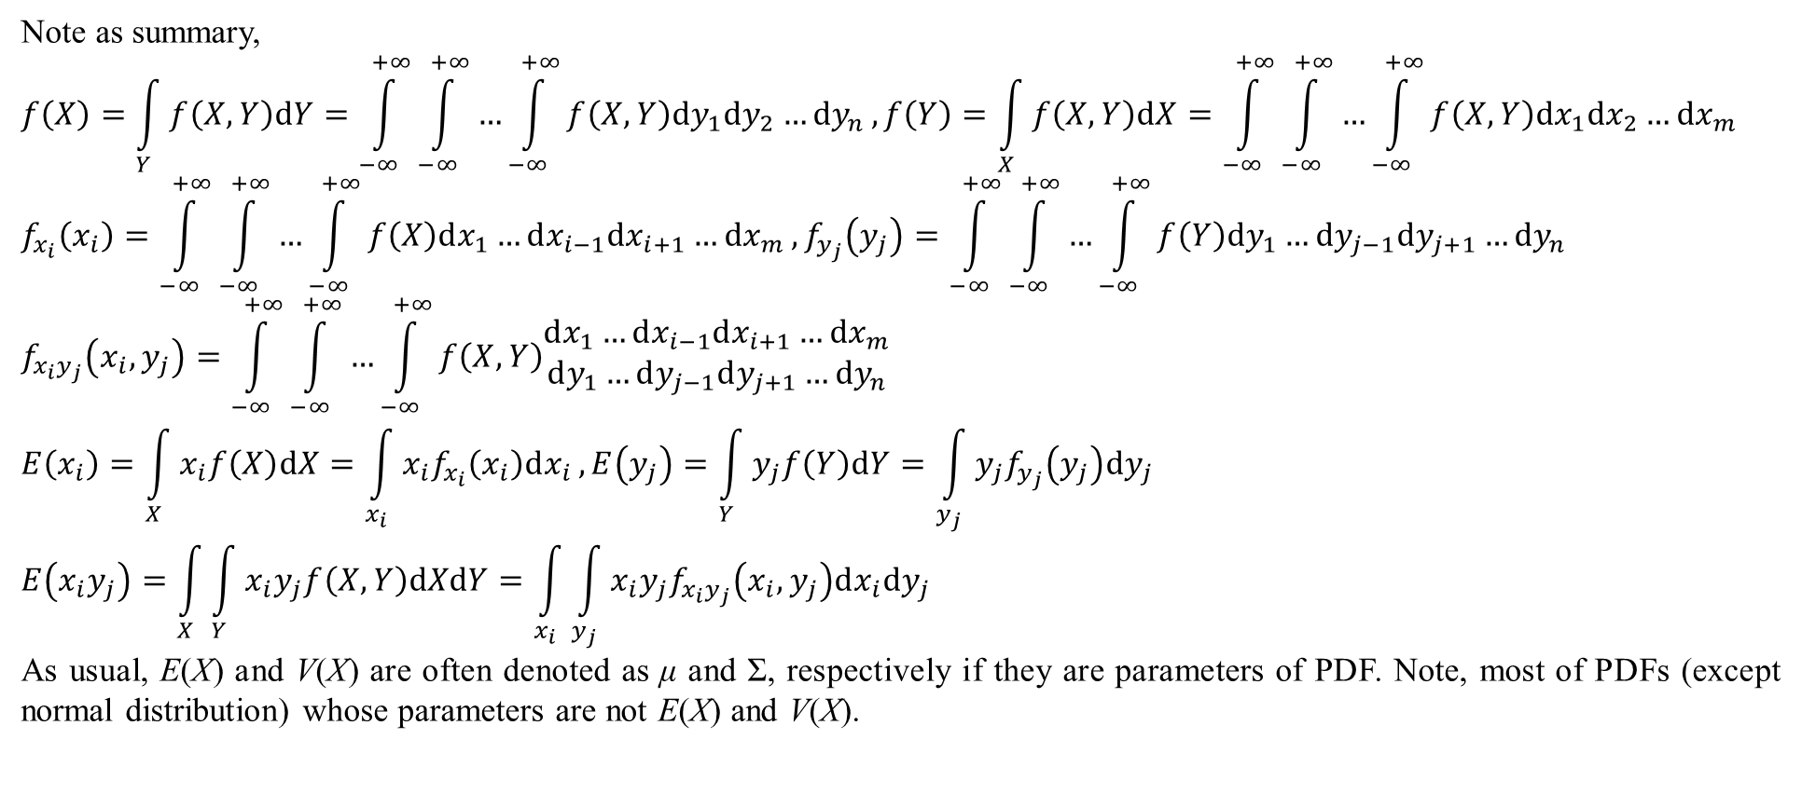
1. Basic concepts
Note as summary,
$$f\left(X\right)=\int_{Y}{f\left(X,Y\right)dY}=\int_{−∞}^{+∞}{\int_{−∞}^{+∞}{…\int_{−∞}^{+∞}{f\left(X,Y\right)dy_{1}dy_{2}…dy_{n}}}},f\left(Y\right)=\int_{X}{f\left(X,Y\right)dX}=\int_{−∞}^{+∞}{\int_{−∞}^{+∞}{…\int_{−∞}^{+∞}{f\left(X,Y\right)dx_{1}dx_{2}…dx_{m}}}}$$
$$f_{x_{i}}\left(x_{i}\right)=\int_{−∞}^{+∞}{\int_{−∞}^{+∞}{…\int_{−∞}^{+∞}{f\left(X\right)dx_{1}…dx_{i−1}dx_{i+1}…dx_{m}}}},f_{y_{j}}\left(y_{j}\right)=\int_{−∞}^{+∞}{\int_{−∞}^{+∞}{…\int_{−∞}^{+∞}{f\left(Y\right)dy_{1}…dy_{j−1}dy_{j+1}…dy_{n}}}}$$
$$f_{x_{i}y_{j}}\left(x_{i},y_{j}\right)=\int_{−∞}^{+∞}{\int_{−∞}^{+∞}{…\int_{−∞}^{+∞}{f\left(X,Y\right)\begin{matrix}dx_{1}…dx_{i−1}dx_{i+1}…dx_{m} \\ dy_{1}…dy_{j−1}dy_{j+1}…dy_{n}\end{matrix}}}}$$
$$E\left(x_{i}\right)=\int_{X}{x_{i}f\left(X\right)dX}=\int_{x_{i}}{x_{i}f_{x_{i}}\left(x_{i}\right)dx_{i}},E\left(y_{j}\right)=\int_{Y}{y_{j}f\left(Y\right)dY}=\int_{y_{j}}{y_{j}f_{y_{j}}\left(y_{j}\right)dy_{j}}$$
$$E\left(x_{i}y_{j}\right)=\int_{X}{\int_{Y}{x_{i}y_{j}f\left(X,Y\right)dXdY}}=\int_{x_{i}}{\int_{y_{j}}{x_{i}y_{j}f_{x_{i}y_{j}}\left(x_{i},y_{j}\right)dx_{i}dy_{j}}}$$
As usual, E(X) and V(X) are often denoted as μ and Σ, respectively if they are parameters of PDF. Note, most of PDFs (except normal distribution) whose parameters are not E(X) and V(X).

Slide 28
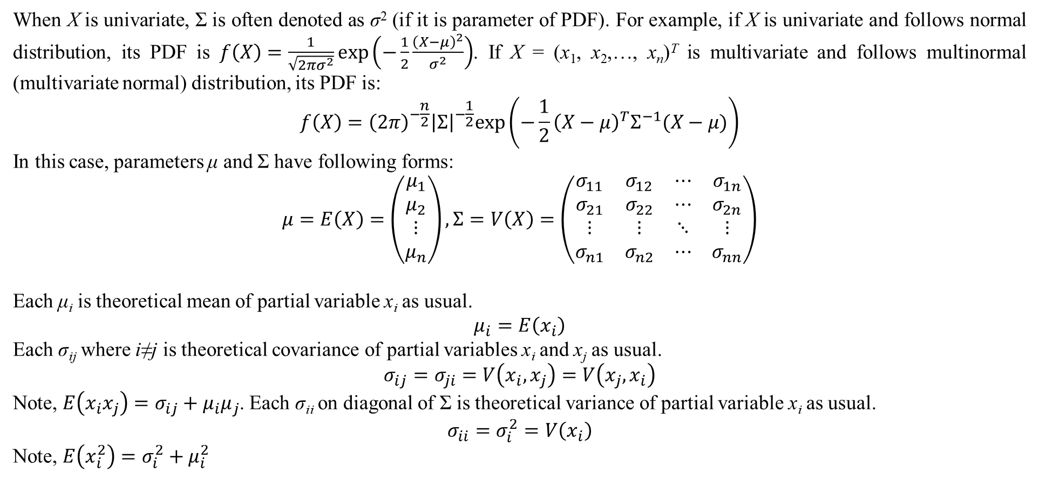
1. Basic concepts
When X is univariate, Σ is often denoted as σ² (if it is parameter of PDF). For example, if X is univariate and follows normal distribution, its PDF is $f\left(X\right)=\frac{1}{\sqrt{2πσ^{2}}}exp\left(−\frac{1}{2}\frac{{\left(X−μ\right)}^{2}}{σ^{2}}\right)$. If X = (x₁, x₂,…, x_{n})^{T} is multivariate and follows multinormal (multivariate normal) distribution, its PDF is:
$$f\left(X\right)={\left(2π\right)}^{−\frac{n}{2}}{\left|Σ\right|}^{−\frac{1}{2}}exp\left(−\frac{1}{2}{\left(X−μ\right)}^{T}Σ^{−1}(X−μ)\right)$$
In this case, parameters μ and Σ have following forms:
$$μ=E\left(X\right)=\left(\begin{matrix}μ_{1} \\ μ_{2} \\ ⋮ \\ μ_{n}\end{matrix}\right),Σ=V\left(X\right)=\left(\begin{matrix}σ_{11} & σ_{12} & ⋯ & σ_{1n} \\ σ_{21} & σ_{22} & ⋯ & σ_{2n} \\ ⋮ & ⋮ & ⋱ & ⋮ \\ σ_{n1} & σ_{n2} & ⋯ & σ_{nn}\end{matrix}\right)$$
Each μ_{i} is theoretical mean of partial variable x_{i} as usual.
$$μ_{i}=E\left(x_{i}\right)$$
Each σ_{ij} where i≠j is theoretical covariance of partial variables x_{i} and x_{j} as usual.
$$σ_{ij}=σ_{ji}=V\left(x_{i},x_{j}\right)=V\left(x_{j},x_{i}\right)$$
Note, $E\left(x_{i}x_{j}\right)=σ_{ij}+μ_{i}μ_{j}$. Each σ_{ii} on diagonal of Σ is theoretical variance of partial variable x_{i} as usual.
$$σ_{ii}=σ_{i}^{2}=V\left(x_{i}\right)$$
Note, $E\left(x_{i}^{2}\right)=σ_{i}^{2}+μ_{i}^{2}$

Slide 29
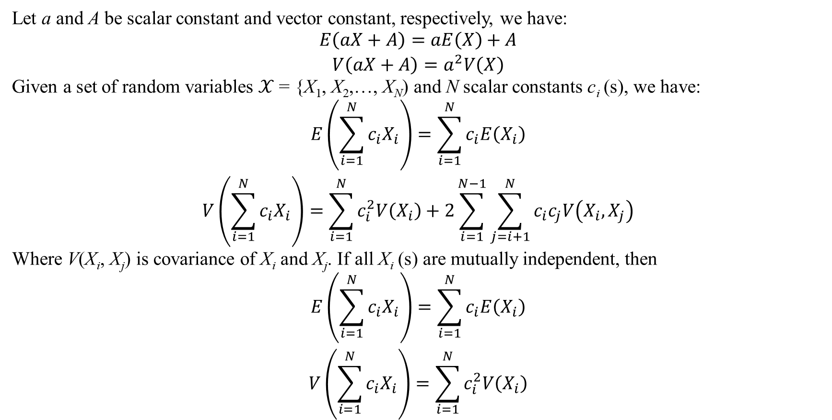
1. Basic concepts
Let a and A be scalar constant and vector constant, respectively, we have:
$$\begin{matrix}E\left(aX+A\right)=aE\left(X\right)+A \\ V\left(aX+A\right)=a^{2}V\left(X\right)\end{matrix}$$
Given a set of random variables $𝒳$ = {X₁, X₂,…, X_{N}) and N scalar constants c_{i} (s), we have:
$$\begin{matrix}E\left(\sum_{i=1}^{N}{c_{i}X_{i}}\right)=\sum_{i=1}^{N}{c_{i}E\left(X_{i}\right)} \\ V\left(\sum_{i=1}^{N}{c_{i}X_{i}}\right)=\sum_{i=1}^{N}{c_{i}^{2}V\left(X_{i}\right)}+2\sum_{i=1}^{N−1}{\sum_{j=i+1}^{N}{c_{i}c_{j}V\left(X_{i},X_{j}\right)}}\end{matrix}$$
Where V(X_{i}, X_{j}) is covariance of X_{i} and X_{j}. If all X_{i} (s) are mutually independent, then
$$\begin{matrix}E\left(\sum_{i=1}^{N}{c_{i}X_{i}}\right)=\sum_{i=1}^{N}{c_{i}E\left(X_{i}\right)} \\ V\left(\sum_{i=1}^{N}{c_{i}X_{i}}\right)=\sum_{i=1}^{N}{c_{i}^{2}V\left(X_{i}\right)}\end{matrix}$$

Slide 30
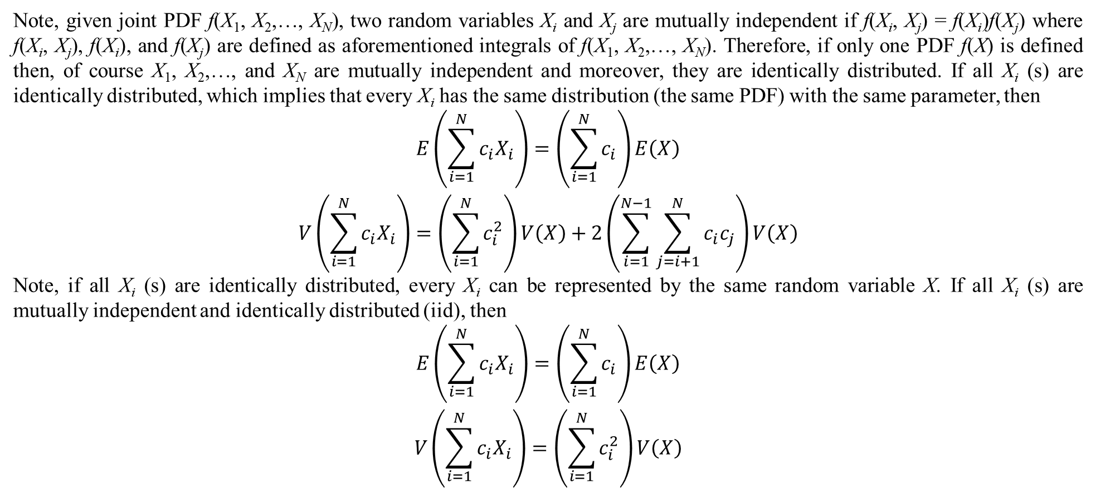
1. Basic concepts
Note, given joint PDF f(X₁, X₂,…, X_{N}), two random variables X_{i} and X_{j} are mutually independent if f(X_{i}, X_{j}) = f(X_{i})f(X_{j}) where f(X_{i}, X_{j}), f(X_{i}), and f(X_{j}) are defined as aforementioned integrals of f(X₁, X₂,…, X_{N}). Therefore, if only one PDF f(X) is defined then, of course X₁, X₂,…, and X_{N} are mutually independent and moreover, they are identically distributed. If all X_{i} (s) are identically distributed, which implies that every X_{i} has the same distribution (the same PDF) with the same parameter, then
$$\begin{matrix}E\left(\sum_{i=1}^{N}{c_{i}X_{i}}\right)=\left(\sum_{i=1}^{N}{c_{i}}\right)E\left(X\right) \\ V\left(\sum_{i=1}^{N}{c_{i}X_{i}}\right)=\left(\sum_{i=1}^{N}{c_{i}^{2}}\right)V\left(X\right)+2\left(\sum_{i=1}^{N−1}{\sum_{j=i+1}^{N}{c_{i}c_{j}}}\right)V\left(X\right)\end{matrix}$$
Note, if all X_{i} (s) are identically distributed, every X_{i} can be represented by the same random variable X. If all X_{i} (s) are mutually independent and identically distributed (iid), then
$$\begin{matrix}E\left(\sum_{i=1}^{N}{c_{i}X_{i}}\right)=\left(\sum_{i=1}^{N}{c_{i}}\right)E\left(X\right) \\ V\left(\sum_{i=1}^{N}{c_{i}X_{i}}\right)=\left(\sum_{i=1}^{N}{c_{i}^{2}}\right)V\left(X\right)\end{matrix}$$

Slide 31
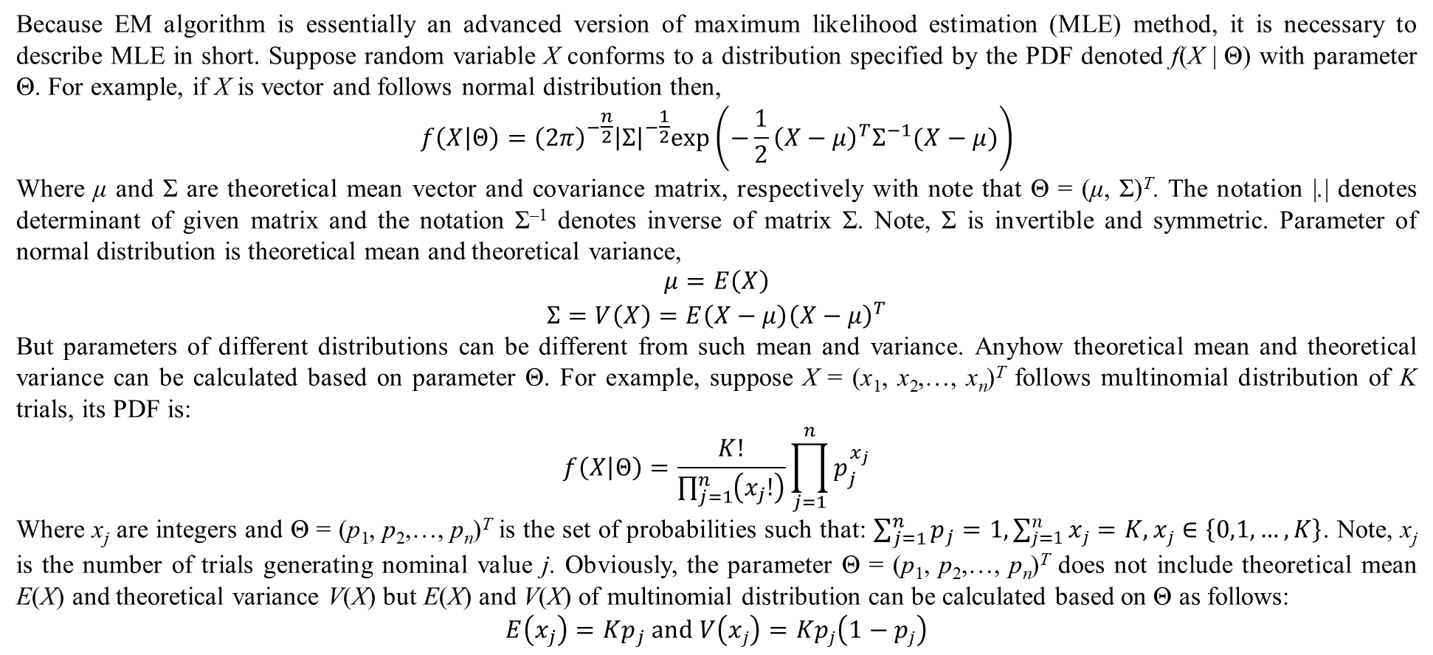
2. Parameter estimation
Because EM algorithm is essentially an advanced version of maximum likelihood estimation (MLE) method, it is necessary to describe MLE in short. Suppose random variable X conforms to a distribution specified by the PDF denoted f(X | Θ) with parameter Θ. For example, if X is vector and follows normal distribution then,
$$f\left(X | Θ\right)={\left(2π\right)}^{−\frac{n}{2}}{\left|Σ\right|}^{−\frac{1}{2}}exp\left(−\frac{1}{2}{\left(X−μ\right)}^{T}Σ^{−1}(X−μ)\right)$$
Where μ and Σ are theoretical mean vector and covariance matrix, respectively with note that Θ = (μ, Σ)^{T}. The notation |.| denotes determinant of given matrix and the notation Σ^{–1} denotes inverse of matrix Σ. Note, Σ is invertible and symmetric. Parameter of normal distribution is theoretical mean and theoretical variance,
$$\begin{matrix}μ=E\left(X\right) \\ Σ=V\left(X\right)=E\left(X−μ\right){\left(X−μ\right)}^{T}\end{matrix}$$
But parameters of different distributions can be different from such mean and variance. Anyhow theoretical mean and theoretical variance can be calculated based on parameter Θ. For example, suppose X = (x₁, x₂,…, x_{n})^{T} follows multinomial distribution of K trials, its PDF is:
$$f\left(X | Θ\right)=\frac{K!}{\prod_{j=1}^{n}{\left(x_{j}!\right)}}\prod_{j=1}^{n}{p_{j}^{x_{j}}}$$
Where x_{j} are integers and Θ = (p₁, p₂,…, p_{n})^{T} is the set of probabilities such that: $\sum_{j=1}^{n}{p_{j}}=1,\sum_{j=1}^{n}{x_{j}}=K,x_{j}∈\left\{0,1,…,K\right\}$. Note, x_{j} is the number of trials generating nominal value j. Obviously, the parameter Θ = (p₁, p₂,…, p_{n})^{T} does not include theoretical mean E(X) and theoretical variance V(X) but E(X) and V(X) of multinomial distribution can be calculated based on Θ as follows:
$$E\left(x_{j}\right)=Kp_{j} and V\left(x_{j}\right)=Kp_{j}\left(1−p_{j}\right)$$

Slide 32
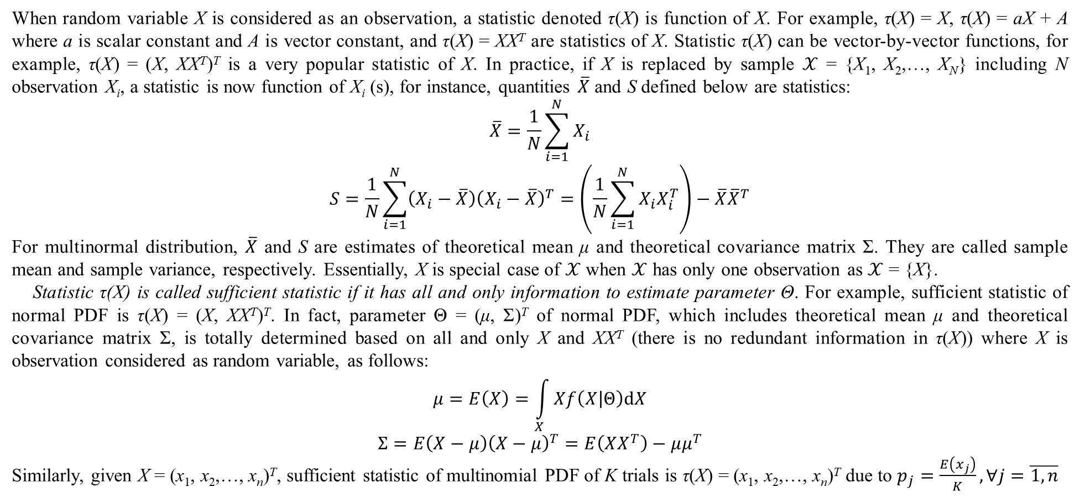
2. Parameter estimation
When random variable X is considered as an observation, a statistic denoted τ(X) is function of X. For example, τ(X) = X, τ(X) = aX + A where a is scalar constant and A is vector constant, and τ(X) = XX^{T} are statistics of X. Statistic τ(X) can be vector-by-vector functions, for example, τ(X) = (X, XX^{T})^{T} is a very popular statistic of X. In practice, if X is replaced by sample $𝒳$ = {X₁, X₂,…, X_{N}} including N observation X_{i}, a statistic is now function of X_{i} (s), for instance, quantities $\overline{X}$ and S defined below are statistics:
$$\overline{X}=\frac{1}{N}\sum_{i=1}^{N}{X_{i}}$$
$$S=\frac{1}{N}\sum_{i=1}^{N}{\left(X_{i}−\overline{X}\right){\left(X_{i}−\overline{X}\right)}^{T}}=\left(\frac{1}{N}\sum_{i=1}^{N}{X_{i}X_{i}^{T}}\right)−\overline{X}{\overline{X}}^{T}$$
For multinormal distribution, $\overline{X}$ and S are estimates of theoretical mean μ and theoretical covariance matrix Σ. They are called sample mean and sample variance, respectively. Essentially, X is special case of $𝒳$ when $𝒳$ has only one observation as $𝒳$ = {X}.
Statistic τ(X) is called sufficient statistic if it has all and only information to estimate parameter Θ. For example, sufficient statistic of normal PDF is τ(X) = (X, XX^{T})^{T}. In fact, parameter Θ = (μ, Σ)^{T} of normal PDF, which includes theoretical mean μ and theoretical covariance matrix Σ, is totally determined based on all and only X and XX^{T} (there is no redundant information in τ(X)) where X is observation considered as random variable, as follows:
$$μ=E\left(X\right)=\int_{X}{Xf\left(X | Θ\right)dX}$$
$$Σ=E{\left(X−μ\right)\left(X−μ\right)}^{T}=E\left(XX^{T}\right)−μμ^{T}$$
Similarly, given X = (x₁, x₂,…, x_{n})^{T}, sufficient statistic of multinomial PDF of K trials is τ(X) = (x₁, x₂,…, x_{n})^{T} due to $p_{j}=\frac{E\left(x_{j}\right)}{K},∀j=\overline{1,n}$

Slide 33
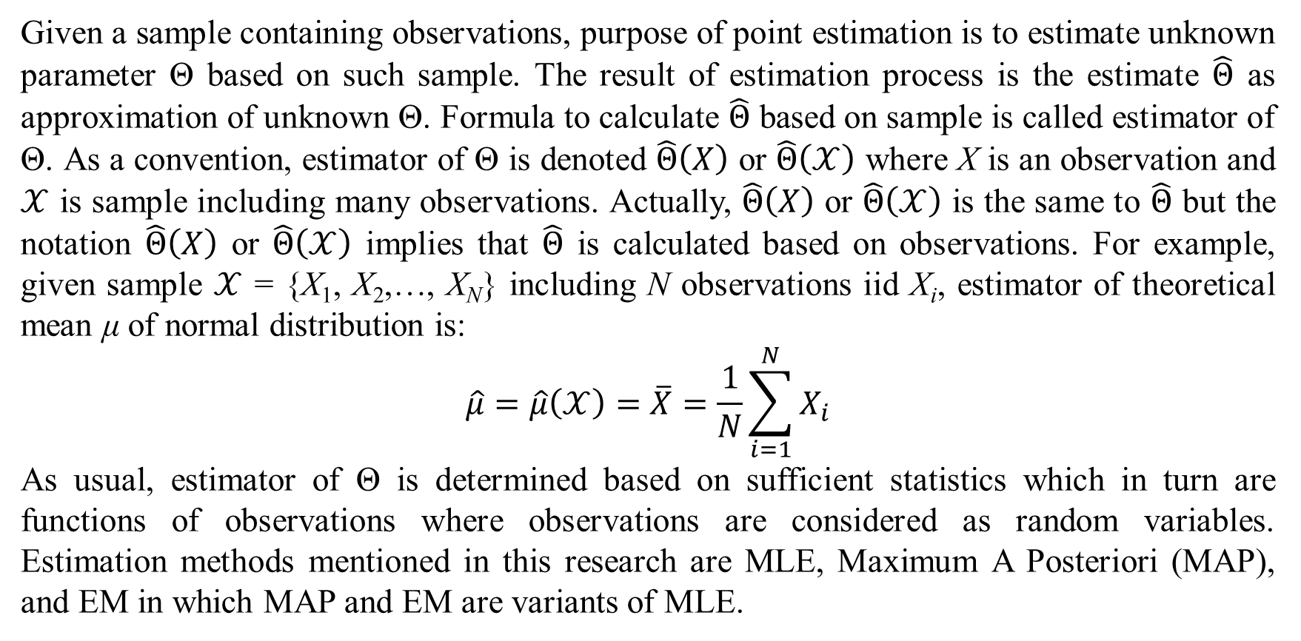
2. Parameter estimation
Given a sample containing observations, purpose of point estimation is to estimate unknown parameter Θ based on such sample. The result of estimation process is the estimate $\hat{Θ}$ as approximation of unknown Θ. Formula to calculate $\hat{Θ}$ based on sample is called estimator of Θ. As a convention, estimator of Θ is denoted $\hat{Θ}\left(X\right)$ or $\hat{Θ}\left(𝒳\right)$ where X is an observation and $𝒳$ is sample including many observations. Actually, $\hat{Θ}\left(X\right)$ or $\hat{Θ}\left(𝒳\right)$ is the same to $\hat{Θ}$ but the notation $\hat{Θ}\left(X\right)$ or $\hat{Θ}\left(𝒳\right)$ implies that $\hat{Θ}$ is calculated based on observations. For example, given sample $𝒳$ = {X₁, X₂,…, X_{N}} including N observations iid X_{i}, estimator of theoretical mean μ of normal distribution is:
$$\hat{μ}=\hat{μ}\left(𝒳\right)=\overline{X}=\frac{1}{N}\sum_{i=1}^{N}{X_{i}}$$
As usual, estimator of Θ is determined based on sufficient statistics which in turn are functions of observations where observations are considered as random variables. Estimation methods mentioned in this research are MLE, Maximum A Posteriori (MAP), and EM in which MAP and EM are variants of MLE.

Slide 34
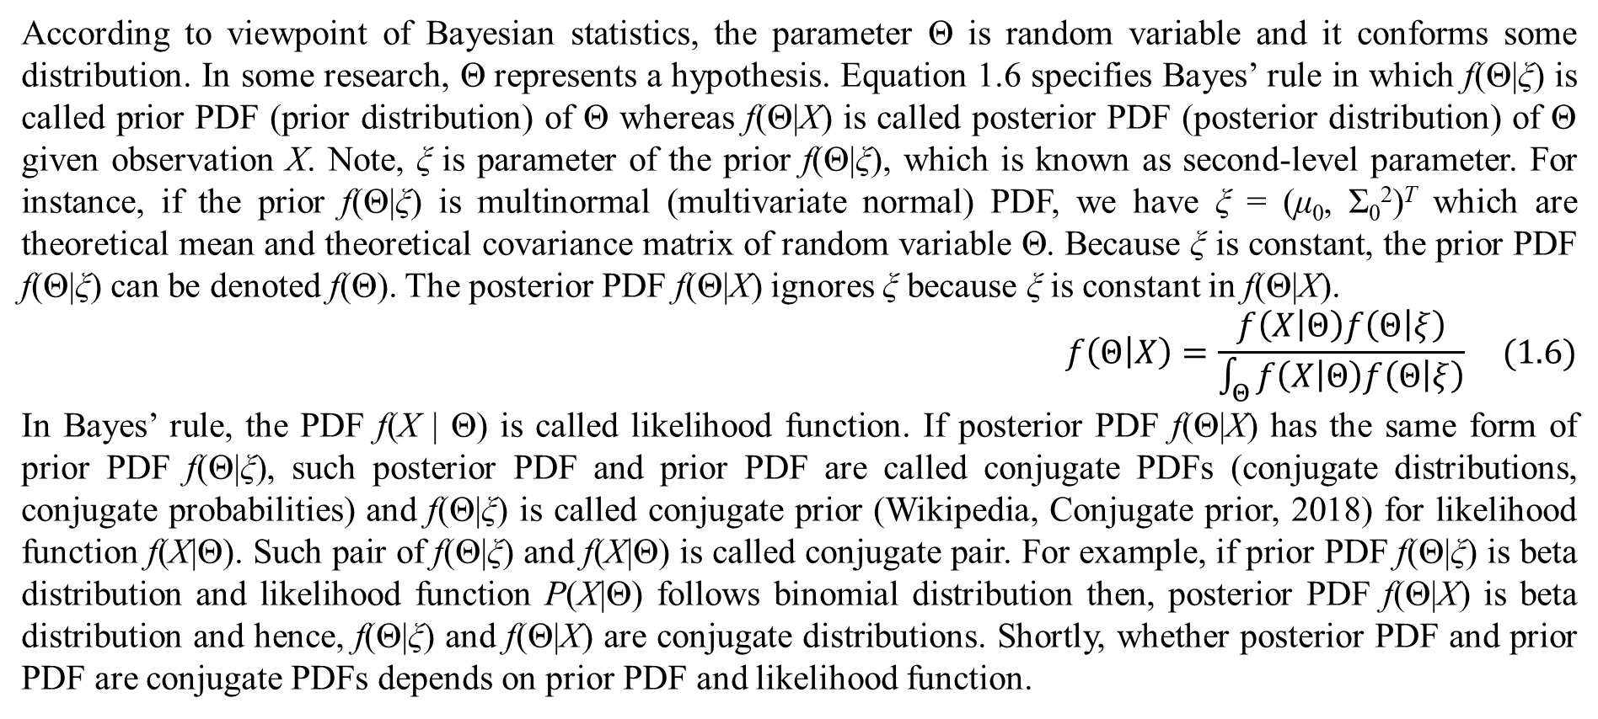
2. Parameter estimation
According to viewpoint of Bayesian statistics, the parameter Θ is random variable and it conforms some distribution. In some research, Θ represents a hypothesis. Equation 1.6 specifies Bayes’ rule in which f(Θ|ξ) is called prior PDF (prior distribution) of Θ whereas f(Θ|X) is called posterior PDF (posterior distribution) of Θ given observation X. Note, ξ is parameter of the prior f(Θ|ξ), which is known as second-level parameter. For instance, if the prior f(Θ|ξ) is multinormal (multivariate normal) PDF, we have ξ = (μ₀, Σ₀²)^{T} which are theoretical mean and theoretical covariance matrix of random variable Θ. Because ξ is constant, the prior PDF f(Θ|ξ) can be denoted f(Θ). The posterior PDF f(Θ|X) ignores ξ because ξ is constant in f(Θ|X).
$$f\left(Θ | X\right)=\frac{f\left(X | Θ\right)f\left(Θ | ξ\right)}{\int_{Θ}{f\left(X | Θ\right)f\left(Θ | ξ\right)}} (1.6)$$
In Bayes’ rule, the PDF f(X | Θ) is called likelihood function. If posterior PDF f(Θ|X) has the same form of prior PDF f(Θ|ξ), such posterior PDF and prior PDF are called conjugate PDFs (conjugate distributions, conjugate probabilities) and f(Θ|ξ) is called conjugate prior (Wikipedia, Conjugate prior, 2018) for likelihood function f(X|Θ). Such pair of f(Θ|ξ) and f(X|Θ) is called conjugate pair. For example, if prior PDF f(Θ|ξ) is beta distribution and likelihood function P(X|Θ) follows binomial distribution then, posterior PDF f(Θ|X) is beta distribution and hence, f(Θ|ξ) and f(Θ|X) are conjugate distributions. Shortly, whether posterior PDF and prior PDF are conjugate PDFs depends on prior PDF and likelihood function.

Slide 35
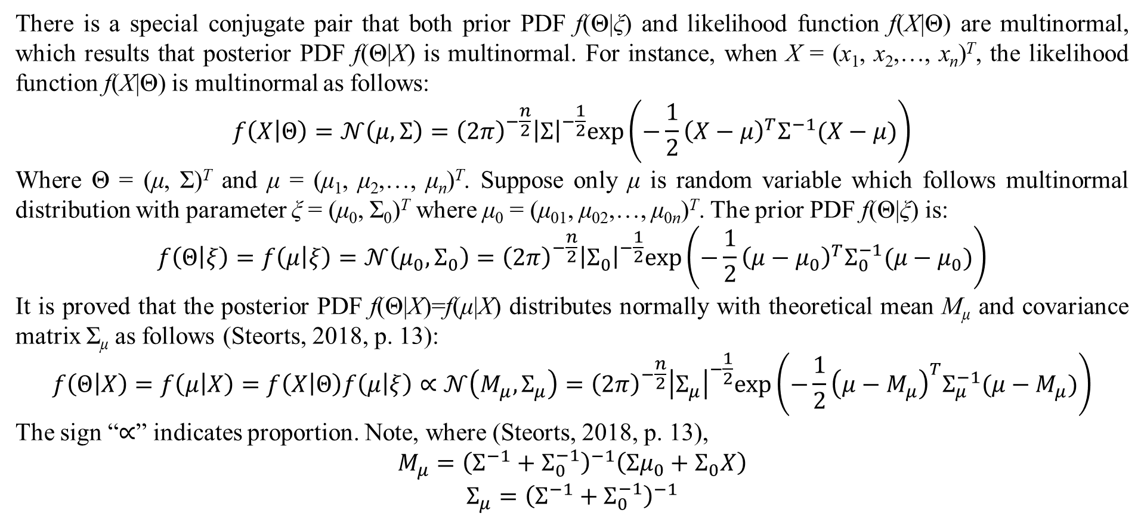
2. Parameter estimation
There is a special conjugate pair that both prior PDF f(Θ|ξ) and likelihood function f(X|Θ) are multinormal, which results that posterior PDF f(Θ|X) is multinormal. For instance, when X = (x₁, x₂,…, x_{n})^{T}, the likelihood function f(X|Θ) is multinormal as follows:
$$f\left(X | Θ\right)=𝒩\left(μ,Σ\right)={\left(2π\right)}^{−\frac{n}{2}}{\left|Σ\right|}^{−\frac{1}{2}}exp\left(−\frac{1}{2}{\left(X−μ\right)}^{T}Σ^{−1}(X−μ)\right)$$
Where Θ = (μ, Σ)^{T} and μ = (μ₁, μ₂,…, μ_{n})^{T}. Suppose only μ is random variable which follows multinormal distribution with parameter ξ = (μ₀, Σ₀)^{T} where μ₀ = (μ₀₁, μ₀₂,…, μ_{0n})^{T}. The prior PDF f(Θ|ξ) is:
$$f\left(Θ | ξ\right)=f\left(μ | ξ\right)=𝒩\left(μ_{0},Σ_{0}\right)={\left(2π\right)}^{−\frac{n}{2}}{\left|Σ_{0}\right|}^{−\frac{1}{2}}exp\left(−\frac{1}{2}{\left(μ−μ_{0}\right)}^{T}Σ_{0}^{−1}(μ−μ_{0})\right)$$
It is proved that the posterior PDF f(Θ|X)=f(μ|X) distributes normally with theoretical mean M_{μ} and covariance matrix Σ_{μ} as follows (Steorts, 2018, p. 13):
$$f\left(Θ | X\right)=f\left(μ | X\right)=f\left(X | Θ\right)f\left(μ | ξ\right)∝𝒩\left(M_{μ},Σ_{μ}\right)={\left(2π\right)}^{−\frac{n}{2}}{\left|Σ_{μ}\right|}^{−\frac{1}{2}}exp\left(−\frac{1}{2}{\left(μ−M_{μ}\right)}^{T}Σ_{μ}^{−1}(μ−M_{μ})\right)$$
The sign “$∝$” indicates proportion. Note, where (Steorts, 2018, p. 13),
$$M_{μ}={\left(Σ^{−1}+Σ_{0}^{−1}\right)}^{−1}\left(Σμ_{0}+Σ_{0}X\right)$$
$$Σ_{μ}={\left(Σ^{−1}+Σ_{0}^{−1}\right)}^{−1}$$

Slide 36
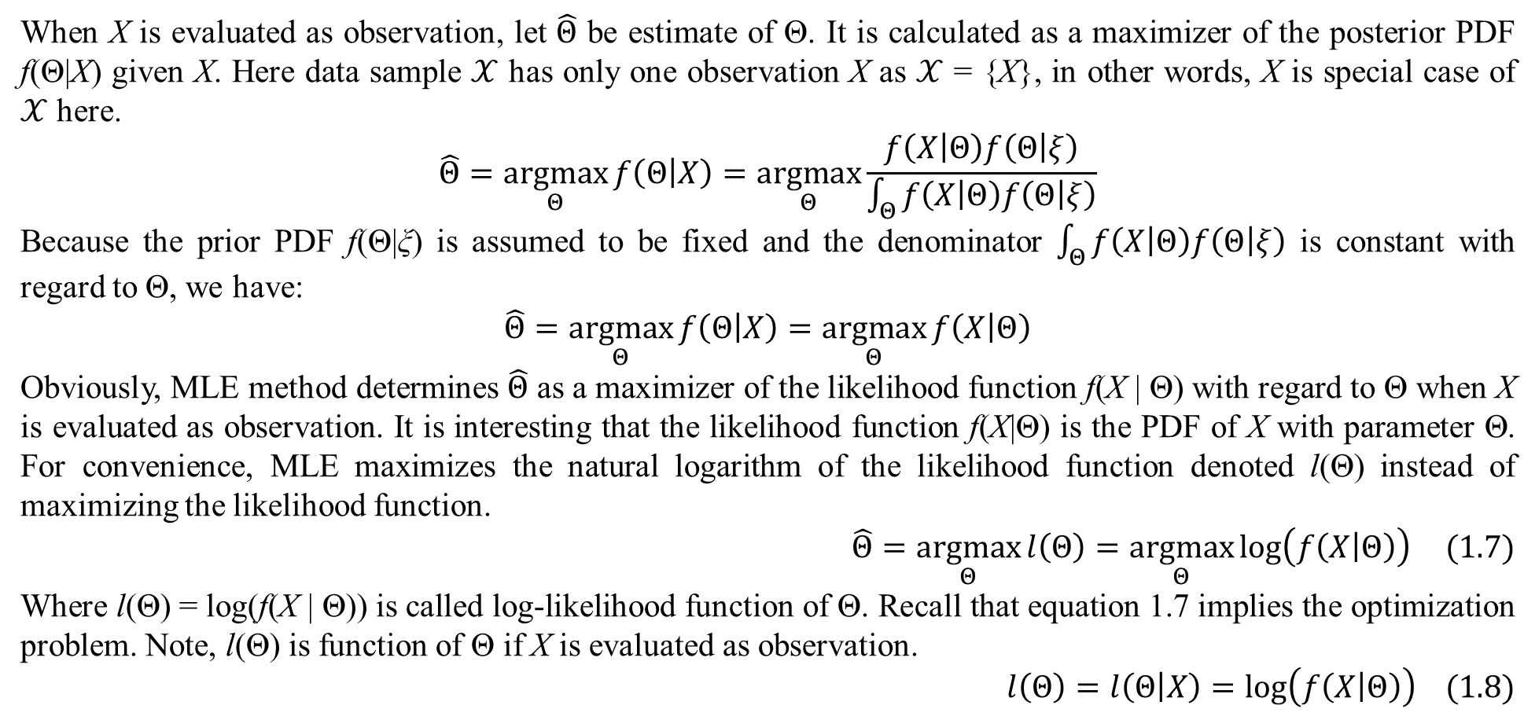
2. Parameter estimation
When X is evaluated as observation, let $\hat{Θ}$ be estimate of Θ. It is calculated as a maximizer of the posterior PDF f(Θ|X) given X. Here data sample $𝒳$ has only one observation X as $𝒳$ = {X}, in other words, X is special case of $𝒳$ here.
$$\hat{Θ}=\underset{Θ}{argmax}{f\left(Θ | X\right)}=\underset{Θ}{argmax}{\frac{f\left(X | Θ\right)f\left(Θ | ξ\right)}{\int_{Θ}{f\left(X | Θ\right)f\left(Θ | ξ\right)}}}$$
Because the prior PDF f(Θ|ξ) is assumed to be fixed and the denominator $\int_{Θ}{f\left(X | Θ\right)f\left(Θ | ξ\right)}$ is constant with regard to Θ, we have:
$$\hat{Θ}=\underset{Θ}{argmax}{f\left(Θ | X\right)}=\underset{Θ}{argmax}{f\left(X | Θ\right)}$$
Obviously, MLE method determines $\hat{Θ}$ as a maximizer of the likelihood function f(X | Θ) with regard to Θ when X is evaluated as observation. It is interesting that the likelihood function f(X|Θ) is the PDF of X with parameter Θ. For convenience, MLE maximizes the natural logarithm of the likelihood function denoted l(Θ) instead of maximizing the likelihood function.
$$\hat{Θ}=\underset{Θ}{argmax}{l\left(Θ\right)}=\underset{Θ}{argmax}{log\left(f\left(X | Θ\right)\right)} (1.7)$$
Where l(Θ) = log(f(X | Θ)) is called log-likelihood function of Θ. Recall that equation 1.7 implies the optimization problem. Note, l(Θ) is function of Θ if X is evaluated as observation.
$$l\left(Θ\right)=l\left(Θ | X\right)=log\left(f\left(X | Θ\right)\right) (1.8)$$

Slide 37
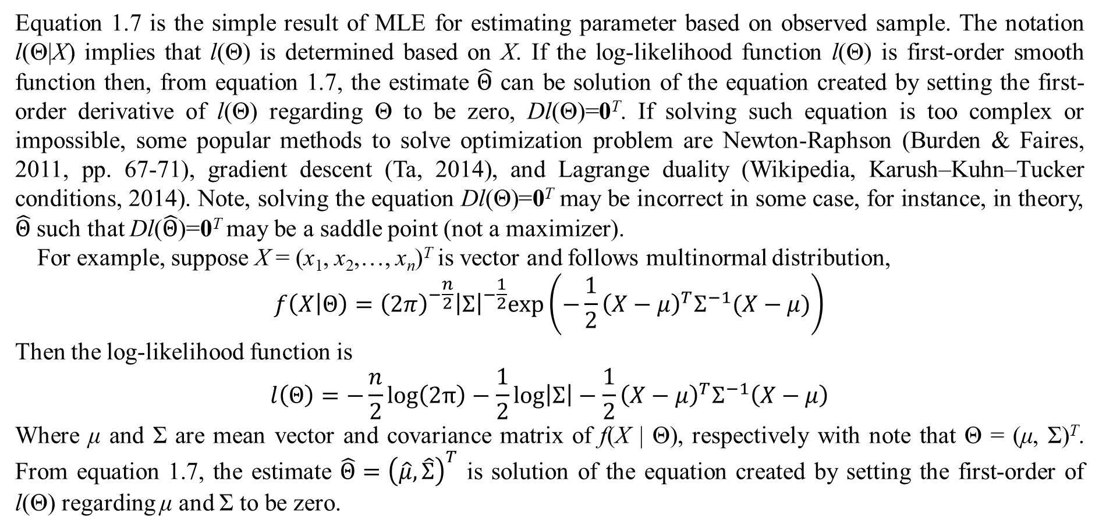
2. Parameter estimation
Equation 1.7 is the simple result of MLE for estimating parameter based on observed sample. The notation l(Θ|X) implies that l(Θ) is determined based on X. If the log-likelihood function l(Θ) is first-order smooth function then, from equation 1.7, the estimate $\hat{Θ}$ can be solution of the equation created by setting the first-order derivative of l(Θ) regarding Θ to be zero, Dl(Θ)=0^{T}. If solving such equation is too complex or impossible, some popular methods to solve optimization problem are Newton-Raphson (Burden & Faires, 2011, pp. 67-71), gradient descent (Ta, 2014), and Lagrange duality (Wikipedia, Karush–Kuhn–Tucker conditions, 2014). Note, solving the equation Dl(Θ)=0^{T} may be incorrect in some case, for instance, in theory, $\hat{Θ}$ such that Dl($\hat{Θ}$)=0^{T} may be a saddle point (not a maximizer).
For example, suppose X = (x₁, x₂,…, x_{n})^{T} is vector and follows multinormal distribution,
$$f\left(X | Θ\right)={\left(2π\right)}^{−\frac{n}{2}}{\left|Σ\right|}^{−\frac{1}{2}}exp\left(−\frac{1}{2}{\left(X−μ\right)}^{T}Σ^{−1}(X−μ)\right)$$
Then the log-likelihood function is
$$l\left(Θ\right)=−\frac{n}{2}log\left(2π\right)−\frac{1}{2}log\left|Σ\right|−\frac{1}{2}{\left(X−μ\right)}^{T}Σ^{−1}\left(X−μ\right)$$
Where μ and Σ are mean vector and covariance matrix of f(X | Θ), respectively with note that Θ = (μ, Σ)^{T}. From equation 1.7, the estimate $\hat{Θ}={\left(\hat{μ},\hat{Σ}\right)}^{T}$ is solution of the equation created by setting the first-order of l(Θ) regarding μ and Σ to be zero.

Slide 38
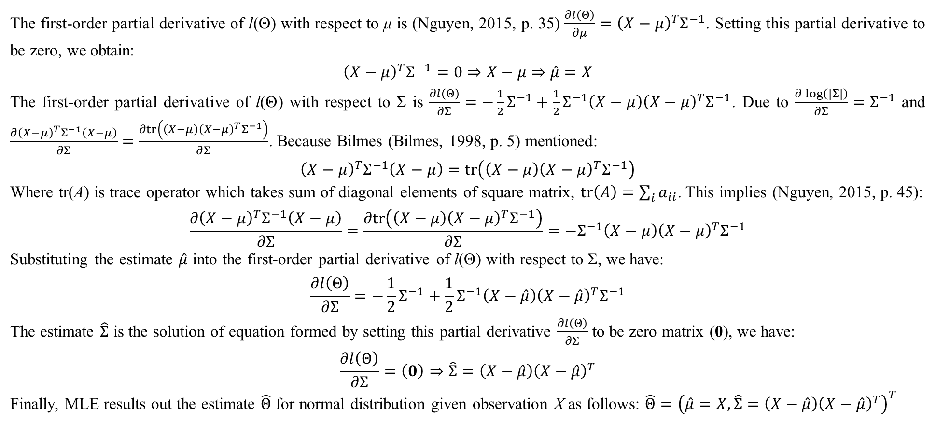
2. Parameter estimation
The first-order partial derivative of l(Θ) with respect to μ is (Nguyen, 2015, p. 35) $\frac{∂l\left(Θ\right)}{∂μ}={\left(X−μ\right)}^{T}Σ^{−1}$. Setting this partial derivative to be zero, we obtain:
$${\left(X−μ\right)}^{T}Σ^{−1}=0⇒X−μ⇒\hat{μ}=X$$
The first-order partial derivative of l(Θ) with respect to Σ is $\frac{∂l\left(Θ\right)}{∂Σ}=−\frac{1}{2}Σ^{−1}+\frac{1}{2}Σ^{−1}\left(X−μ\right){\left(X−μ\right)}^{T}Σ^{−1}$. Due to $\frac{∂\log\left(\left|Σ\right|\right)}{∂Σ}=Σ^{−1}$ and $\frac{∂{\left(X−μ\right)}^{T}Σ^{−1}\left(X−μ\right)}{∂Σ}=\frac{∂tr\left(\left(X−μ\right){\left(X−μ\right)}^{T}Σ^{−1}\right)}{∂Σ}$. Because Bilmes (Bilmes, 1998, p. 5) mentioned:
$${\left(X−μ\right)}^{T}Σ^{−1}\left(X−μ\right)=tr\left(\left(X−μ\right){\left(X−μ\right)}^{T}Σ^{−1}\right)$$
Where tr(A) is trace operator which takes sum of diagonal elements of square matrix, $tr\left(A\right)=\sum_{i}{a_{ii}}$. This implies (Nguyen, 2015, p. 45):
$$\frac{∂{\left(X−μ\right)}^{T}Σ^{−1}\left(X−μ\right)}{∂Σ}=\frac{∂tr\left(\left(X−μ\right){\left(X−μ\right)}^{T}Σ^{−1}\right)}{∂Σ}=−Σ^{−1}\left(X−μ\right){\left(X−μ\right)}^{T}Σ^{−1}$$
Substituting the estimate $\hat{μ}$ into the first-order partial derivative of l(Θ) with respect to Σ, we have:
$$\frac{∂l\left(Θ\right)}{∂Σ}=−\frac{1}{2}Σ^{−1}+\frac{1}{2}Σ^{−1}\left(X−\hat{μ}\right){\left(X−\hat{μ}\right)}^{T}Σ^{−1}$$
The estimate $\hat{Σ}$ is the solution of equation formed by setting this partial derivative $\frac{∂l\left(Θ\right)}{∂Σ}$ to be zero matrix (0), we have:
$$\frac{∂l\left(Θ\right)}{∂Σ}=\left(0\right)⇒\hat{Σ}=\left(X−\hat{μ}\right){\left(X−\hat{μ}\right)}^{T}$$
Finally, MLE results out the estimate $\hat{Θ}$ for normal distribution given observation X as follows: $\hat{Θ}={\left(\hat{μ}=X,\hat{Σ}=\left(X−\hat{μ}\right){\left(X−\hat{μ}\right)}^{T}\right)}^{T}$

Slide 39
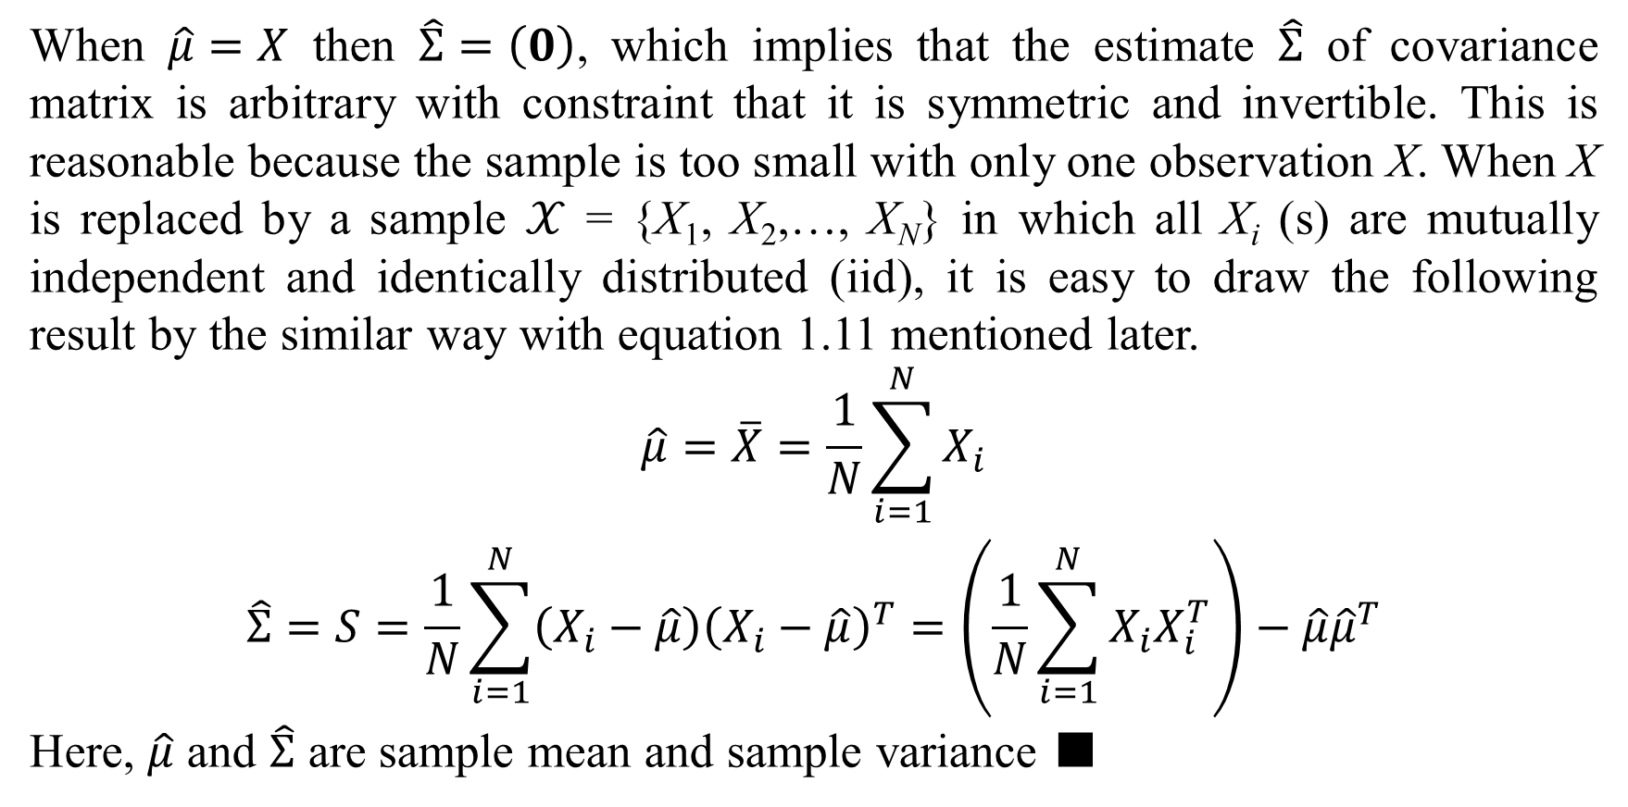
2. Parameter estimation
When $\hat{μ}=X$ then $\hat{Σ}=\left(0\right)$, which implies that the estimate $\hat{Σ}$ of covariance matrix is arbitrary with constraint that it is symmetric and invertible. This is reasonable because the sample is too small with only one observation X. When X is replaced by a sample $𝒳$ = {X₁, X₂,…, X_{N}} in which all X_{i} (s) are mutually independent and identically distributed (iid), it is easy to draw the following result by the similar way with equation 1.11 mentioned later.
$$\begin{matrix}\hat{μ}=\overline{X}=\frac{1}{N}\sum_{i=1}^{N}{X_{i}} \\ \hat{Σ}=S=\frac{1}{N}\sum_{i=1}^{N}{\left(X_{i}−\hat{μ}\right){\left(X_{i}−\hat{μ}\right)}^{T}}=\left(\frac{1}{N}\sum_{i=1}^{N}{X_{i}X_{i}^{T}}\right)−\hat{μ}{\hat{μ}}^{T}\end{matrix}$$
Here, $\hat{μ}$ and $\hat{Σ}$ are sample mean and sample variance ■

Slide 40
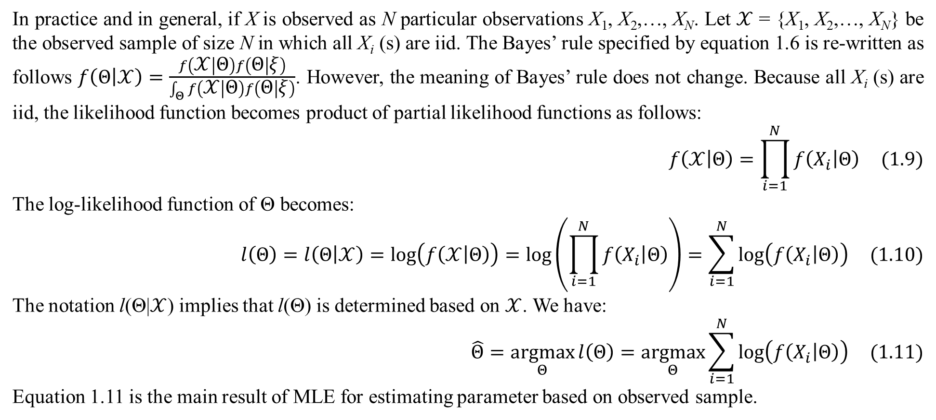
2. Parameter estimation
In practice and in general, if X is observed as N particular observations X₁, X₂,…, X_{N}. Let $𝒳$ = {X₁, X₂,…, X_{N}} be the observed sample of size N in which all X_{i} (s) are iid. The Bayes’ rule specified by equation 1.6 is re-written as follows $f\left(Θ | 𝒳\right)=\frac{f\left(𝒳 | Θ\right)f\left(Θ | ξ\right)}{\int_{Θ}{f\left(𝒳 | Θ\right)f\left(Θ | ξ\right)}}$. However, the meaning of Bayes’ rule does not change. Because all X_{i} (s) are iid, the likelihood function becomes product of partial likelihood functions as follows:
$$f\left(𝒳 | Θ\right)=\prod_{i=1}^{N}{f\left(X_{i} | Θ\right)} (1.9)$$
The log-likelihood function of Θ becomes:
$$l\left(Θ\right)=l\left(Θ | 𝒳\right)=log\left(f\left(𝒳 | Θ\right)\right)=log\left(\prod_{i=1}^{N}{f\left(X_{i} | Θ\right)}\right)=\sum_{i=1}^{N}{log\left(f\left(X_{i} | Θ\right)\right)} (1.10)$$
The notation l(Θ|$𝒳$) implies that l(Θ) is determined based on $𝒳$. We have:
$$\hat{Θ}=\underset{Θ}{argmax}{l\left(Θ\right)}=\underset{Θ}{argmax}{\sum_{i=1}^{N}{log\left(f\left(X_{i} | Θ\right)\right)}} (1.11)$$
Equation 1.11 is the main result of MLE for estimating parameter based on observed sample.

Slide 41
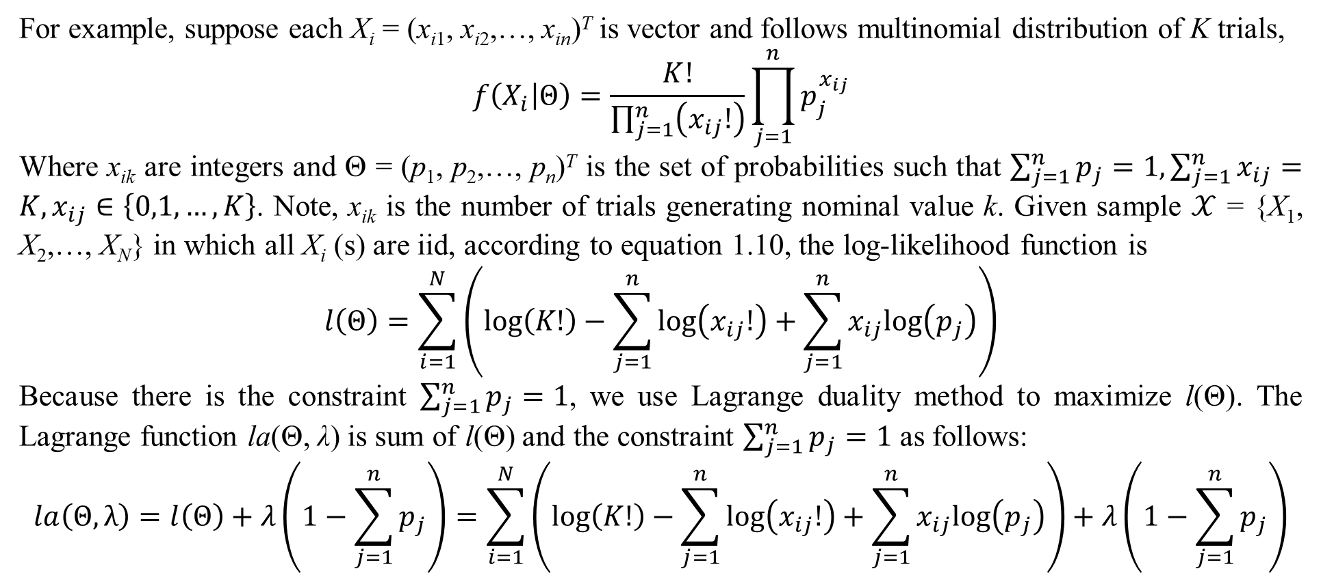
2. Parameter estimation
For example, suppose each X_{i} = (x_{i1}, x_{i2},…, x_{in})^{T} is vector and follows multinomial distribution of K trials,
$$f\left(X_{i} | Θ\right)=\frac{K!}{\prod_{j=1}^{n}{\left(x_{ij}!\right)}}\prod_{j=1}^{n}{p_{j}^{x_{ij}}}$$
Where x_{ik} are integers and Θ = (p₁, p₂,…, p_{n})^{T} is the set of probabilities such that $\sum_{j=1}^{n}{p_{j}}=1,\sum_{j=1}^{n}{x_{ij}}=K,x_{ij}∈\left\{0,1,…,K\right\}$. Note, x_{ik} is the number of trials generating nominal value k. Given sample $𝒳$ = {X₁, X₂,…, X_{N}} in which all X_{i} (s) are iid, according to equation 1.10, the log-likelihood function is
$$l\left(Θ\right)=\sum_{i=1}^{N}{\left(log\left(K!\right)−\sum_{j=1}^{n}{log\left(x_{ij}!\right)}+\sum_{j=1}^{n}{x_{ij}log\left(p_{j}\right)}\right)}$$
Because there is the constraint $\sum_{j=1}^{n}{p_{j}}=1$, we use Lagrange duality method to maximize l(Θ). The Lagrange function la(Θ, λ) is sum of l(Θ) and the constraint $\sum_{j=1}^{n}{p_{j}}=1$ as follows:
$$la\left(Θ,λ\right)=l\left(Θ\right)+λ\left(1−\sum_{j=1}^{n}{p_{j}}\right)=\sum_{i=1}^{N}{\left(log\left(K!\right)−\sum_{j=1}^{n}{log\left(x_{ij}!\right)}+\sum_{j=1}^{n}{x_{ij}log\left(p_{j}\right)}\right)}+λ\left(1−\sum_{j=1}^{n}{p_{j}}\right)$$

Slide 42
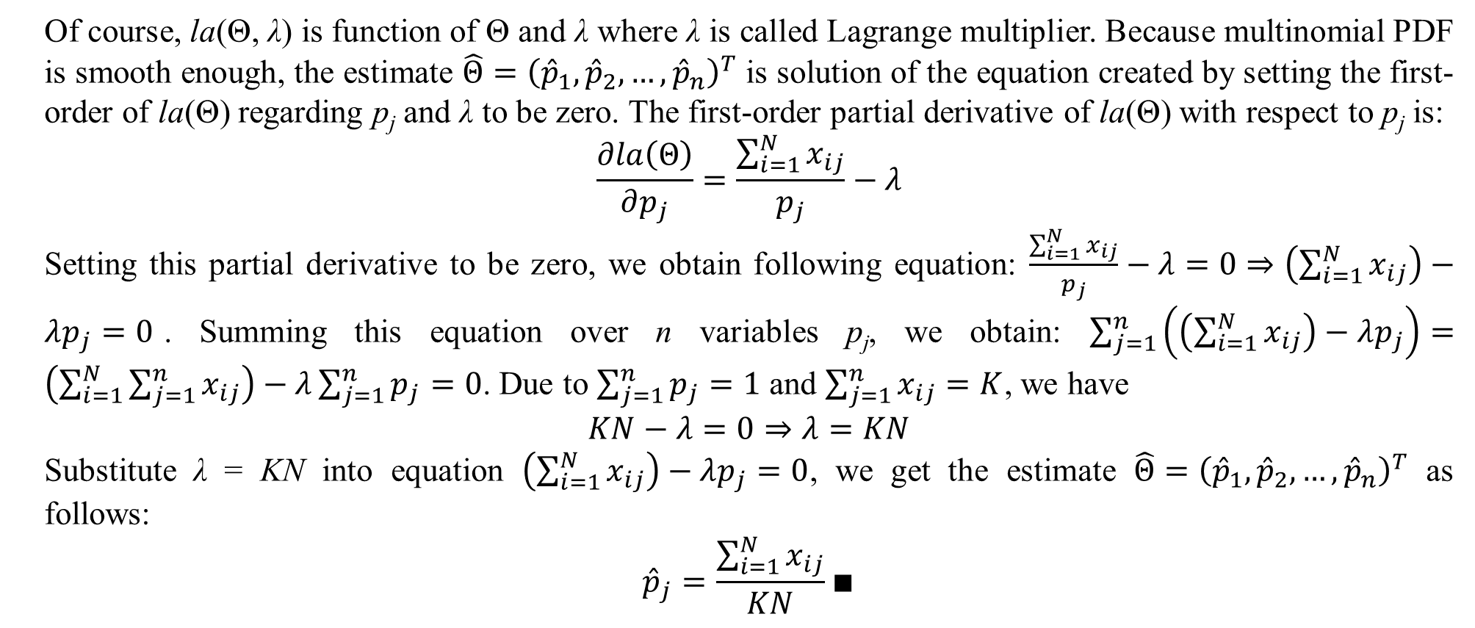
2. Parameter estimation
Of course, la(Θ, λ) is function of Θ and λ where λ is called Lagrange multiplier. Because multinomial PDF is smooth enough, the estimate $\hat{Θ}={\left({\hat{p}}_{1},{\hat{p}}_{2},…,{\hat{p}}_{n}\right)}^{T}$ is solution of the equation created by setting the first-order of la(Θ) regarding p_{j} and λ to be zero. The first-order partial derivative of la(Θ) with respect to p_{j} is:
$$\frac{∂la\left(Θ\right)}{∂p_{j}}=\frac{\sum_{i=1}^{N}{x_{ij}}}{p_{j}}−λ$$
Setting this partial derivative to be zero, we obtain following equation: $\frac{\sum_{i=1}^{N}{x_{ij}}}{p_{j}}−λ=0⇒\left(\sum_{i=1}^{N}{x_{ij}}\right)−λp_{j}=0$. Summing this equation over n variables p_{j}, we obtain: $\sum_{j=1}^{n}{\left(\left(\sum_{i=1}^{N}{x_{ij}}\right)−λp_{j}\right)}=\left(\sum_{i=1}^{N}{\sum_{j=1}^{n}{x_{ij}}}\right)−λ\sum_{j=1}^{n}{p_{j}}=0$. Due to $\sum_{j=1}^{n}{p_{j}}=1$ and $\sum_{j=1}^{n}{x_{ij}}=K$, we have
$$KN−λ=0⇒λ=KN$$
Substitute λ = KN into equation $\left(\sum_{i=1}^{N}{x_{ij}}\right)−λp_{j}=0$, we get the estimate $\hat{Θ}={\left({\hat{p}}_{1},{\hat{p}}_{2},…,{\hat{p}}_{n}\right)}^{T}$ as follows:
$${\hat{p}}_{j}=\frac{\sum_{i=1}^{N}{x_{ij}}}{KN}∎$$

Slide 43
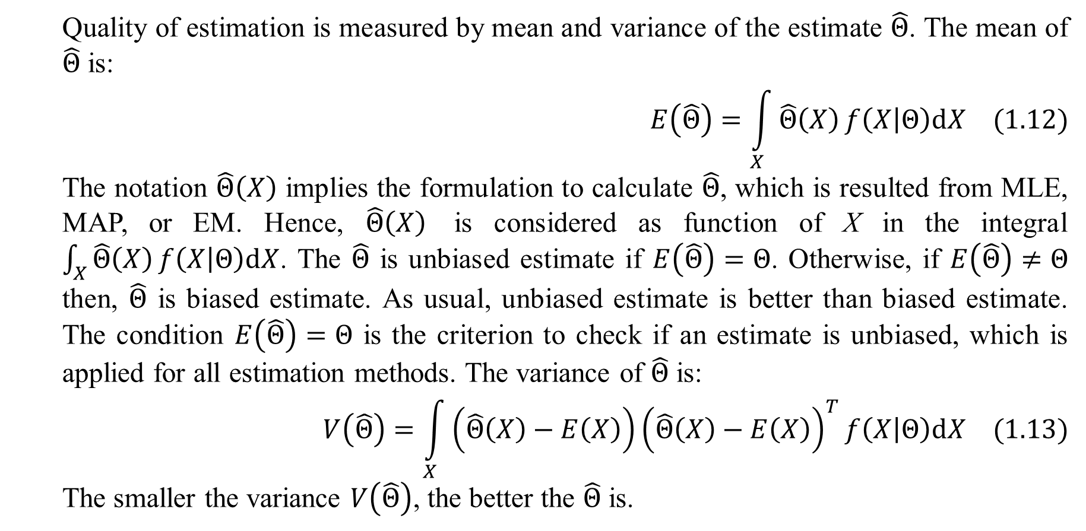
2. Parameter estimation
Quality of estimation is measured by mean and variance of the estimate $\hat{Θ}$. The mean of $\hat{Θ}$ is:
$$E\left(\hat{Θ}\right)=\int_{X}{\hat{Θ}\left(X\right)}f\left(X | Θ\right)dX (1.12)$$
The notation $\hat{Θ}\left(X\right)$ implies the formulation to calculate $\hat{Θ}$, which is resulted from MLE, MAP, or EM. Hence, $\hat{Θ}\left(X\right)$ is considered as function of X in the integral $\int_{X}{\hat{Θ}\left(X\right)}f\left(X | Θ\right)dX$. The $\hat{Θ}$ is unbiased estimate if $E\left(\hat{Θ}\right)=Θ$. Otherwise, if $E\left(\hat{Θ}\right)≠Θ$ then, $\hat{Θ}$ is biased estimate. As usual, unbiased estimate is better than biased estimate. The condition $E\left(\hat{Θ}\right)=Θ$ is the criterion to check if an estimate is unbiased, which is applied for all estimation methods. The variance of $\hat{Θ}$ is:
$$V\left(\hat{Θ}\right)=\int_{X}{\left(\hat{Θ}\left(X\right)−E\left(X\right)\right){\left(\hat{Θ}\left(X\right)−E\left(X\right)\right)}^{T}}f\left(X | Θ\right)dX (1.13)$$
The smaller the variance $V\left(\hat{Θ}\right)$, the better the $\hat{Θ}$ is.

Slide 44
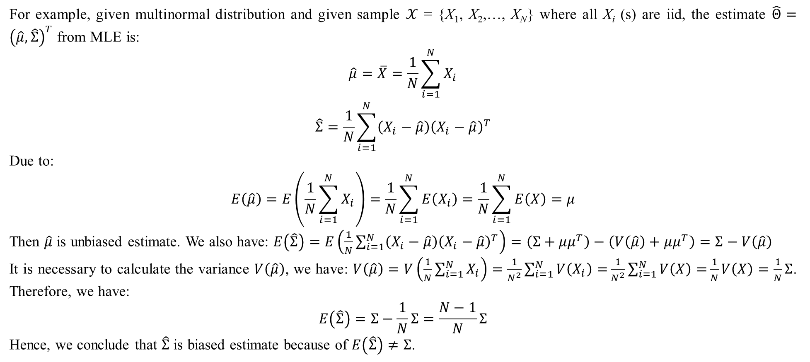
2. Parameter estimation
For example, given multinormal distribution and given sample $𝒳$ = {X₁, X₂,…, X_{N}} where all X_{i} (s) are iid, the estimate $\hat{Θ}={\left(\hat{μ},\hat{Σ}\right)}^{T}$ from MLE is:
$$\begin{matrix}\hat{μ}=\overline{X}=\frac{1}{N}\sum_{i=1}^{N}{X_{i}} \\ \hat{Σ}=\frac{1}{N}\sum_{i=1}^{N}{\left(X_{i}−\hat{μ}\right){\left(X_{i}−\hat{μ}\right)}^{T}}\end{matrix}$$
Due to:
$$E\left(\hat{μ}\right)=E\left(\frac{1}{N}\sum_{i=1}^{N}{X_{i}}\right)=\frac{1}{N}\sum_{i=1}^{N}{E\left(X_{i}\right)}=\frac{1}{N}\sum_{i=1}^{N}{E\left(X\right)}=μ$$
Then $\hat{μ}$ is unbiased estimate. We also have: $E\left(\hat{Σ}\right)=E\left(\frac{1}{N}\sum_{i=1}^{N}{\left(X_{i}−\hat{μ}\right){\left(X_{i}−\hat{μ}\right)}^{T}}\right)=\left(Σ+μμ^{T}\right)−\left(V\left(\hat{μ}\right)+μμ^{T}\right)=Σ−V\left(\hat{μ}\right)$
It is necessary to calculate the variance $V\left(\hat{μ}\right)$, we have: $V\left(\hat{μ}\right)=V\left(\frac{1}{N}\sum_{i=1}^{N}{X_{i}}\right)=\frac{1}{N^{2}}\sum_{i=1}^{N}{V\left(X_{i}\right)=}\frac{1}{N^{2}}\sum_{i=1}^{N}{V\left(X\right)=}\frac{1}{N}V\left(X\right)=\frac{1}{N}Σ$. Therefore, we have:
$$E\left(\hat{Σ}\right)=Σ−\frac{1}{N}Σ=\frac{N−1}{N}Σ$$
Hence, we conclude that $\hat{Σ}$ is biased estimate because of $E\left(\hat{Σ}\right)≠Σ$.

Slide 45
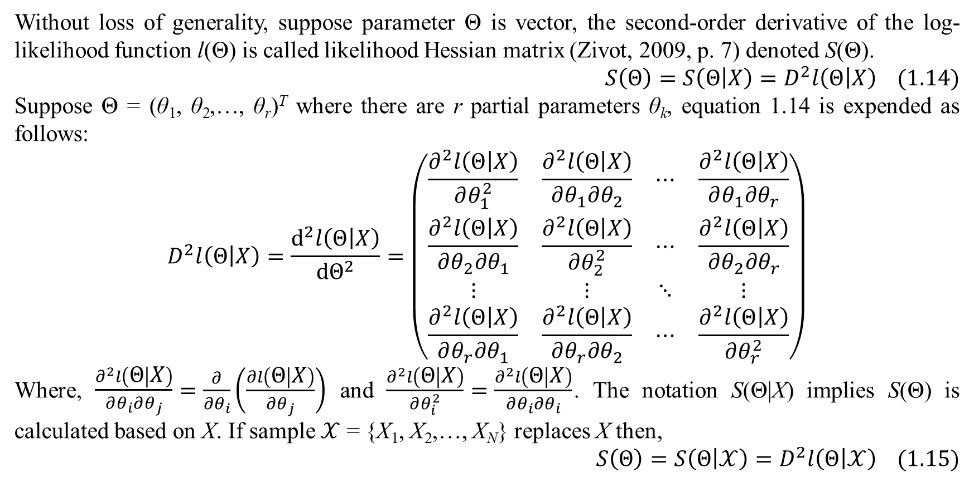
2. Parameter estimation
Without loss of generality, suppose parameter Θ is vector, the second-order derivative of the log-likelihood function l(Θ) is called likelihood Hessian matrix (Zivot, 2009, p. 7) denoted S(Θ).
$$S\left(Θ\right)=S\left(Θ | X\right)=D^{2}l\left(Θ | X\right) (1.14)$$
Suppose Θ = (θ₁, θ₂,…, θ_{r})^{T} where there are r partial parameters θ_{k}, equation 1.14 is expended as follows:
$$D^{2}l\left(Θ | X\right)=\frac{d^{2}l\left(Θ | X\right)}{dΘ^{2}}=\left(\begin{matrix}\frac{∂^{2}l\left(Θ | X\right)}{∂θ_{1}^{2}} & \frac{∂^{2}l\left(Θ | X\right)}{∂θ_{1}∂θ_{2}} & ⋯ & \frac{∂^{2}l\left(Θ | X\right)}{∂θ_{1}∂θ_{r}} \\ \frac{∂^{2}l\left(Θ | X\right)}{∂θ_{2}∂θ_{1}} & \frac{∂^{2}l\left(Θ | X\right)}{∂θ_{2}^{2}} & ⋯ & \frac{∂^{2}l\left(Θ | X\right)}{∂θ_{2}∂θ_{r}} \\ ⋮ & ⋮ & ⋱ & ⋮ \\ \frac{∂^{2}l\left(Θ | X\right)}{∂θ_{r}∂θ_{1}} & \frac{∂^{2}l\left(Θ | X\right)}{∂θ_{r}∂θ_{2}} & ⋯ & \frac{∂^{2}l\left(Θ | X\right)}{∂θ_{r}^{2}}\end{matrix}\right)$$
Where, $\begin{matrix}\frac{∂^{2}l\left(Θ | X\right)}{∂θ_{i}∂θ_{j}}\end{matrix}=\frac{∂}{∂θ_{i}}\left(\frac{∂l\left(Θ | X\right)}{∂θ_{j}}\right)$ and $\frac{∂^{2}l\left(Θ | X\right)}{∂θ_{i}^{2}}=\frac{∂^{2}l\left(Θ | X\right)}{∂θ_{i}∂θ_{i}}$. The notation S(Θ|X) implies S(Θ) is calculated based on X. If sample $𝒳$ = {X₁, X₂,…, X_{N}} replaces X then,
$$S\left(Θ\right)=S\left(Θ | 𝒳\right)=D^{2}l\left(Θ | 𝒳\right) (1.15)$$

Slide 46
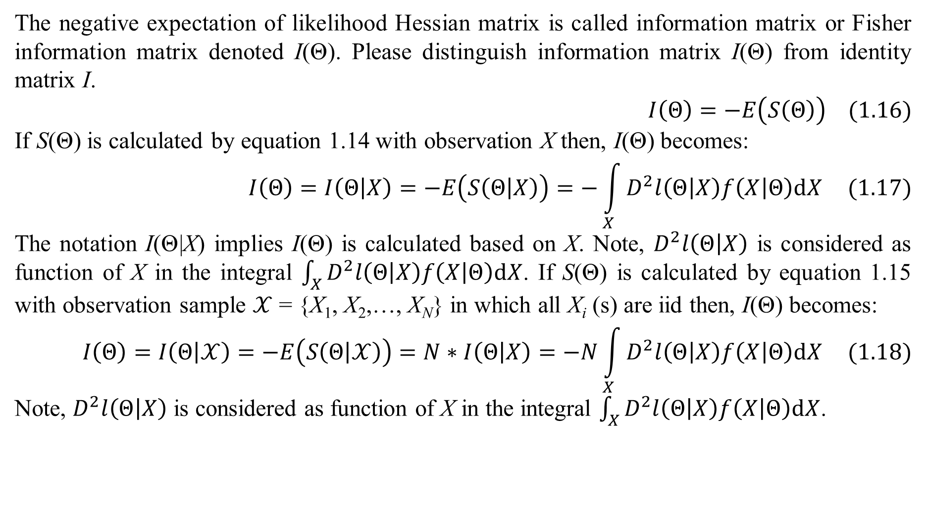
2. Parameter estimation
The negative expectation of likelihood Hessian matrix is called information matrix or Fisher information matrix denoted I(Θ). Please distinguish information matrix I(Θ) from identity matrix I.
$$I\left(Θ\right)=−E\left(S\left(Θ\right)\right) (1.16)$$
If S(Θ) is calculated by equation 1.14 with observation X then, I(Θ) becomes:
$$I\left(Θ\right)=I\left(Θ | X\right)=−E\left(S\left(Θ | X\right)\right)=−\int_{X}{D^{2}l\left(Θ | X\right)f\left(X | Θ\right)dX} (1.17)$$
The notation I(Θ|X) implies I(Θ) is calculated based on X. Note, $D^{2}l\left(Θ | X\right)$ is considered as function of X in the integral $\int_{X}{D^{2}l\left(Θ | X\right)f\left(X | Θ\right)dX}$. If S(Θ) is calculated by equation 1.15 with observation sample $𝒳$ = {X₁, X₂,…, X_{N}} in which all X_{i} (s) are iid then, I(Θ) becomes:
$$I\left(Θ\right)=I\left(Θ | 𝒳\right)=−E\left(S\left(Θ | 𝒳\right)\right)=N∗I\left(Θ | X\right)=−N\int_{X}{D^{2}l\left(Θ | X\right)f\left(X | Θ\right)dX} (1.18)$$
Note, $D^{2}l\left(Θ | X\right)$ is considered as function of X in the integral $\int_{X}{D^{2}l\left(Θ | X\right)f\left(X | Θ\right)dX}$.

Slide 47
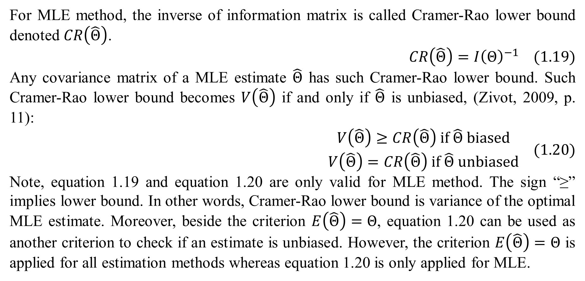
2. Parameter estimation
For MLE method, the inverse of information matrix is called Cramer-Rao lower bound denoted $CR\left(\hat{Θ}\right)$.
$$CR\left(\hat{Θ}\right)={I\left(Θ\right)}^{−1} (1.19)$$
Any covariance matrix of a MLE estimate $\hat{Θ}$ has such Cramer-Rao lower bound. Such Cramer-Rao lower bound becomes $V\left(\hat{Θ}\right)$ if and only if $\hat{Θ}$ is unbiased, (Zivot, 2009, p. 11):
$$\begin{matrix}V\left(\hat{Θ}\right)≥CR\left(\hat{Θ}\right) if \hat{Θ} biased \\ V\left(\hat{Θ}\right)=CR\left(\hat{Θ}\right) if \hat{Θ} unbiased\end{matrix} (1.20)$$
Note, equation 1.19 and equation 1.20 are only valid for MLE method. The sign “≥” implies lower bound. In other words, Cramer-Rao lower bound is variance of the optimal MLE estimate. Moreover, beside the criterion $E\left(\hat{Θ}\right)=Θ$, equation 1.20 can be used as another criterion to check if an estimate is unbiased. However, the criterion $E\left(\hat{Θ}\right)=Θ$ is applied for all estimation methods whereas equation 1.20 is only applied for MLE.

Slide 48
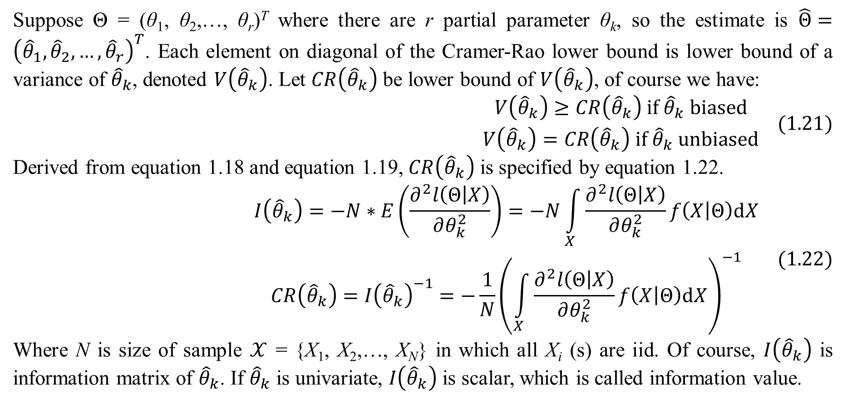
2. Parameter estimation
Suppose Θ = (θ₁, θ₂,…, θ_{r})^{T} where there are r partial parameter θ_{k}, so the estimate is $\hat{Θ}={\left({\hat{θ}}_{1},{\hat{θ}}_{2},…,{\hat{θ}}_{r}\right)}^{T}$. Each element on diagonal of the Cramer-Rao lower bound is lower bound of a variance of ${\hat{θ}}_{k}$, denoted $V\left({\hat{θ}}_{k}\right)$. Let $CR\left({\hat{θ}}_{k}\right)$ be lower bound of $V\left({\hat{θ}}_{k}\right)$, of course we have:
$$\begin{matrix}V\left({\hat{θ}}_{k}\right)≥CR\left({\hat{θ}}_{k}\right) if {\hat{θ}}_{k} biased \\ V\left({\hat{θ}}_{k}\right)=CR\left({\hat{θ}}_{k}\right) if {\hat{θ}}_{k} unbiased\end{matrix} (1.21)$$
Derived from equation 1.18 and equation 1.19, $CR\left({\hat{θ}}_{k}\right)$ is specified by equation 1.22.
$$\begin{matrix}I\left({\hat{θ}}_{k}\right)=−N∗E\left(\frac{∂^{2}l\left(Θ | X\right)}{∂θ_{k}^{2}}\right)=−N\int_{X}{\frac{∂^{2}l\left(Θ | X\right)}{∂θ_{k}^{2}}f\left(X | Θ\right)dX} \\ CR\left({\hat{θ}}_{k}\right)={I\left({\hat{θ}}_{k}\right)}^{−1}=−\frac{1}{N}{\left(\int_{X}{\frac{∂^{2}l\left(Θ | X\right)}{∂θ_{k}^{2}}f\left(X | Θ\right)dX}\right)}^{−1}\end{matrix} (1.22)$$
Where N is size of sample $𝒳$ = {X₁, X₂,…, X_{N}} in which all X_{i} (s) are iid. Of course, $I\left({\hat{θ}}_{k}\right)$ is information matrix of ${\hat{θ}}_{k}$. If ${\hat{θ}}_{k}$ is univariate, $I\left({\hat{θ}}_{k}\right)$ is scalar, which is called information value.

Slide 49
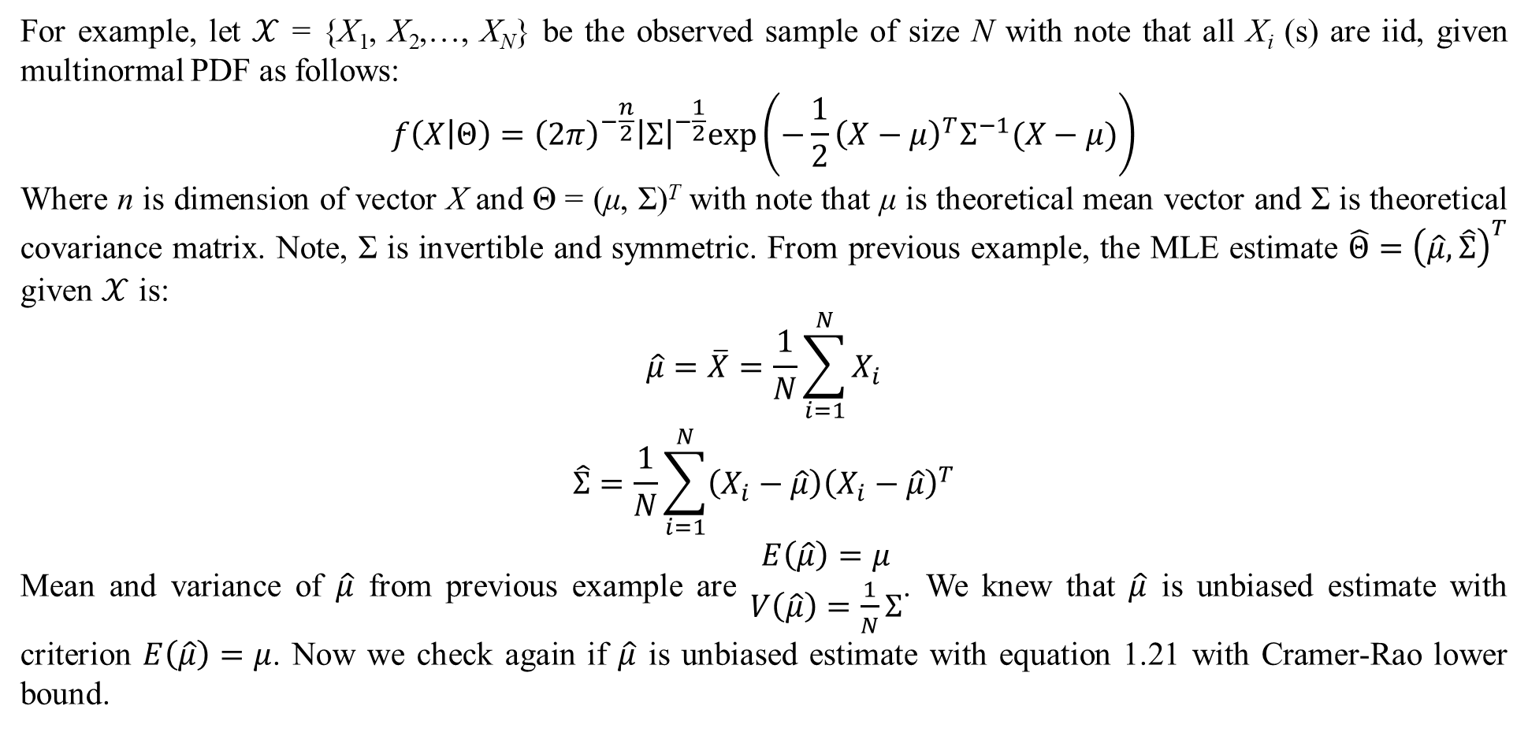
2. Parameter estimation
For example, let $𝒳$ = {X₁, X₂,…, X_{N}} be the observed sample of size N with note that all X_{i} (s) are iid, given multinormal PDF as follows:
$$f\left(X | Θ\right)={\left(2π\right)}^{−\frac{n}{2}}{\left|Σ\right|}^{−\frac{1}{2}}exp\left(−\frac{1}{2}{\left(X−μ\right)}^{T}Σ^{−1}(X−μ)\right)$$
Where n is dimension of vector X and Θ = (μ, Σ)^{T} with note that μ is theoretical mean vector and Σ is theoretical covariance matrix. Note, Σ is invertible and symmetric. From previous example, the MLE estimate $\hat{Θ}={\left(\hat{μ},\hat{Σ}\right)}^{T}$ given $𝒳$ is:
$$\begin{matrix}\hat{μ}=\overline{X}=\frac{1}{N}\sum_{i=1}^{N}{X_{i}} \\ \hat{Σ}=\frac{1}{N}\sum_{i=1}^{N}{\left(X_{i}−\hat{μ}\right){\left(X_{i}−\hat{μ}\right)}^{T}}\end{matrix}$$
Mean and variance of $\hat{μ}$ from previous example are $\begin{matrix}E\left(\hat{μ}\right)=μ \\ V\left(\hat{μ}\right)=\frac{1}{N}Σ\end{matrix}$. We knew that $\hat{μ}$ is unbiased estimate with criterion $E\left(\hat{μ}\right)=μ$. Now we check again if $\hat{μ}$ is unbiased estimate with equation 1.21 with Cramer-Rao lower bound.

Slide 50
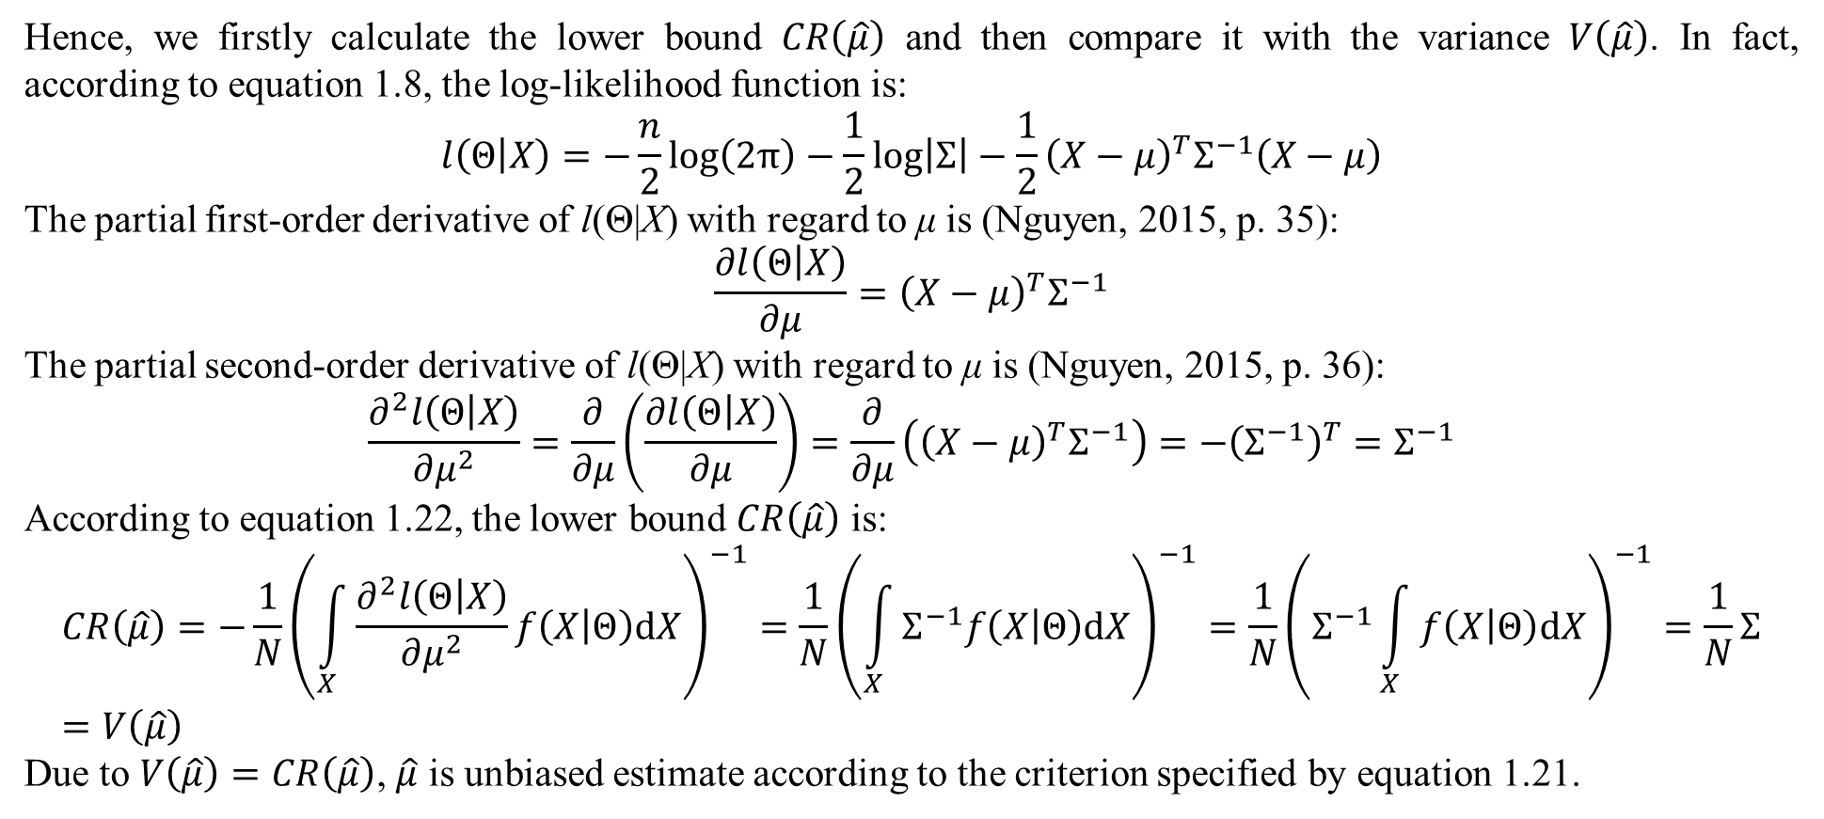
2. Parameter estimation
Hence, we firstly calculate the lower bound $CR\left(\hat{μ}\right)$ and then compare it with the variance $V\left(\hat{μ}\right)$. In fact, according to equation 1.8, the log-likelihood function is:
$$l\left(Θ | X\right)=−\frac{n}{2}log\left(2π\right)−\frac{1}{2}log\left|Σ\right|−\frac{1}{2}{\left(X−μ\right)}^{T}Σ^{−1}\left(X−μ\right)$$
The partial first-order derivative of l(Θ|X) with regard to μ is (Nguyen, 2015, p. 35):
$$\frac{∂l\left(Θ | X\right)}{∂μ}={\left(X−μ\right)}^{T}Σ^{−1}$$
The partial second-order derivative of l(Θ|X) with regard to μ is (Nguyen, 2015, p. 36):
$$\frac{∂^{2}l\left(Θ | X\right)}{∂μ^{2}}=\frac{∂}{∂μ}\left(\frac{∂l\left(Θ | X\right)}{∂μ}\right)=\frac{∂}{∂μ}\left({\left(X−μ\right)}^{T}Σ^{−1}\right)=−{\left(Σ^{−1}\right)}^{T}=Σ^{−1}$$
According to equation 1.22, the lower bound $CR\left(\hat{μ}\right)$ is:
$$CR\left(\hat{μ}\right)=−\frac{1}{N}{\left(\int_{X}{\frac{∂^{2}l\left(Θ | X\right)}{∂μ^{2}}f\left(X | Θ\right)dX}\right)}^{−1}=\frac{1}{N}{\left(\int_{X}{Σ^{−1}f\left(X | Θ\right)dX}\right)}^{−1}=\frac{1}{N}{\left(Σ^{−1}\int_{X}{f\left(X | Θ\right)dX}\right)}^{−1}=\frac{1}{N}Σ=V\left(\hat{μ}\right)$$
Due to $V\left(\hat{μ}\right)=CR\left(\hat{μ}\right)$, $\hat{μ}$ is unbiased estimate according to the criterion specified by equation 1.21.

Slide 51
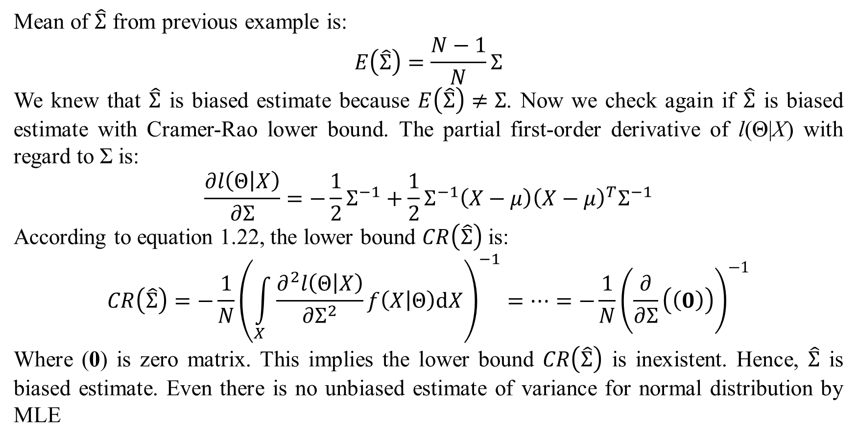
2. Parameter estimation
Mean of $\hat{Σ}$ from previous example is:
$$E\left(\hat{Σ}\right)=\frac{N−1}{N}Σ$$
We knew that $\hat{Σ}$ is biased estimate because $E\left(\hat{Σ}\right)≠Σ$. Now we check again if $\hat{Σ}$ is biased estimate with Cramer-Rao lower bound. The partial first-order derivative of l(Θ|X) with regard to Σ is:
$$\frac{∂l\left(Θ | X\right)}{∂Σ}=−\frac{1}{2}Σ^{−1}+\frac{1}{2}Σ^{−1}\left(X−μ\right){\left(X−μ\right)}^{T}Σ^{−1}$$
According to equation 1.22, the lower bound $CR\left(\hat{Σ}\right)$ is:
$$CR\left(\hat{Σ}\right)=−\frac{1}{N}{\left(\int_{X}{\frac{∂^{2}l\left(Θ | X\right)}{∂Σ^{2}}f\left(X | Θ\right)dX}\right)}^{−1}=…=−\frac{1}{N}{\left(\frac{∂}{∂Σ}\left(\left(0\right)\right)\right)}^{−1}$$
Where (0) is zero matrix. This implies the lower bound $CR\left(\hat{Σ}\right)$ is inexistent. Hence, $\hat{Σ}$ is biased estimate. Even there is no unbiased estimate of variance for normal distribution by MLE

Slide 52
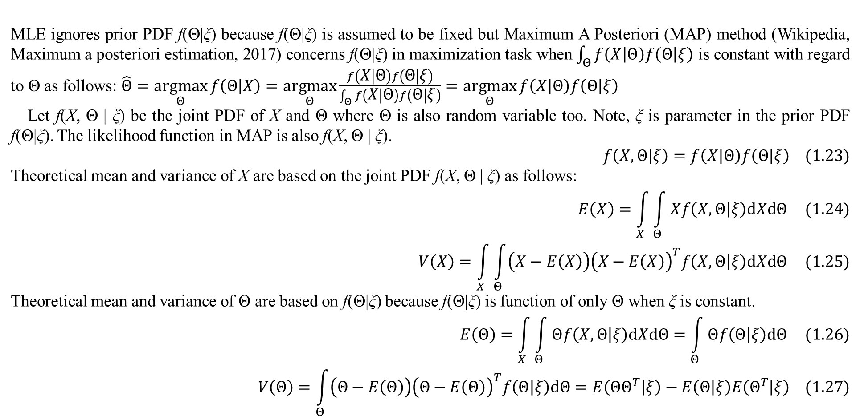
2. Parameter estimation
MLE ignores prior PDF f(Θ|ξ) because f(Θ|ξ) is assumed to be fixed but Maximum A Posteriori (MAP) method (Wikipedia, Maximum a posteriori estimation, 2017) concerns f(Θ|ξ) in maximization task when $\int_{Θ}{f\left(X | Θ\right)f\left(Θ | ξ\right)}$ is constant with regard to Θ as follows: $\hat{Θ}=\underset{Θ}{argmax}{f\left(Θ | X\right)}=\underset{Θ}{argmax}{\frac{f\left(X | Θ\right)f\left(Θ | ξ\right)}{\int_{Θ}{f\left(X | Θ\right)f\left(Θ | ξ\right)}}}=\underset{Θ}{argmax}{f\left(X | Θ\right)f\left(Θ | ξ\right)}$
Let f(X, Θ | ξ) be the joint PDF of X and Θ where Θ is also random variable too. Note, ξ is parameter in the prior PDF f(Θ|ξ). The likelihood function in MAP is also f(X, Θ | ξ).
$$f\left(X,Θ | ξ\right)=f\left(X | Θ\right)f\left(Θ | ξ\right) (1.23)$$
Theoretical mean and variance of X are based on the joint PDF f(X, Θ | ξ) as follows:
$$E\left(X\right)=\int_{X}{\int_{Θ}{Xf\left(X,Θ | ξ\right)dXdΘ}} (1.24)$$
$$V\left(X\right)=\int_{X}{\int_{Θ}{\left(X−E\left(X\right)\right){\left(X−E\left(X\right)\right)}^{T}f\left(X,Θ | ξ\right)dXdΘ}} (1.25)$$
Theoretical mean and variance of Θ are based on f(Θ|ξ) because f(Θ|ξ) is function of only Θ when ξ is constant.
$$E\left(Θ\right)=\int_{X}{\int_{Θ}{Θf\left(X,Θ | ξ\right)dXdΘ}}=\int_{Θ}{Θf\left(Θ | ξ\right)dΘ} (1.26)$$
$$V\left(Θ\right)=\int_{Θ}{\left(Θ−E\left(Θ\right)\right){\left(Θ−E\left(Θ\right)\right)}^{T}f\left(Θ | ξ\right)dΘ}=E\left(ΘΘ^{T} | ξ\right)−E\left(Θ | ξ\right)E\left(Θ^{T} | ξ\right) (1.27)$$

Slide 53
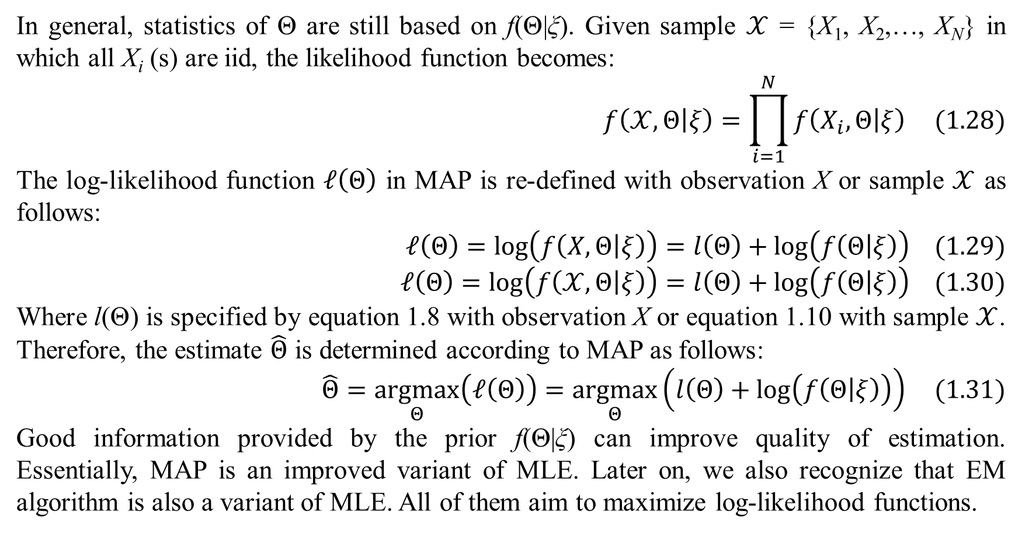
2. Parameter estimation
In general, statistics of Θ are still based on f(Θ|ξ). Given sample $𝒳$ = {X₁, X₂,…, X_{N}} in which all X_{i} (s) are iid, the likelihood function becomes:
$$f\left(𝒳,Θ | ξ\right)=\prod_{i=1}^{N}{f\left(X_{i},Θ | ξ\right)} (1.28)$$
The log-likelihood function $𝓁\left(Θ\right)$ in MAP is re-defined with observation X or sample $𝒳$ as follows:
$$𝓁\left(Θ\right)=log\left(f\left(X,Θ | ξ\right)\right)=l\left(Θ\right)+log\left(f\left(Θ | ξ\right)\right) (1.29)$$
$$𝓁\left(Θ\right)=log\left(f\left(𝒳,Θ | ξ\right)\right)=l\left(Θ\right)+log\left(f\left(Θ | ξ\right)\right) (1.30)$$
Where l(Θ) is specified by equation 1.8 with observation X or equation 1.10 with sample $𝒳$. Therefore, the estimate $\hat{Θ}$ is determined according to MAP as follows:
$$\hat{Θ}=\underset{Θ}{argmax}\left(𝓁\left(Θ\right)\right)=\underset{Θ}{argmax}\left(l\left(Θ\right)+log\left(f\left(Θ | ξ\right)\right)\right) (1.31)$$
Good information provided by the prior f(Θ|ξ) can improve quality of estimation. Essentially, MAP is an improved variant of MLE. Later on, we also recognize that EM algorithm is also a variant of MLE. All of them aim to maximize log-likelihood functions.

Slide 54

2. Parameter estimation
Likelihood Hessian matrix $S\left(\hat{Θ}\right)$, information matrix $I\left(\hat{Θ}\right)$, and Cramer-Rao lower bound $CR\left(\hat{Θ}\right)$, $CR\left({\hat{θ}}_{k}\right)$ are extended in MAP with the new likelihood function $𝓁\left(Θ\right)$.
$$S\left(Θ\right)=D^{2}𝓁\left(Θ\right),I\left(Θ\right)=−E\left(S\left(Θ\right)\right),CR\left(\hat{Θ}\right)={I\left(Θ\right)}^{−1}$$
$$I\left({\hat{θ}}_{k}\right)=−N∗E\left(\frac{∂^{2}𝓁\left(Θ\right)}{∂θ_{k}^{2}}\right)=−N\int_{X}{\int_{Θ}{\frac{∂^{2}𝓁\left(Θ\right)}{∂θ_{k}^{2}}f\left(X,Θ | ξ\right)dXdΘ}}$$
$$CR\left({\hat{θ}}_{k}\right)={I\left({\hat{θ}}_{k}\right)}^{−1}$$
Where N is size of sample $𝒳$ = {X₁, X₂,…, X_{N}} in which all X_{i} (s) are iid. Mean and variance of the estimate $\hat{Θ}$ which are used to measure estimation quality are not changed except that the joint PDF f(X, Θ | ξ) is used instead.
$$E\left(\hat{Θ}\right)=\int_{X}{\int_{Θ}{\hat{Θ}\left(X,Θ\right)f\left(X,Θ | ξ\right)dXdΘ}} (1.32)$$
$$V\left(\hat{Θ}\right)=\int_{X}{\int_{Θ}{\left(\hat{Θ}\left(X,Θ\right)−E\left(X\right)\right){\left(\hat{Θ}\left(X,Θ\right)−E\left(X\right)\right)}^{T}f\left(X,Θ | ξ\right)dXdΘ}} (1.33)$$
As extension for MAP, recall that there are two criteria to check if $\hat{Θ}$ is unbiased estimate, as follows:
$$\begin{matrix}E\left(\hat{Θ}\right)=Θ \\ V\left(\hat{Θ}\right)=CR\left(\hat{Θ}\right)\end{matrix}$$

Slide 55

2. Parameter estimation
It is necessary to have an example for parameter estimation with MAP. Given sample $𝒳$ = {X₁, X₂,…, X_{N}} in which all X_{i} (s) are iid. Each n-dimension X_{i} has following multinormal PDF:
$$f\left(X_{i} | Θ\right)={\left(2π\right)}^{−\frac{n}{2}}{\left|Σ\right|}^{−\frac{1}{2}}exp\left(−\frac{1}{2}{\left(X_{i}−μ\right)}^{T}Σ^{−1}(X_{i}−μ)\right)$$
Where μ and Σ are mean vector and covariance matrix of f(X | Θ), respectively with note that Θ = (μ, Σ)^{T}. In Θ = (μ, Σ)^{T}, suppose only μ distributes normally with parameter ξ = (μ₀, Σ₀) where μ₀ and Σ₀ are theoretical mean and covariance matrix of μ. Thus, Σ is variable but not random variable. The second-level parameter ξ is constant. The prior PDF f(Θ|ξ) becomes f(μ|ξ), which specified as follows:
$$f\left(Θ | ξ\right)=f\left(μ | μ_{0},Σ_{0}\right)={\left(2π\right)}^{−\frac{n}{2}}{\left|Σ_{0}\right|}^{−\frac{1}{2}}exp\left(−\frac{1}{2}{\left(μ−μ_{0}\right)}^{T}Σ_{0}^{−1}(μ−μ_{0})\right)$$
Note, μ₀ is n-element vector like μ and Σ₀ is n_{x}n matrix like Σ. Of course, Σ₀ is also invertible and symmetric. Theoretical mean and theoretical variance of X are:
$$E\left(X\right)=\int_{X}{\int_{Θ}{Xf\left(X,Θ | ξ\right)dXdΘ}}=…=\int_{μ}{μf\left(μ | μ_{0},Σ_{0}\right)dμ}=E\left(μ\right)=μ_{0}$$
$$V\left(X\right)=\int_{X}{\int_{Θ}{\left(X−E\left(X\right)\right){\left(X−E\left(X\right)\right)}^{T}f\left(X,Θ | ξ\right)dXdΘ}}=…=\int_{μ}{Σf\left(μ | μ_{0},Σ_{0}\right)dμ}=Σ$$

Slide 56

2. Parameter estimation
The log-likelihood function in MAP is
$$𝓁\left(Θ\right)=log\left(f\left(μ | ξ\right)\right)+l\left(Θ\right)=log\left(f\left(μ | ξ\right)\right)+\sum_{i=1}^{N}{log\left(f\left(X_{i} | Θ\right)\right)}=−\frac{n}{2}log\left(2π\right)−\frac{1}{2}log\left|Σ_{0}\right|−\frac{1}{2}{\left(μ−μ_{0}\right)}^{T}Σ_{0}^{−1}(μ−μ_{0})+\sum_{i=1}^{N}{\left(−\frac{n}{2}log\left(2π\right)−\frac{1}{2}log\left|Σ\right|−\frac{1}{2}{\left(X−μ\right)}^{T}Σ^{−1}\left(X−μ\right)\right)}$$
Because normal PDF is smooth enough, from equation 1.24, the estimate $\hat{Θ}={\left(\hat{μ},\hat{Σ}\right)}^{T}$ is solution of the equation created by setting the first-order of $𝓁$(Θ) regarding μ and Σ to be zero. The first-order partial derivative of $𝓁$(Θ) with respect to μ is:
$$\frac{∂𝓁\left(Θ\right)}{∂μ}=−μ^{T}\left(Σ_{0}^{−1}+NΣ^{−1}\right)+μ_{0}^{T}Σ_{0}^{−1}+\left(\sum_{i=1}^{N}{X_{i}^{T}}\right)Σ^{−1}$$
Setting this partial derivative to be zero, we obtain:
$$μ={\left(ΣΣ_{0}^{−1}+NI\right)}^{−1}\left(ΣΣ_{0}^{−1}μ_{0}+N\overline{X}\right)$$
Where I is identity matrix and $\overline{X}=\frac{1}{N}\sum_{i=1}^{N}{X_{i}}$

Slide 57

2. Parameter estimation
The first-order partial derivative of l(Θ) with respect to Σ is:
$$\frac{∂𝓁\left(Θ\right)}{∂Σ}=\sum_{i=1}^{N}{\left(−\frac{1}{2}Σ^{−1}+\frac{1}{2}Σ^{−1}\left(X_{i}−μ\right){\left(X_{i}−μ\right)}^{T}Σ^{−1}\right)}$$
Setting this partial derivative to be zero, we obtain:
$$Σ=\left(\frac{1}{N}\sum_{i=1}^{N}{X_{i}X_{i}^{T}}\right)−\frac{2}{N}μ\sum_{i=1}^{N}{X_{i}^{T}}+μμ^{T}=\left(\frac{1}{N}\sum_{i=1}^{N}{X_{i}X_{i}^{T}}\right)−2μ\overline{X}+μμ^{T}$$
Because Σ is independent from the prior PDF f(μ | μ₀, Σ₀), it is estimated by MLE as usual,
$$\hat{Σ}=\left(\frac{1}{N}\sum_{i=1}^{N}{X_{i}X_{i}^{T}}\right)−\overline{X}{\overline{X}}^{T}$$
The estimate $\hat{Σ}$ in MAP here is as same as the one in MLE and so, it is biased. Substituting $\hat{Σ}$ for Σ, we obtain the estimate $\hat{μ}$ in MAP:
$$\hat{μ}={\left(\hat{Σ}Σ_{0}^{−1}+NI\right)}^{−1}\left(\hat{Σ}Σ_{0}^{−1}μ_{0}+N\overline{X}\right)$$
Note, $E\left(\overline{X}\right)=μ_{0}$ and $V\left(\overline{X}\right)=\frac{1}{N}Σ$.

Slide 58

2. Parameter estimation
Now we check if $\hat{μ}$ is unbiased estimate. In fact, we have:
$$E\left(\hat{μ}\right)=E\left({\left(\hat{Σ}Σ_{0}^{−1}+NI\right)}^{−1}\left(\hat{Σ}Σ_{0}^{−1}μ_{0}+N\overline{X}\right)\right)=…=μ_{0}$$
Therefore, the estimate $\hat{μ}$ is biased because the variable μ is not always to equal μ₀. Now we try to check again if $\hat{μ}$ is unbiased estimate with Cramer-Rao lower bound. The second-order partial derivative of $𝓁\left(Θ\right)$ regarding μ is: $\frac{∂^{2}𝓁\left(Θ\right)}{∂μ^{2}}=\frac{∂}{∂μ}\left(\frac{∂𝓁\left(Θ\right)}{∂μ}\right)=…=−\left(Σ_{0}^{−1}+NΣ^{−1}\right)$. Cramer-Rao lower bound of $\hat{μ}$ is:
$$CR\left(\hat{μ}\right)=−\frac{1}{N}{\left(\int_{X}{\int_{Θ}{\frac{∂^{2}𝓁\left(Θ\right)}{∂μ^{2}}f\left(X,Θ | ξ\right)dXdΘ}}\right)}^{−1}=…=\frac{1}{N}{\left(Σ_{0}^{−1}+NΣ^{−1}\right)}^{−1}$$
Suppose we fix Σ so that $\hat{Σ}=Σ_{0}=Σ$, variance of $\hat{μ}$ is calculated as follows:
$$V\left(\hat{μ}\right)=V\left({\left(ΣΣ_{0}^{−1}+NI\right)}^{−1}\left(ΣΣ_{0}^{−1}μ_{0}+N\overline{X}\right)\right)=…=\frac{N}{{\left(N+1\right)}^{2}}Σ$$
By fixing $\hat{Σ}=Σ_{0}=Σ,$the Cramer-Rao lower bound of $\hat{μ}$ is re-written as follows: $CR\left(\hat{μ}\right)=\frac{1}{N}{\left(Σ_{0}^{−1}+NΣ^{−1}\right)}^{−1}=\frac{1}{N\left(N+1\right)}Σ$.
Obviously, $\hat{μ}$ is biased estimate due to $V\left(\hat{μ}\right)≠CR\left(\hat{μ}\right)$. In general, the estimate $\hat{Θ}$ in MAP is affected by the prior PDF f(Θ|ξ). Even though it is biased, it can be better than the one resulted from MLE because of valuable information in f(Θ|ξ). For instance, if fixing Σ, the variance of $\hat{μ}$ from MAP $\left(\frac{N}{{\left(N+1\right)}^{2}}Σ\right)$ is “smaller” (lower bounded) than the one from MLE $\left(\frac{1}{N}Σ\right)$.

Slide 59

3. EM algorithm
Now we skim through an introduction of EM algorithm. Suppose there are two spaces X and Y, in which X is hidden space whereas Y is observed space. We do not know X but there is a mapping from X to Y so that we can survey X by observing Y. The mapping is many-one function φ: X → Y and we denote φ^{–1}(Y) = {$X∈X$: φ(X) = Y} as all $X∈X$ such that φ(X) = Y. We also denote X(Y) = φ^{–1}(Y). Let f(X | Θ) be the PDF of random variable $X∈X$ and let g(Y | Θ) be the PDF of random variable $Y∈Y$. Note, Y is also called observation. Equation 1.34 specifies g(Y | Θ) as integral of f(X | Θ) over φ^{–1}(Y).
$$g\left(Y | Θ\right)=\int_{φ^{−1}\left(Y\right)}{f\left(X | Θ\right)dX} (1.34)$$
Where Θ is probabilistic parameter represented as a column vector, Θ = (θ₁, θ₂,…, θ_{r})^{T} in which each θ_{i} is a particular parameter. If X and Y are discrete, equation 1.34 is re-written as follows:
$$g\left(Y | Θ\right)=\sum_{X∈φ^{−1}\left(Y\right)}{f\left(X | Θ\right)}$$
According to viewpoint of Bayesian statistics, Θ is also random variable. As a convention, let Ω be the domain of Θ such that $Θ∈Ω$ and the dimension of Ω is r. For example, normal distribution has two particular parameters such as mean μ and variance σ² and so we have Θ = (μ, σ²)^{T}. Note that, Θ can degrades into a scalar as Θ = θ.

Slide 60

3. EM algorithm
The conditional PDF of X given Y, denoted k(X | Y, Θ), is specified by equation 1.35.
$$k\left(X | Y,Θ\right)=\frac{f\left(X | Θ\right)}{g\left(Y | Θ\right)} (1.35)$$
According to DLR (Dempster, Laird, & Rubin, 1977, p. 1), X is called complete data and the term “incomplete data” implies existence of X and Y where X is not observed directly and X is only known by the many-one mapping φ: X → Y. In general, we only know Y, f(X | Θ), and k(X | Y, Θ) and so our purpose is to estimate Θ based on such Y, f(X | Θ), and k(X | Y, Θ). Like MLE approach, EM algorithm also maximizes the likelihood function to estimate Θ but the likelihood function in EM concerns Y and there are also some different aspects in EM which will be described later. Pioneers in EM algorithm firstly assumed that f(X | Θ) belongs to exponential family with note that many popular distributions such as normal, multinomial, and Poisson belong to exponential family. Although DLR (Dempster, Laird, & Rubin, 1977) proposed a generality of EM algorithm in which f(X | Θ) distributes arbitrarily, we should concern exponential family a little bit. Exponential family (Wikipedia, Exponential family, 2016) refers to a set of probabilistic distributions whose PDF (s) have the same exponential form according to equation 1.36 (Dempster, Laird, & Rubin, 1977, p. 3):
$$f\left(X | Θ\right)=b\left(X\right){exp\left(Θ^{T}τ\left(X\right)\right)}/{a\left(Θ\right)} (1.36)$$

Slide 61

3. EM algorithm
$$f\left(X | Θ\right)=b\left(X\right){exp\left(Θ^{T}τ\left(X\right)\right)}/{a\left(Θ\right)} (1.36)$$
Where b(X) is a function of X, which is called base measure and τ(X) is a vector function of X, which is sufficient statistic. For example, the sufficient statistic of normal distribution is τ(X) = (X, XX^{T})^{T}. Equation 1.36 expresses the canonical form of exponential family. Recall that Ω is the domain of Θ such that $Θ∈Ω$. Suppose that Ω is a convex set. If Θ is restricted only to Ω then, f(X | Θ) specifies a regular exponential family. If Θ lies in a curved sub-manifold Ω₀ of Ω then, f(X | Θ) specifies a curved exponential family. The a(Θ) is partition function for variable X, which is used for normalization.
$$a\left(Θ\right)=\int_{X}{b\left(X\right)exp\left(Θ^{T}τ\left(X\right)\right)dX}$$
As usual, a PDF is known as a popular form but its exponential family form (canonical form of exponential family) specified by equation 1.36 looks unlike popular form although they are the same. Therefore, parameter in popular form is different from parameter in exponential family form.

Slide 62

3. EM algorithm
For example, multinormal distribution with theoretical mean μ and covariance matrix Σ of random variable X = (x₁, x₂,…, x_{n})^{T} has PDF in popular form as follows:
$$f\left(X | μ,Σ\right)={\left(2π\right)}^{−\frac{n}{2}}{\left|Σ\right|}^{−\frac{1}{2}}∗exp\left(−\frac{1}{2}{\left(X−μ\right)}^{T}Σ^{−1}(X−μ)\right)$$
Hence, parameter in popular form is Θ = (μ, Σ)^{T}. Exponential family form of such PDF is:
$$f\left(X | θ_{1},θ_{2}\right)={\left(2π\right)}^{−\frac{n}{2}}∗{exp\left(\left(θ_{1},θ_{2}\right)\left(\begin{matrix}X \\ XX^{T}\end{matrix}\right)\right)}/{exp\left(−\frac{1}{4}θ_{1}^{T}θ_{2}^{−1}θ_{1}−\frac{1}{2}log\left|−2θ_{2}\right|\right)}$$
Where,
$$Θ=\left(\begin{matrix}θ_{1} \\ θ_{2}\end{matrix}\right),θ_{1}=Σ^{−1}μ,θ_{2}=−\frac{1}{2}Σ^{−1}$$
$$b\left(X\right)={\left(2π\right)}^{−\frac{n}{2}},τ\left(X\right)=\left(\begin{matrix}X \\ XX^{T}\end{matrix}\right)$$
$$a\left(Θ\right)=exp\left(−\frac{1}{4}θ_{1}^{T}θ_{2}^{−1}θ_{1}−\frac{1}{2}log\left|−2θ_{2}\right|\right)$$
Hence, parameter in exponential family form is Θ = (θ₁, θ₂)^{T}. Although, f(X | θ₁, θ₂) looks unlike f(X | μ, Σ) but they are the same, f(X | θ₁, θ₂) = f(X | μ, Σ).

Slide 63

3. EM algorithm
The exponential family form is used to represents all distributions belonging to exponential family as canonical form. Parameter in exponential family form is called exponential family parameter. As a convention, parameter Θ mentioned in EM algorithm is often exponential family parameter if PDF belongs to exponential family and there is no additional information. Table 1.1 shows some popular distributions belonging to exponential family along with their canonical forms (Wikipedia, Exponential family, 2016). In case of multivariate distributions, dimension of random variable X = (x₁, x₂,…, x_{n})^{T} is n.

Slide 64

3. EM algorithm
It is necessary to survey some features of exponential family. The first-order derivative of log(a(Θ)) is expectation of transposed τ(X).
$$\log^{′}\left(a\left(Θ\right)\right)=\frac{dlog\left(a\left(Θ\right)\right)}{dΘ}=\int_{X}{{\left(τ\left(X\right)\right)}^{T}b\left(X\right){exp\left(Θ^{T}τ\left(X\right)\right)}/{a\left(Θ\right)}dX}={\left(E\left(τ\left(X\right) | Θ\right)\right)}^{T}$$
The second-order derivative of log(a(Θ)) is (Jebara, 2015):
$$\log^{′′}\left(a\left(Θ\right)\right)=V\left(τ\left(X\right) | Θ\right)=\int_{X}{\left(τ\left(X\right)−E\left(τ\left(X\right) | Θ\right)\right){\left(τ\left(X\right)−E\left(τ\left(X\right) | Θ\right)\right)}^{T}f\left(X | Θ\right)dX}$$
Where V(τ(X) | Θ) is central covariance matrix of τ(X). If f(X | Θ) follows exponential family then, k(X | Y, Θ) also follows exponential family: $k\left(X | Y,Θ\right)=b\left(X\right){exp\left(Θ^{T}τ\left(X\right)\right)}/{a\left(Θ | Y\right)}$. Note, a(Θ | Y) is the observed partition function for observation Y.
$$a\left(Θ | Y\right)=\int_{φ^{−1}\left(Y\right)}{b\left(X\right)exp\left(Θ^{T}τ\left(X\right)\right)dX}$$
Similarly, we obtain that the first-order derivative of log(a(θ | Y)) is expectation of transposed τ(X) based on Y.
$$\log^{′}\left(a\left(Θ | Y\right)\right)={\left(E\left(τ\left(X\right) | Y,Θ\right)\right)}^{T}$$
The second-order derivative of log(a(Θ) | Y) is:
$$\log^{′′}\left(a\left(Θ | Y\right)\right)=V\left(τ\left(X\right) | Y,Θ\right)=\int_{φ^{−1}\left(Y\right)}{\left(τ\left(X\right)−E\left(τ\left(X\right) | Y,Θ\right)\right){\left(τ\left(X\right)−E\left(τ\left(X\right) | Y,Θ\right)\right)}^{T}k\left(X | Y,Θ\right)dX}$$
Where V(τ(X) | Y, Θ) is central covariance matrix of τ(X) given observed Y.

Slide 65

3. EM algorithm
Table 1.2 is summary of f(X | Θ), g(Y | Θ), k(X | Y, Θ), a(Θ), log’(a(Θ)), log’’(a(Θ)), a(Θ | Y), log’(a(Θ | Y)), and log’’(a(Θ | Y)) with exponential family.
Simply, EM algorithm is iterative process including many iterations, in which each iteration has expectation step (E-step) and maximization step (M-step). E-step aims to estimate sufficient statistic given current parameter and observed data Y whereas M-step aims to re-estimate the parameter based on such sufficient statistic by maximizing likelihood function of X related to Y. EM algorithm is described in the next section in detail. As an introduction, DLR gave an example for illustrating EM algorithm (Dempster, Laird, & Rubin, 1977, pp. 2-3).

Slide 66

3. EM algorithm
Example 1.1. Rao (Rao, 1955) presents observed data Y of 197 animals following multinomial distribution with four categories, such as Y = (y₁, y₂, y₃, y₄) = (125, 18, 20, 34). The PDF of Y is:
$$g\left(Y | θ\right)=\frac{\left(\sum_{i=1}^{4}{y_{i}}\right)!}{\prod_{i=1}^{4}{y_{i}!}}∗{\left(\frac{1}{2}+\frac{θ}{4}\right)}^{y_{1}}∗{\left(\frac{1}{4}−\frac{θ}{4}\right)}^{y_{2}}∗{\left(\frac{1}{4}−\frac{θ}{4}\right)}^{y_{3}}∗{\left(\frac{θ}{4}\right)}^{y_{4}}$$
Note, probabilities p_{y1}, p_{y2}, p_{y3}, and p_{y4} in g(Y | θ) are 1/2 + θ/4, 1/4 – θ/4, 1/4 – θ/4, and θ/4, respectively as parameters. The expectation of any sufficient statistic y_{i} with regard to g(Y | θ) is:
$$E\left(y_{i} | Y,θ\right)=y_{i}p_{y_{i}}$$
Observed data Y is associated with hidden data X following multinomial distribution with five categories, such as X = {x₁, x₂, x₃, x₄, x₅} where y₁ = x₁ + x₂, y₂ = x₃, y₃ = x₄, y₄ = x₅. The PDF of X is:
$$f\left(X | θ\right)=\frac{\left(\sum_{i=1}^{5}{x_{i}}\right)!}{\prod_{i=1}^{5}{\left(x_{i}!\right)}}∗{\left(\frac{1}{2}\right)}^{x_{1}}∗{\left(\frac{θ}{4}\right)}^{x_{2}}∗{\left(\frac{1}{4}−\frac{θ}{4}\right)}^{x_{3}}∗{\left(\frac{1}{4}−\frac{θ}{4}\right)}^{x_{4}}∗{\left(\frac{θ}{4}\right)}^{x_{5}}$$
Note, probabilities p_{x1}, p_{x2}, p_{x3}, p_{x4}, and p_{x5} in f(X | θ) are 1/2, θ/4, 1/4 – θ/4, 1/4 – θ/4, and θ/4, respectively as parameters. The expectation of any sufficient statistic x_{i} with regard to f(X | θ) is: $E\left(x_{i} | θ\right)=x_{i}p_{x_{i}}$
Due to y₁ = x₁ + x₂, y₂ = x₃, y₃ = x₄, y₄ = x₅, the mapping function φ between X and Y is y₁ = φ(x₁, x₂) = x₁ + x₂. Therefore g(Y | θ) is sum of f(X | θ) over x₁ and x₂ such that x₁ + x₂ = y₁ according to equation 1.34. In other words, g(Y | θ) is resulted from summing f(X | θ) over all (x₁, x₂) pairs such as (0, 125), (1, 124),…, (125, 0) and then substituting (18, 20, 34) for (x₃, x₄, x₅) because of y₁ = 125 from observed Y.
$$g\left(Y | θ\right)=\sum_{x_{1}=0}^{125}{\left(\sum_{x_{2}=125−x_{1}}^{0}{f\left(X | θ\right)}\right)}$$

Slide 67

3. EM algorithm
Rao (Rao, 1955) applied EM algorithm into determining the optimal estimate θ*. Note y₂ = x₃, y₃ = x₄, y₄ = x₅ are known and so only sufficient statistics x₁ and x₂ are not known. Given the t^{th} iteration, sufficient statistics x₁ and x₂ are estimated as x₁^{(t)} and x₂^{(t)} based on current parameter θ^{(t)} and g(Y | θ) in E-step below:
$$x_{1}^{\left(t\right)}+x_{2}^{\left(t\right)}=y_{1}^{\left(t\right)}=E\left(y_{1} | Y,θ^{\left(t\right)}\right)$$
Given p_{y1} = 1/2 + θ/4, which implies that:
$$y_{1}^{\left(t\right)}=E\left(y_{1} | Y,θ^{\left(t\right)}\right)=y_{1}p_{y_{1}}=y_{1}\left(\frac{1}{2}+\frac{θ^{\left(t\right)}}{4}\right)$$
When y₁ = 125, we have:
$$x_{1}^{\left(t\right)}+x_{2}^{\left(t\right)}=125\left(\frac{1}{2}+\frac{θ^{\left(t\right)}}{4}\right)$$
This suggests us to select:
$$x_{1}^{\left(t\right)}=E\left(x_{1} | Y,θ^{\left(t\right)}\right)=125\frac{1/2}{1/2+{θ^{\left(t\right)}}/4}$$
$$x_{2}^{\left(t\right)}=E\left(x_{2} | Y,θ^{\left(t\right)}\right)=125\frac{{θ^{\left(t\right)}}/4}{1/2+{θ^{\left(t\right)}}/4}$$

Slide 68

3. EM algorithm
According to M-step, the next estimate θ^{(t+1)} is a maximizer of the log-likelihood function of X related to Y. This log-likelihood function is:
$$log\left(f\left(X | θ\right)\right)=log\left(\frac{\left(\sum_{i=1}^{5}{x_{i}}\right)!}{\prod_{i=1}^{5}{\left(x_{i}!\right)}}\right)−\left(x_{1}+2x_{2}+2x_{3}+2x_{4}+2x_{5}\right)log\left(2\right)+\left(x_{2}+x_{5}\right)log\left(θ\right)+\left(x_{3}+x_{4}\right)log\left(1−θ\right)$$
The first-order derivative of log(f(X | θ) is: $\frac{dlog\left(f\left(X | θ\right)\right)}{dθ}=\frac{x_{2}+x_{5}}{θ}−\frac{x_{3}+x_{4}}{1−θ}=\frac{x_{2}+x_{5}−\left(x_{2}+x_{3}+x_{4}+x_{5}\right)θ}{θ\left(1−θ\right)}$. Because y₂ = x₃ = 18, y₃ = x₄ = 20, y₄ = x₅ = 34 and x₂ is approximated by x₂^{(t)}, we have:
$$\frac{dlog\left(f\left(X | θ\right)\right)}{dθ}=\frac{x_{2}^{\left(t\right)}+34−\left(x_{2}^{\left(t\right)}+72\right)θ}{θ\left(1−θ\right)}$$
As a maximizer of log(f(X | θ), the next estimate θ^{(t+1)} is solution of the following equation
$$\frac{dlog\left(f\left(X | θ\right)\right)}{dθ}=\frac{x_{2}^{\left(t\right)}+34−\left(x_{2}^{\left(t\right)}+72\right)θ}{θ\left(1−θ\right)}=0$$
So we have:
$$θ^{\left(t+1\right)}=\frac{x_{2}^{\left(t\right)}+34}{x_{2}^{\left(t\right)}+72}$$
Where, $x_{2}^{\left(t\right)}=125\frac{{θ^{\left(t\right)}}/4}{1/2+{θ^{\left(t\right)}}/4}$

Slide 69


3. EM algorithm
For example, given the initial θ⁽¹⁾ = 0.5, at the first iteration, we have:
$$x_{2}^{\left(1\right)}=125\frac{{θ^{\left(1\right)}}/4}{1/2+{θ^{\left(1\right)}}/4}=\frac{125∗0.5/4}{0.5+0.5/4}=25 \\ θ^{\left(2\right)}=\frac{x_{2}^{\left(1\right)}+34}{x_{2}^{\left(1\right)}+72}=\frac{25+34}{25+72}=0.6082$$
After five iterations we gets the optimal estimate θ*:
$$θ^{∗}=θ^{\left(4\right)}=θ^{\left(5\right)}=0.6268$$
Table 1.3 (Dempster, Laird, & Rubin, 1977, p. 3) lists estimates of θ over five iterations (t =1, 2, 3, 4, 5) with note that θ⁽¹⁾ is initialized arbitrarily and θ* = θ⁽⁵⁾ = θ⁽⁶⁾ is determined at the 5th iteration. The third column gives deviation θ* and θ^{(t)} whereas the fourth column gives the ratio of successive deviations. Later on, we will know that such ratio implies convergence rate. For example, at the first iteration, we have:
$$θ^{∗}−θ^{\left(1\right)}=0.6268−0.5=0.1268 \\ \frac{θ^{∗}−θ^{\left(2\right)}}{θ^{∗}−θ^{\left(1\right)}}=\frac{θ^{\left(2\right)}−θ^{∗}}{θ^{\left(1\right)}−θ^{∗}}=\frac{0.6082−0.6268}{0.5−0.6268}=0.1465$$

Slide 70
References
Bilmes, J. A. (1998). A Gentle Tutorial of the EM Algorithm and its Application to Parameter Estimation for Gaussian Mixture and Hidden Markov Models. International Computer Science Institute, Department of Electrical Engineering and Computer Science. Berkeley: University of Washington. Retrieved from http://melodi.ee.washington.edu/people/bilmes/mypubs/bilmes1997-em.pdf
Burden, R. L., & Faires, D. J. (2011). Numerical Analysis (9th Edition ed.). (M. Julet, Ed.) Brooks/Cole Cengage Learning.
Dempster, A. P., Laird, N. M., & Rubin, D. B. (1977). Maximum Likelihood from Incomplete Data via the EM Algorithm. (M. Stone, Ed.) Journal of the Royal Statistical Society, Series B (Methodological), 39(1), 1-38.
Hardle, W., & Simar, L. (2013). Applied Multivariate Statistical Analysis. Berlin, Germany: Research Data Center, School of Business and Economics, Humboldt University.
Jebara, T. (2015). The Exponential Family of Distributions. Columbia University, Computer Science Department. New York: Columbia Machine Learning Lab. Retrieved April 27, 2016, from http://www.cs.columbia.edu/~jebara/4771/tutorials/lecture12.pdf
Jia, Y.-B. (2013). Lagrange Multipliers. Lecture notes on course “Problem Solving Techniques for Applied Computer Science”, Iowa State University of Science and Technology, USA.
Montgomery, D. C., & Runger, G. C. (2003). Applied Statistics and Probability for Engineers (3rd Edition ed.). New York, NY, USA: John Wiley & Sons, Inc.
Nguyen, L. (2015). Matrix Analysis and Calculus (1st ed.). (C. Evans, Ed.) Hanoi, Vietnam: Lambert Academic Publishing. Retrieved from https://www.shuyuan.sg/store/gb/book/matrix-analysis-and-calculus/isbn/978-3-659-69400-4
Rao, R. C. (1955, June). Estimation and tests of significance in factor analysis. Psychometrika, 20(2), 93-111. doi:10.1007/BF02288983
Rosen, K. H. (2012). Discrete Mathematics and Its Applications (7nd Edition ed.). (M. Lange, Ed.) McGraw-Hill Companies.
StackExchange. (2013, November 19). Eigenvalues of the product of 2 symmetric matrices. (Stack Exchange Network) Retrieved February 9, 2018, from Mathematics StackExchange: https://math.stackexchange.com/questions/573583/eigenvalues-of-the-product-of-2-symmetric-matrices

Slide 71
References
Steorts, R. (2018). The Multivariate Distributions: Normal and Wishart. Duke University. Rebecca Steorts Homepage. Retrieved October 21, 2020, from http://www2.stat.duke.edu/~rcs46/lecturesModernBayes/601-module10-multivariate-normal/multivariate-normal.pdf
Ta, P. D. (2014). Numerical Analysis Lecture Notes. Vietnam Institute of Mathematics, Numerical Analysis and Scientific Computing. Hanoi: Vietnam Institute of Mathematics. Retrieved 2014
Wikipedia. (2014, August 4). Karush–Kuhn–Tucker conditions. (Wikimedia Foundation) Retrieved November 16, 2014, from Wikipedia website: http://en.wikipedia.org/wiki/Karush–Kuhn–Tucker_conditions
Wikipedia. (2014, October 10). Set (mathematics). (A. Rubin, Editor, & Wikimedia Foundation) Retrieved October 11, 2014, from Wikipedia website: http://en.wikipedia.org/wiki/Set_(mathematics)
Wikipedia. (2016, March September). Exponential family. (Wikimedia Foundation) Retrieved 2015, from Wikipedia website: https://en.wikipedia.org/wiki/Exponential_family
Wikipedia. (2017, February 27). Commuting matrices. (Wikimedia Foundation) Retrieved February 9, 2018, from Wikipedia website: https://en.wikipedia.org/wiki/Commuting_matrices
Wikipedia. (2017, November 27). Diagonalizable matrix. (Wikimedia Foundation) Retrieved February 10, 2018, from Wikipedia website: https://en.wikipedia.org/wiki/Diagonalizable_matrix#Simultaneous_diagonalization
Wikipedia. (2017, March 2). Maximum a posteriori estimation. (Wikimedia Foundation) Retrieved April 15, 2017, from Wikipedia website: https://en.wikipedia.org/wiki/Maximum_a_posteriori_estimation
Wikipedia. (2018, January 15). Conjugate prior. (Wikimedia Foundation) Retrieved February 15, 2018, from Wikipedia website: https://en.wikipedia.org/wiki/Conjugate_prior
Wikipedia. (2018, January 28). Gradient descent. (Wikimedia Foundation) Retrieved February 20, 2018, from Wikipedia website: https://en.wikipedia.org/wiki/Gradient_descent
Wikipedia. (2018, January 7). Symmetry of second derivatives. (Wikimedia Foundation) Retrieved February 10, 2018, from Wikipedia website: https://en.wikipedia.org/wiki/Symmetry_of_second_derivatives
Zivot, E. (2009). Maximum Likelihood Estimation. Lecture Notes on course "Econometric Theory I: Estimation and Inference (first quarter, second year PhD)", University of Washington, Seattle, Washington, USA.

Slide 72
Thank you for attention

